Slide 1
Assessment at College of the Canyons
Post- AB 705

Slide 2
New Onboarding Process
On January 2, 2019 – we will have a new onboarding process for all new students.
Apply, Welcome email with Student ID and video
Financial Aid
Assessment and Advisement
Orientation
Register and Pay

Slide 3
Welcome email and video
The email includes the student’s ID number, next steps, and a video to watch. The video is only about 3 minutes long.
Video
  Welcome
  Locations of campuses
  Parking information
  New Steps to take
  Career info
Step 2 is Financial Aid

Slide 4
Assessment: How should students prepare?
In general, the primary factors for Math and English placement will be prior coursework, grades,
and high school GPA. This is why we strongly recommend students come to assess with an
unofficial high school transcript to reference (students can assess without it).
Required To Assess: A Photo ID, COC Student ID #
Students do not need to study for the new assessments, they are not tests.
The new assessment will ask students questions about their academic histories for placement purposes, but also asks other questions that help us match students to our campus programs and resources.
There are about 40 possible questions on the new assessment, though most students will only see about 15-20 multiple choice questions. The new assessment is adaptive/nonlinear. For example, most won’t get ‘branched’ to the additional ESL questions.
Recommended: Unofficial high school transcript, if easily obtained

Slide 5
A New Step: Assessment-Advisement
Assessment is still an on-ground process, but it is no longer an isolated step. Since the new Assessment will typically take less than 20 minutes to complete, it is now intended to be combined with the advisement step on the same day. Academic Advisers will be on rolling ‘drop-in’ for students finishing the assessment.
At the Valencia campus, appointments will be generated for students as soon as their results print-out. The appointment will be for drop in and be on the screen in the Counseling office.

Slide 6
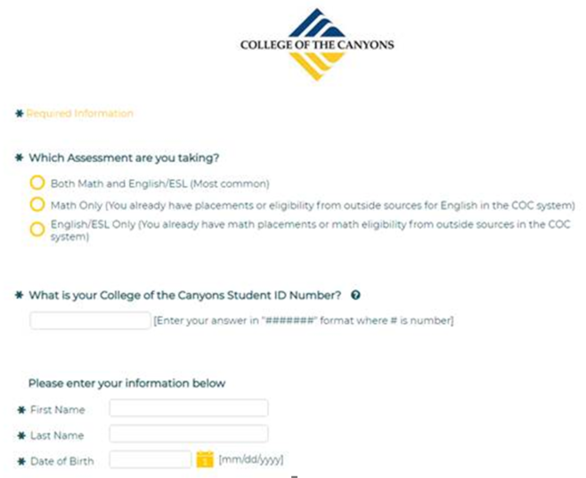
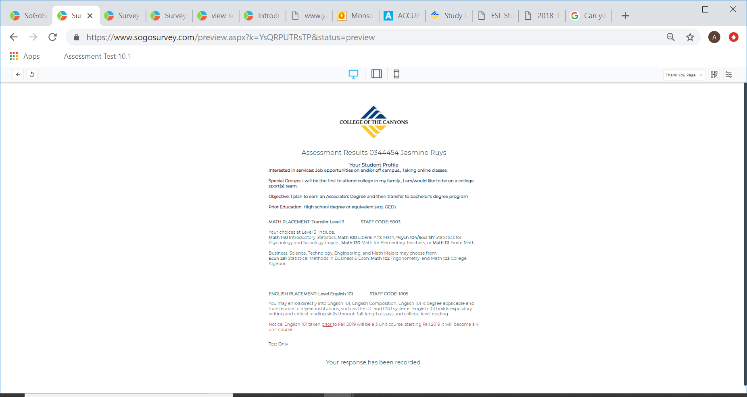
What does the new Assessment look like?
STUDENT RESULT PAGE
START

Slide 7
English Placements
In the Spring and Summer terms students will place into one of two levels:
Level 1= Take Eng 91 now, OR, must wait until fall for English 101 4-unit version (English 101 with the built-in support)
Level 2 = English 101 any (3 or 4) unit version, students may enroll before fall.
Starting fall, regardless of where students are in the English non-transfer level sequence, they will gain eligibility for English 101 4 units.
We will also update the Assessment system before fall to start placing all students into English 101 -4 units going forward.

Slide 9
Math Placements
Student will place into 5 levels of Math. All placements are at the transfer-level, but some courses will not be available until Fall.
Critical for math: Students can take course from at or below their level.
For example, if a student is placed at level 2, and they are a STEM student, you would likely be best severed by taking a course from level 1 like trig 102-92 (with support). See chart next.

Slide 11
Math Support Courses
The new one unit support courses are all 90’s - level courses. TIP: Use the last number to help remember which one goes with which.
140 → 90
102 → 92
103 → 93
These mandatory support classes only come into play if the student places in Level 1 or (Level 2 – and a STEM major). Don’t make a student take a support class if their placement doesn’t require it, those spaces are intended for those who are truly in need of support.
Students must enroll in both parts (core and support class) at the time of registration (similar to registering for PAL). They are treated as separate courses, unlike the English support which is built into the new 101.

Slide 12
Math 100
In addition to adding support courses for fall, math intends to launch a new transfer-level course for liberal arts students called Math 100. Details will be available soon, but it will be a 3 units course that will be open to any new placement group (part of level 1).

Slide 13
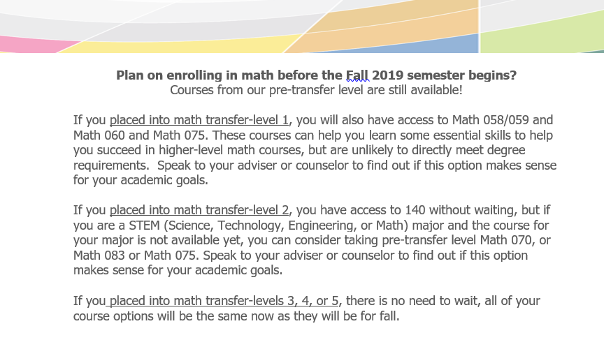
Placement Addendum For Spring & Summer
The math department has not stopped and will not stop offering developmental courses, and some students may find them useful preparation for transfer-level, especially if their transfer-level course is not yet available. Since developmental courses will not be part of the placement chart anymore, we will staple-on an addendum to placements (for those in levels 1 and 2) to notify students about these options.

Slide 14
ESL
ESL placements are part of the new placement system too. However, we don’t need to spend much time training on this because their chart, course options, and placement levels are unchanged. The ESL department has developed their own unique question sets to determine the right placement levels.
Continue to use yellow ESL placement charts. Remember, if the student is asking about ESL it is important to ask if they are credit or non-credit students, as non-credit is a very different assessment process.

Slide 15
That’s all we have.
Questions? Contact Jasmine Ruys by email or phone
  Jasmine.ruys@canyons.edu
  X3466
  It is easier to get to me by email. I am hardly ever at my desk.

