Slide 1
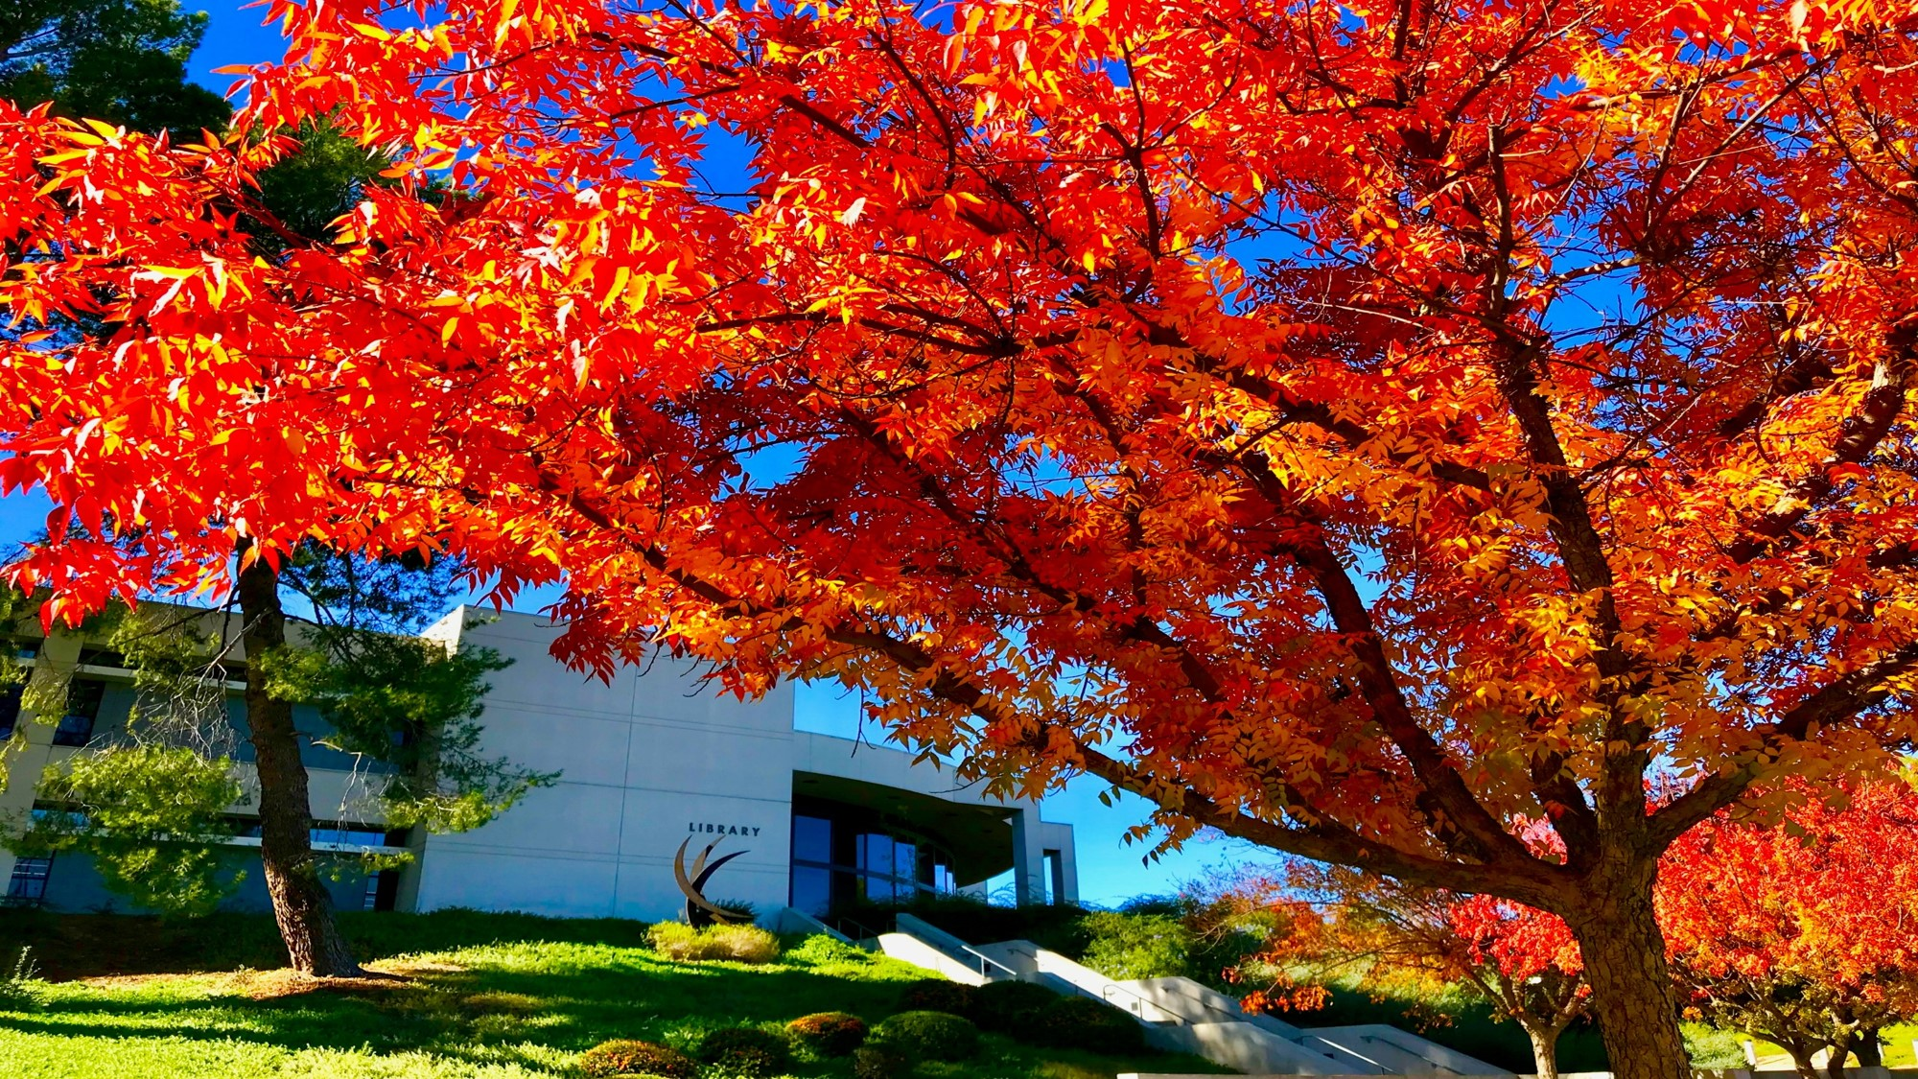

Foundation Board of Directors
November 28, 2023

Slide 2

Awards and Recognition

Slide 3


'cul-de-sac' Hauls in Awards
College of the Canyons' student-produced literary magazine, "cul-de-sac," was honored with a second-place award by the Community College Humanities Association Literary Magazine Competition. Five students also received individual awards:
First Place, Fiction: Ben Stanton, "Next Stop".
First Place, Art: Amy Lin Taing, "Busy Kitty Cafe"
First Place, Photo: Neal Lightfeldt, "Sunset at COC #1"
First Place, Music: Johnny Diaz, "ChillTopZone"
Second Place, Fiction: Javier Serrano, "Orphan of the Universe"

Slide 4

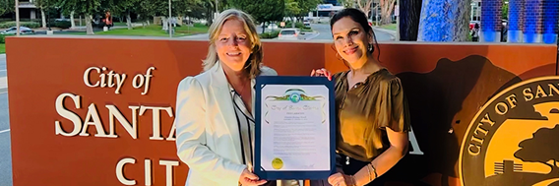
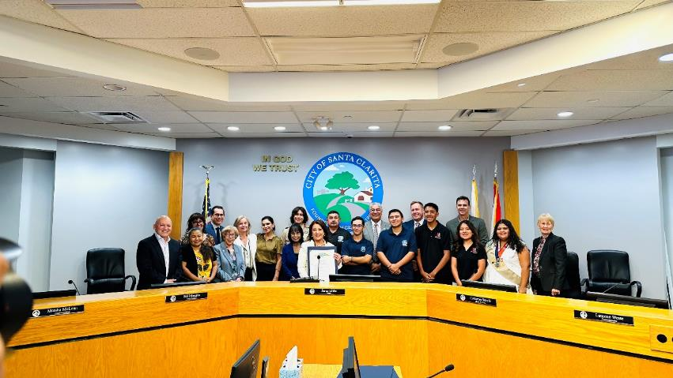
Hispanic Heritage Recognition
Dr. Claudia Acosta, chair of the Department of Modern Languages & Cultures, was among a contingent that accepted a proclamation from the Santa Clarita City Council on Tuesday, Sept. 26th, officially recognizing Hispanic Heritage Month.
Hispanic Heritage Month is celebrated Sept. 15th to Oct. 15th to recognize the contributions of Hispanics to the history, culture, and achievements of the U.S.

Slide 5

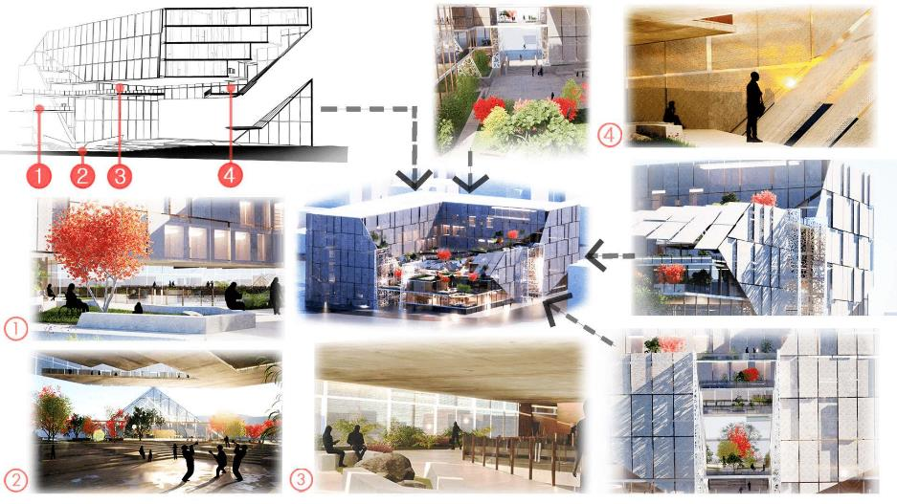
National Competition
A team of College of the Canyons architecture students and their faculty advisors, Jason Oliver and Carlos Gomez, presented their restorative community design proposal, "Quarter Note," at the annual conference for the National Organization of Minority Architects Oct. 11-15th.
Themed "Building Bridges: Towards Just and Joyful Futures," the prestigious conference in Portland, Ore., was attended by more than 1,200 professional designers, as well as teams from colleges and universities across the nation.

Slide 6
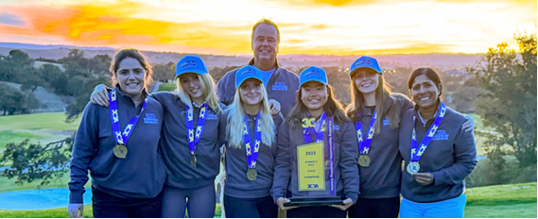
Another State Championship!
The women’s golf team won the 2023 California Community College Athletic Association (3C2A) State Championship with a stunning two-day performance at Hunter Ranch Golf Course in Paso Robles on Nov. 13th and 14th.
The title is the program’s fifth overall (2001, 2007, 2018, 2019, 2023).
Canyons ended Monday’s opening round in fourth place but stormed back the next day, playing some of its best golf of the season.

Slide 7
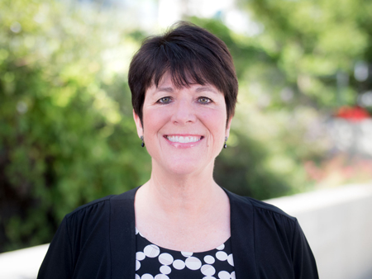
Faculty Member Named Certified Paralegal Champion
Paralegal instructor Lori Young has been named the recipient of the 2023 Certified Paralegal Champion Award by the National Association of Legal Assistants (NALA).
The nationwide award recognizes outstanding achievement by an individual or by a NALA-affiliated association in promoting and advancing the association’s Certified Paralegal (CP) program within the legal profession.
In 2022, the paralegal department team launched the online CP exam study courses that prepare students for the knowledge and skills sections of the CP exam.
The two courses introduce students to sample exam questions based on a hypothetical case, and students analyze relevant legal material, as well as demonstrate strong writing skills.

Slide 8

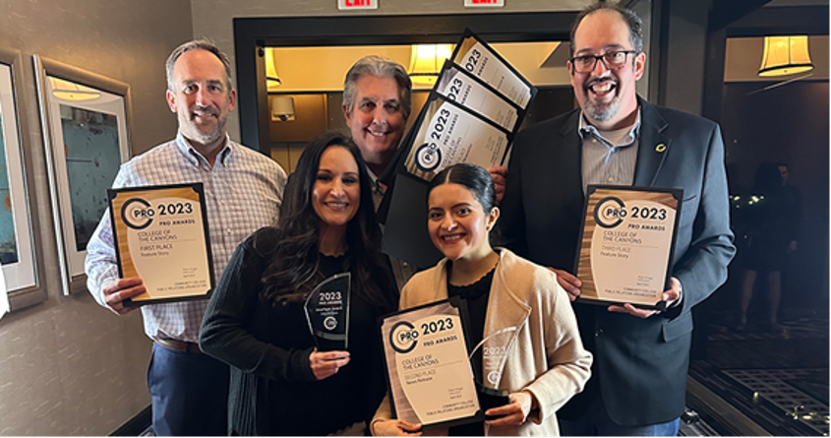
PIO Recognized by NCMPR
The National Council for Marketing & Public Relations (NCMPR) recently announced the winners of the Medallion Awards, and COC’s Public Information Office was recognized in many categories.
The NCMPR Medallion Awards recognize outstanding achievement in design and communication at community and technical colleges in each of NCMPR's seven districts.
We received 10 awards in this year’s District 6 competition. The winners are:
  Gold: E-Newsletter
  Gold: E-Cards
  Gold: Postcard
  Silver: Newsletter
  Silver: Notes/Cards/Invitations
  Bronze: Newsletter
  Bronze: Brochure
  Bronze: Print Advertisement
  Bronze: Excellence in Writing, Short Form
  Bronze: Excellence in Writing, Long Form

Slide 9
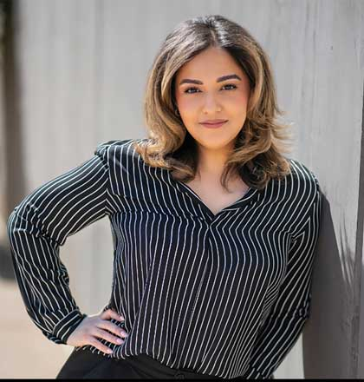

40 Under Forty Honorees
We want to congratulate this year’s 40 Under 40 honorees from College of the Canyons – Vida Manzo from Institutional Development and our very own Executive Assistant to the Board of Trustees, Marilu Ramirez from the Chancellor’s Office!
Each will be recognized at a special awards ceremony on Thursday, Nov. 30th at Blomgren Ranch.

Slide 10
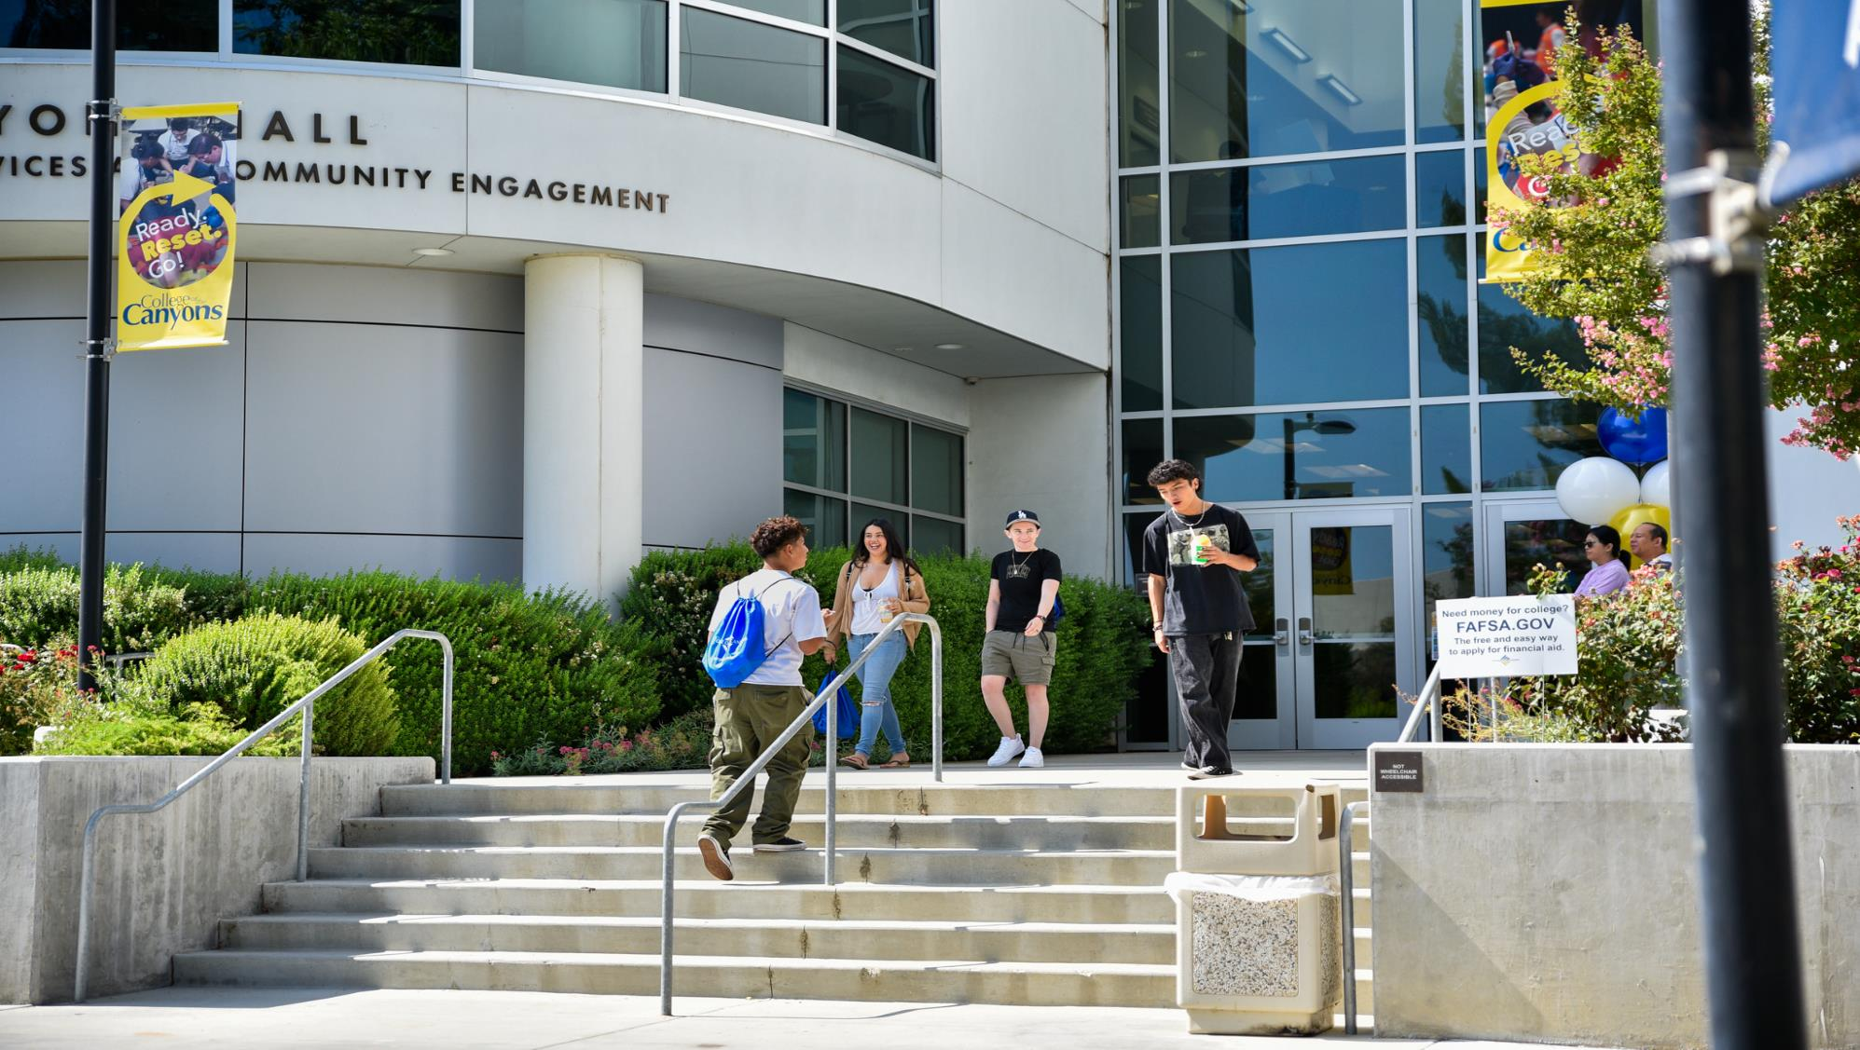
Grants and Research
Update

Slide 11



Grants Development, supports many college program needs and strategic goals in ongoing collaboration. Recent grant highlights (the highest ever) include:
$16,689,466 in grant awards so far secured for the current 23/24 fiscal year—a record-breaking total.
CCCCO: Awarded $4 million for Regional Center of Excellence
Nearly $7 million in pending grant awards for future years
Director Amber Cole and Grant Writer Eric Smith recently served on the CASE Federal Funder’s Taskforce in Washington, D.C., gleaning additional insights on upcoming grant opportunities.
Institutional Research (IRPIE) continues to update and share a variety of helpful resources and tools to the campus community, which recently included a series of engaging “Fall-themed” data workshops.

Slide 12


ETI Receives Training Award
The College of the Canyons Employee Training Institute (ETI) has received $749,785 from the California Employment Training Panel (ETP) to provide worker training to client companies in the Santa Clarita Valley who wish to retain an up-skilled workforce through customized training programs.
The two-year reimbursement contract will allow the college to offset the training costs charged to employers who meet the eligibility requirements set by ETP.
This is the 17th contract of its kind awarded to the college!
This contract will bring the total ETP funding to more than $9 million brought to Santa Clarita Valley employers to offset training costs.

Slide 13
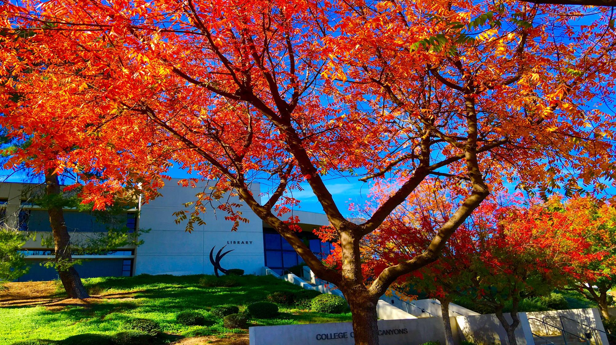
What’s Going On
Around our Campuses

Slide 14

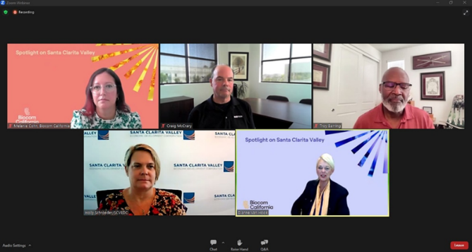
Spotlight on the Santa Clarita Valley
On Wednesday, September 13th I participated in a panel discussion for the Spotlight on the Santa Clarita Valley webinar series.
I spoke on the role of academic institutions in Santa Clarita, and more specifically, the role College of the Canyons has in supporting talent development and the Advanced Techology Center (ATC).
Also on the panel were:
  Troy Barring, CEO & Founder, TAB Diagnostics
  Holly Schroder, former President & CEO, SCV EDC
  Craig McCary, President & COO, NeoTech
Supervisor Kathryn Barger and Mayor Jason Gibbs provided keynote remarks.
Over 70 participants from the business community participated in the webinar.

Slide 15
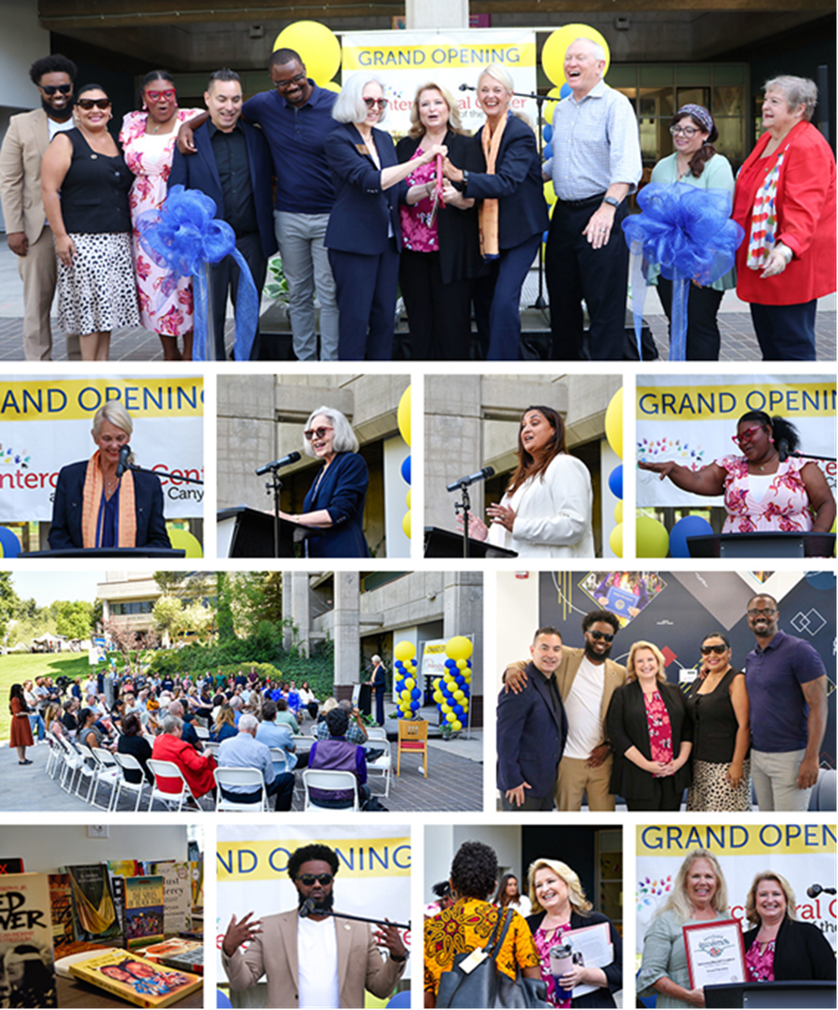
Intercultural Center Opens
The ceremonial ribbon was cut for the Intercultural Center on Wednesday, Sept. 13th, officially opening a new facility designed as a place to meet, build community, and serve as a bridge to student resources.
Guest speaker for the event was Dr. Abdimalik Buul, visiting executive of education excellence, California Community Colleges Chancellor's Office.
The Intercultural Center is located on the ground level of Bonelli Hall.

Slide 16
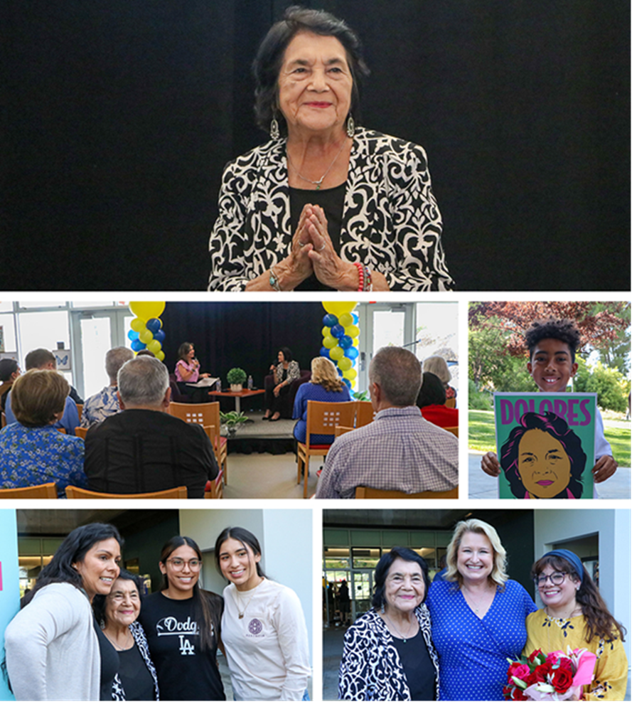
Huerta Reflects on Career
Labor leader Dolores Huerta spoke to a packed crowd of over 250 in the Intercultural Center, with overflow attendance in the ICC atrium on Tuesday, Sept. 19th, to mark Hispanic Heritage Month and Labor Day.
Huerta discussed the evolution of public policy, social justice, and advocacy during her labor and community organizing career, as well as how young people can best serve their communities.
Canyons News present to cover the event.

Slide 17
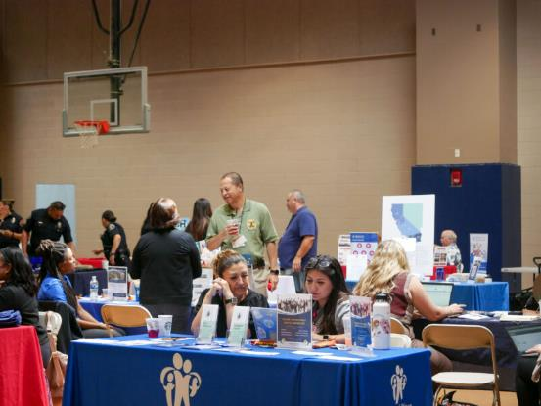
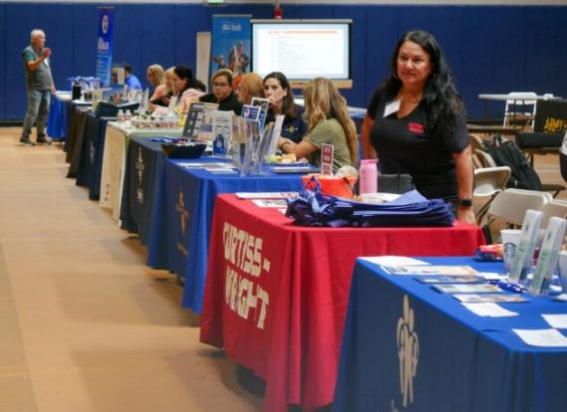
Veterans Collaborative Hosts Inaugural Job Fair
Santa Clarita Veteran Services Collaborative hosted its inaugural free veterans’ job fair at College of the Canyons on Friday, Sept. 29th.
Attendees had the opportunity to connect with local companies looking to hire veterans, additional resources available to them, and government representatives.
The Santa Clarita Veteran Services Collaborative partnered with the COC Veterans Resource Center and Curtiss Wright Corp. to make the fair possible.
There were a total of 45 tables representing different companies and organizations filling up the COC East Gymnasium for attendees to network with.

Slide 18
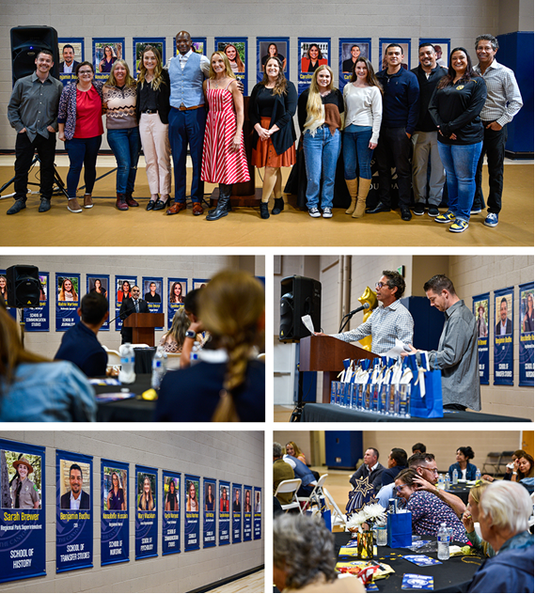
A Banner Day for Alumni
The College of the Canyons Foundation honored outstanding alumni from a variety of industries and disciplines during an awards celebration on Saturday, Sept. 30th.
The honorees received souvenir banners, smaller versions of those displayed on campus.
The outstanding alumni are:
Alahna Martinez Annabelle Hussain
Benjamin Budhu Candise Vogel
Carlos Orozco Caroline Menjivar
Jammal Yarbrough Kari McCoy
Kayla Marquez Mary MacAdam
Sarah Brewer

Slide 19
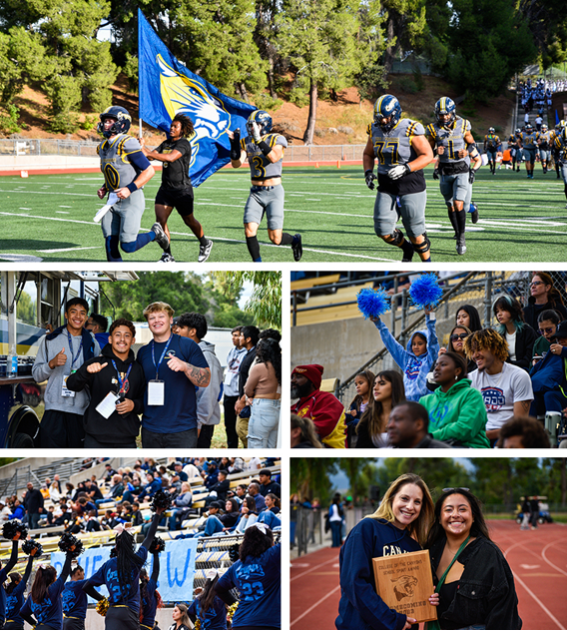
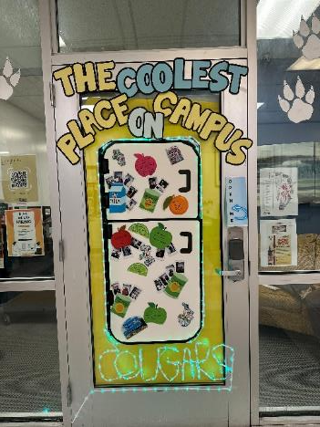
Homecoming Victory
Cougar Spirit was out in force for Homecoming on Saturday, Sept. 30th.
Hundreds of students, employees and fans attended the pre-game festivities and game, which saw the Cougars win their third straight by rolling over Antelope Valley College 29-7.
Activities, games, food, and fun were all there in abundance.
The Basic Needs Center (BaNC) won the School Spirit Award for the second year in a row.
Congratulations to them and, of course, the Mighty Cougars.

Slide 20

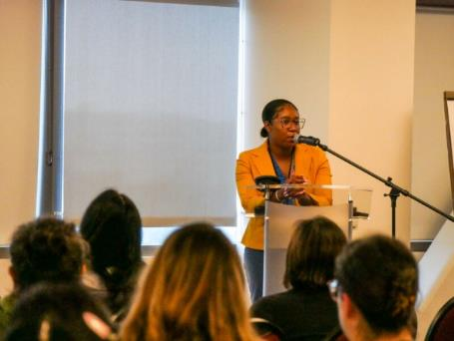
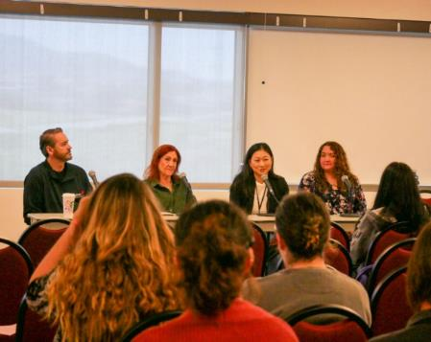
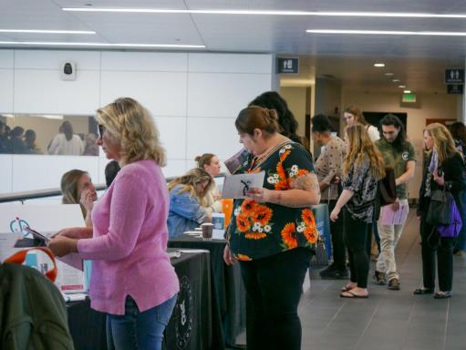
Annual Human Trafficking Summit
College of the Canyons once again hosted the Annual Human Trafficking Prevention Summit on Friday, Sept. 30th in the University Center.
There was standing room only in the room and 72 more participants online hearing from Human Trafficking survivors from the Power Project and nationally and internationally known experts in the field.
The event was sponsored by the Sunrise Santa Clarita Valley Rotary Club and the COC Civic Engagement Department.
Thanks to Larry Schallert for organizing this very important awareness event.

Slide 21
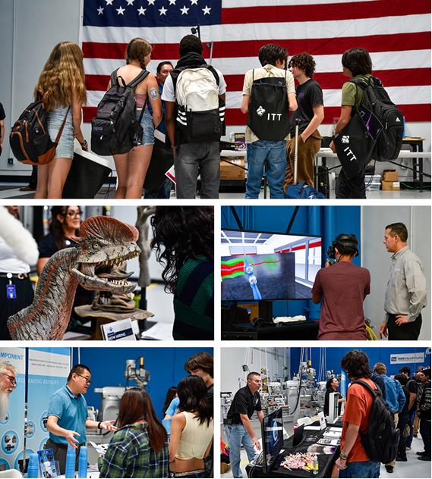
Manufacturing Day
College of the Canyons hosted Manufacturing Day at the interim Advanced Technology Center on Thursday, Oct. 5th.
Over 200 Hart District students attended the event, with 18 businesses showcasing a variety of manufacturing fields.
Business partners explained some of the latest technological trends and provided insight about potential career paths.
The Hart District helped secure buses to get the students from their schools to the ATC.

Slide 22
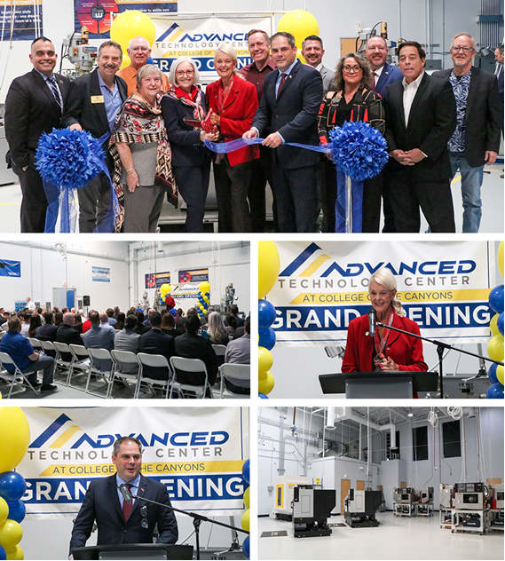
Advanced Technology Center
College of the Canyons officially opened its interim Advanced Technology Center (ATC) with a ribbon-cutting ceremony on Friday, Oct. 6th.
The 13,500-square-foot facility houses a state-of-the-art manufacturing and CNC (Computer Numerical Control) production lab designed to prepare students for careers in advanced manufacturing, welding, and construction technologies.
The interim center will be replaced by a permanent 30,000-square-foot facility on Valley Center Drive, near Soledad Canyon Road. Construction is expected to begin on that facility next year.

Slide 23

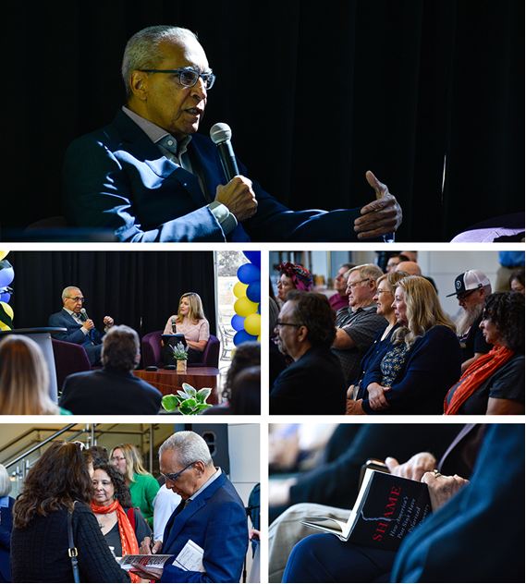
Conversation with Shelby Steele
College of the Canyons hosted a talk with race relations scholar and author Dr. Shelby Steele on Thursday, Oct. 12th.
Approximately 100 people attended the event, presented by the Intercultural Center in the lobby of the University Center.
Political science instructor Lena Smyth served as the interviewer for the event, which focused on the impact of contemporary social programs on race relations in American society. Steele specializes in the study of race relations, multiculturalism, and affirmative action.

Slide 24
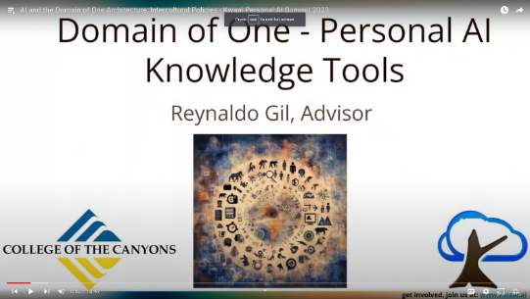
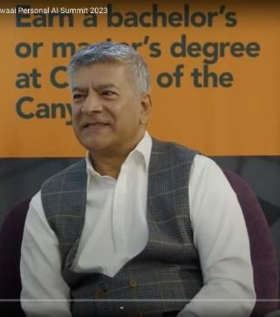
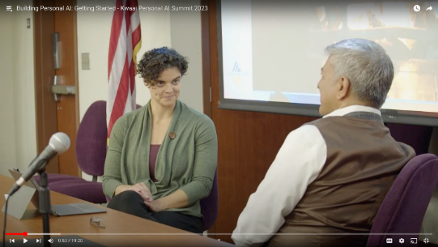
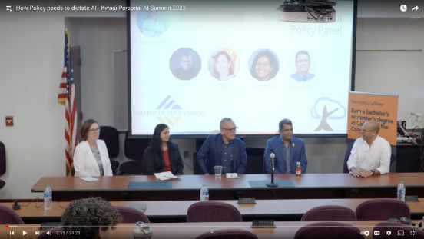
AI Summit
College of the Canyons in collaboration with Kwaai Lab (pronounced ‘kwy’) presented the inaugural Artificial Intelligence Summit on Saturday, Oct. 14th at the University Center.
The theme was “AI will shape the future. How will we shape AI?” in light of the ever-changing college and career environments we face today.
What began as a visit from Ruth Rassool in Dr. Torres’ open office hours developed into this inaugural summit of industry leaders, educators, and thinkers.
60 attendees participated in-person, 255 via LinkedIn Live and 30 via Zoom.

Slide 25
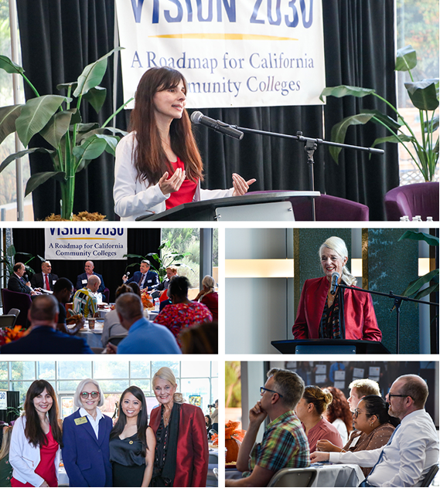
Our System’s Vision for the Future
On Oct. 18th, College of the Canyons welcomed California Community Colleges Chancellor Dr. Sonya Christian, who shared with a group of 77 people the details of Vision 2030, a roadmap for bold and thoughtful action for the state's community colleges.
The convening in the University Center lobby highlighted how College of the Canyons leverages the power of partnerships to fuel regional economies and support social mobility.
A special thank you to those who served as panelists for our engaging discussion, “Advancing Innovation Together: Keys to Growing Successful Partnerships:”
  Jey Wagner, President & CEO of SCV Economic Development Corp.
  Mike Kuhlman, Superintendent, Wm. S. Hart Union High School District
  Jason Crawford, Director of Economic Development, City of SCV
  Omar Torres, VP of Instruction

Slide 26
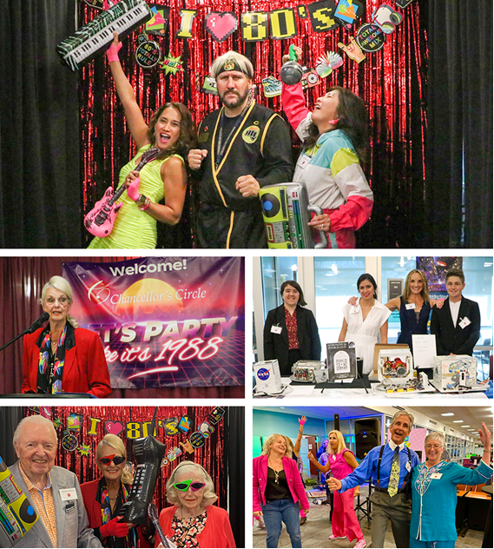
Chancellor’s Circle Dinner
The Chancellor's Circle Dinner celebrated student success and urged investment in the future against the backdrop of the coolest decade in history.
Let's Party Like it's 1988 was the retro theme for the Friday, Oct. 20th, event at the Valencia campus TLC.
Nearly 200 Chancellor’s Circle members and guests, many sporting eye-popping neon and vintage fashions, were treated to a nostalgic celebration.
A live band rocked the backdrop with eighties music, while students showcased the results of projects funded by Chancellor’s Circle innovation grants.

Slide 27
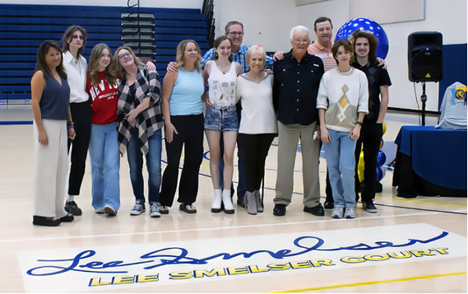
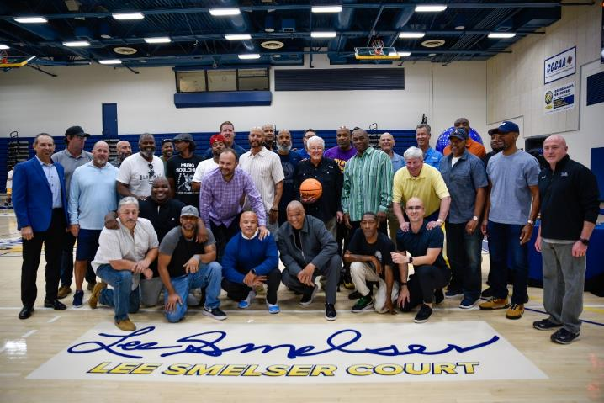
Lee Smelser Court Dedication
College of the Canyons unveiled the newly named Lee Smelser Court during a dedication ceremony Saturday, Oct. 21st, that honored the college's first basketball coach and his 31 years of dedicated service.
The ceremony in West PE's Cougar Cage was followed by the annual Blue & Gold basketball team scrimmage and luncheon.
The college hired Smelser in 1969 to help develop the physical education department and launch men's basketball program.
During his career, he amassed 455 career wins and four Western State Conference championships (1985, 1991, 1992, 1994) while dedicating his time, energy, and mentorship to thousands of student-athletes.

Slide 28
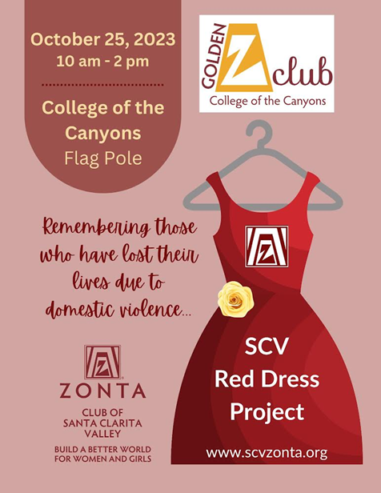
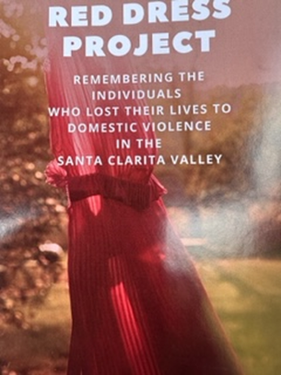
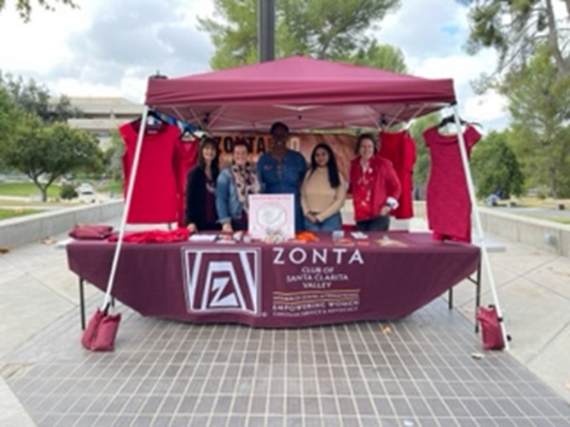

Red Dress Project Project
COC’s Golden Z Club in partnership with the Zonta Club of Santa Clarita Valley hosted a flagpole memorial event on October 25th for victims who lost their lives due to domestic violence.
Over 100 students visited the table to learn more about the mission of Zonta, specifically how the organization works to improve the lives of women and girls. Zonta also addresses many of the UN's 17 Sustainable Development Goals, including gender equity.
Ten students expressed interest in joining COC's Golden Z Chapter, which is led by faculty advisors Patty Robinson, Faculty Director, Civic and Community Engagement and Jessical Edmond, ESL Instructor and co-lead of the Civic and Community Engagement Steering Committee.

Slide 29
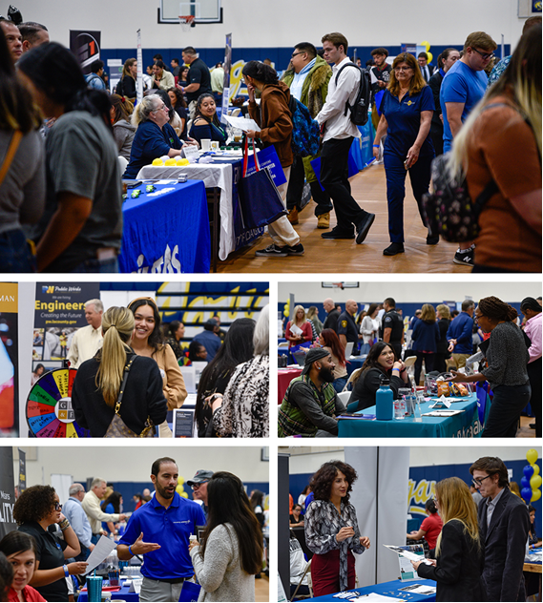

Job Fair Attracts Large Crowd
A record 584 job seekers descended on the West PE gymnasium Friday, Oct. 27th, for the Santa Clarita Job Fair.
Of those job seekers:
  183 were Current COC Students .
  401 were Community Members, 161 of which were COC Alumni and 20 were Veterans.
110 companies were represented at the Job Fair as well our partners – City of Santa Clarita, SCV Chamber of Commerce, America's Job Center of California, and the SCV Economic Development Corp.

Slide 30
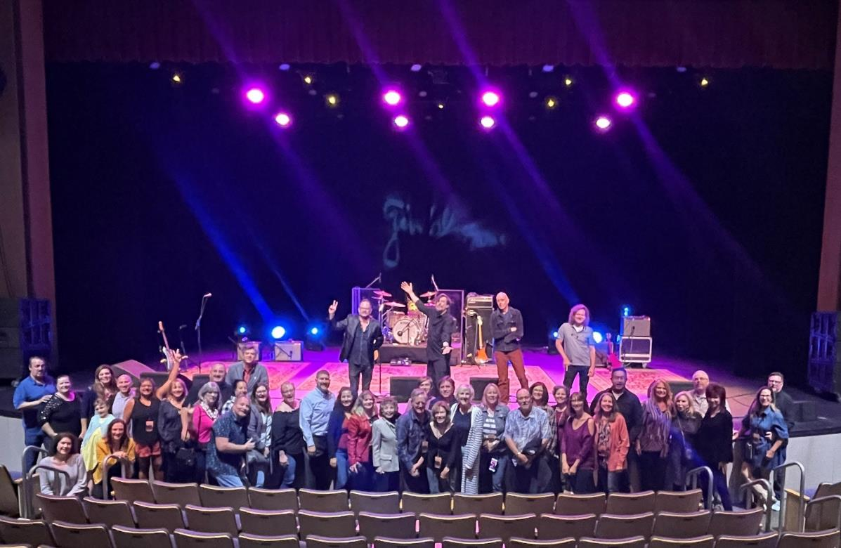
Patrons of the Arts VIP Experience
On October 27th our Patrons of the Arts group was invited to attend a special PAC VIP Pre-Show Experience with the Gin Blossoms band before the doors opened to the 800+ attendee concert.
Yay, Doreen Shine!

Slide 31
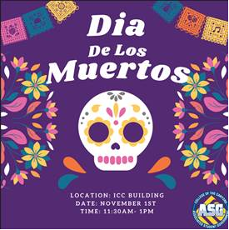
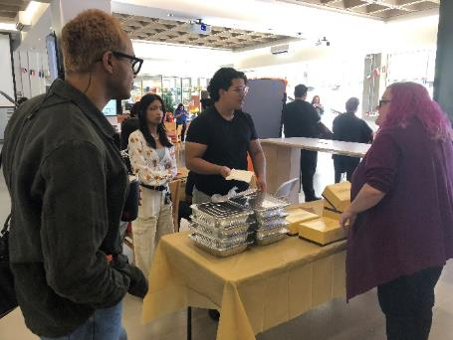
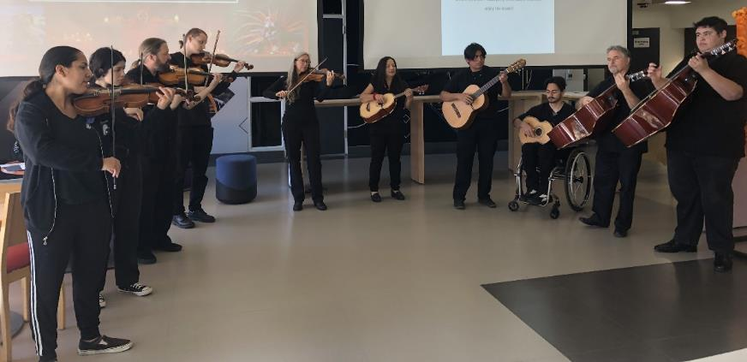
“Día De Los Muertos” A Cultural Event
On Nov. 1st the Intercultural Center, in collaboration with ASG, hosted a traditional Dia De Los Muertos/ Day of the Dead event for our community to learn about this important celebratory event.
100 students, faculty and classified staff attended the event.
We had our very own student ensemble Mariachi band perform live music , led by professor Christina Burbano-Jeffrey and accompanied by Professor Bernardo Feldman.
Students placed marigolds on the Ofrenda (offerings) to pay homage to loved ones who have passed but are never forgotten. They also indulged in some tasty treats from Porto's such as Empanadas and Tamales.

Slide 32
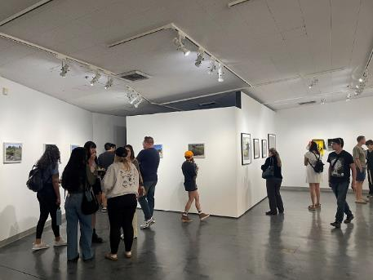
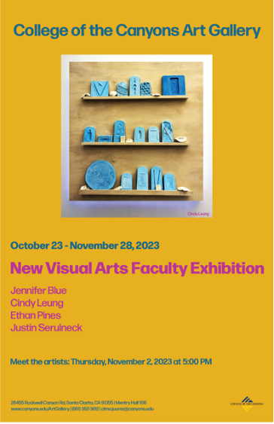
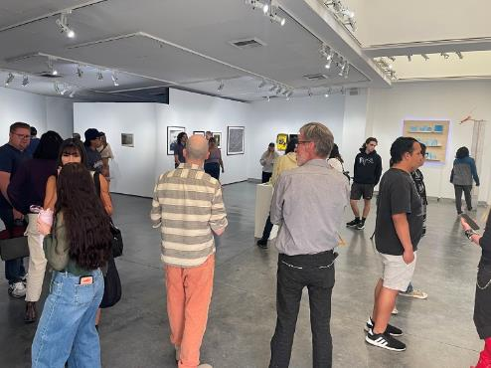
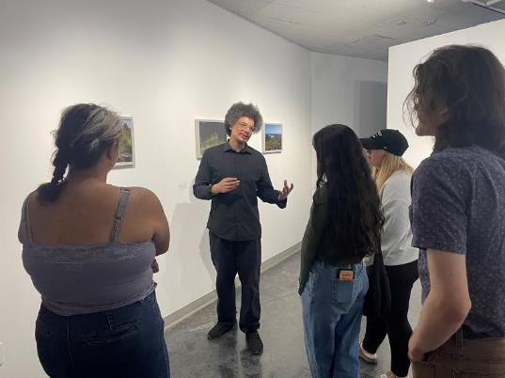
Art Gallery Event
On Nov. 2nd the Art Gallery hosted an opening reception for the New Visual Arts Faculty Exhibition, featuring works created by new faculty members of the Visual and Performing Arts Division.
108 guests, consisting of COC students, staff, faculty and students from CalArts attended the reception.
The artists were present to personally explain their works, giving attendees unique insights into their creative processes and inspirations
The exhibition features vibrant and diverse work, from photographs and sculptures to video, created by our newest faculty members in the Visual and Performing Arts.

Slide 33
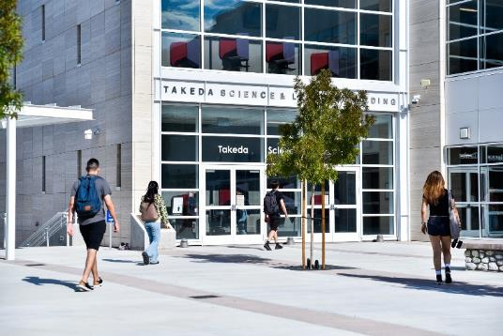
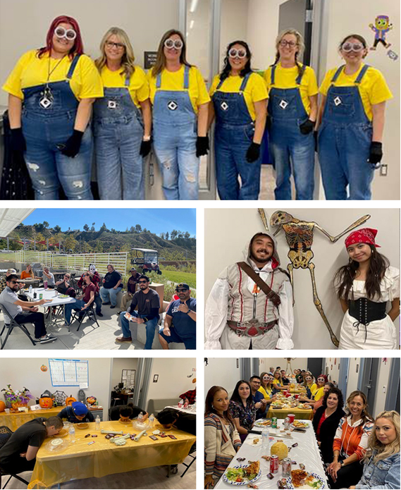
Canyon Country Campus Update
Canyon Country Campus activities continue this bustling Fall semester with a variety of exciting events and activities, such as:
Instruction: Approx. 180 CCC classes in 33 disciplines for Fall. Winter and Spring to feature 27 and 185 sections respectively.
Wrap-Around Services: Expanded with updated ASG, Campus Life and Student Engagement, BaNC, Intercultural Center, MESA services, and more.
Canyon Country Café: CCC food service café is now open, thanks to great coordination with Facilities, Business Services, and staff.
Meeting Highlights: The campus recently hosted two joint Board meetings, on Sept. 27th and Oct. 25th, as well as a Sulphur Springs partnership event on Oct. 13th, taking ample advantage of beautiful facilities at CCC.
CCC Halloween: CCC staff celebrated in style on Oct. 31st, paralleling Valencia.
Chancellor’s Open Office Hours: I offered open office hour opportunities at CCC on Wed, Nov. 1st.

Slide 34

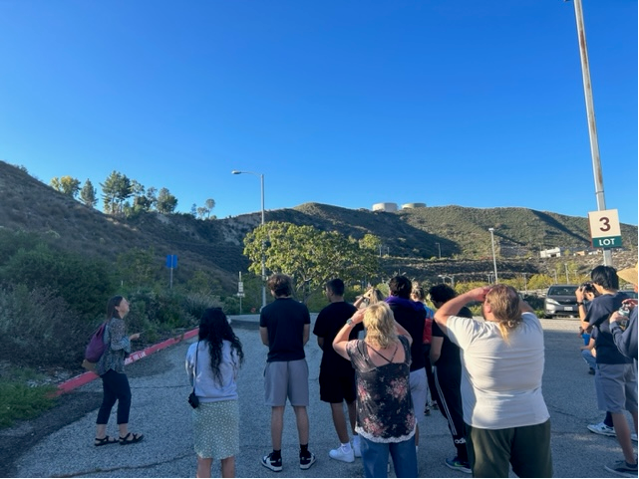
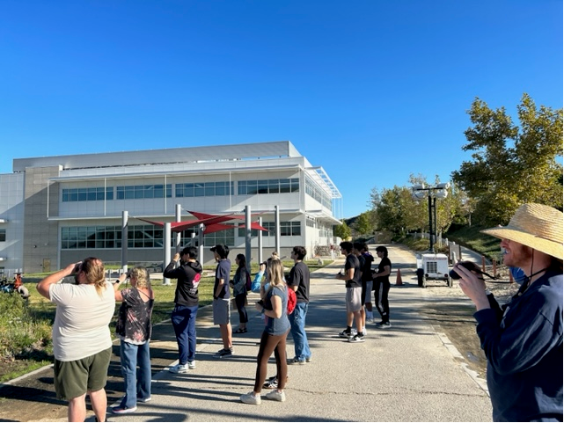
Garden Walk – A Perfect Day!
Close to 20 attendees, including students, staff and community members enjoyed perfect weather as they walked around the Canyon Country Campus, participating in a variety of activities at our Fall Garden Walk on Friday, Oct. 20th.
Jeannie Chari led the way, identifying plants and trees throughout campus.
Along with the usual plant and tree identification, the focus of the morning was to spot and identify as many different types of birds as possible.
Following the event, Professor Chari thanked the group for identifying 12 different species of birds during the walk, one which had never been spotted on campus before!

Slide 35

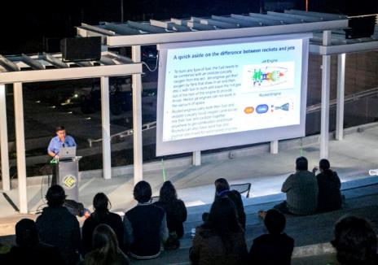
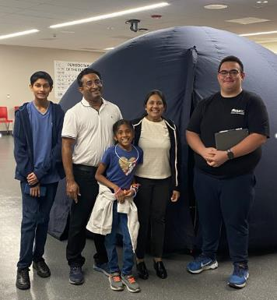

Star Party Attracts Crowd
The Canyon Country campus presented its Star Party and Science Showcase on Friday, Nov. 3rd.
Guest speaker Dr. Varoujan Gorjian, a research astronomer for NASA's Jet Propulsion Laboratory, provided a brief history of JPL.
With the use of pictures from the earliest planetary missions to the latest images from the James Webb Space Telescope, Gorjian demonstrated how JPL has been at the forefront of space exploration for more than 80 years.
Over 400 visitors enjoyed another spectacular Star Party, this time in an expanded format allowing our own students and faculty to showcase science-related areas of specialty (including atmospheric water harvesting, living art made from microbes, empowering STEM students, student NASA space missions, and “All Things Bats”).

Slide 36


Honoring Those Who Served
Veterans were honored during a Veterans Day Fundraiser in the Cougar Den on Saturday, Nov. 11th.
The Foundation event benefitted the Veterans Resource Center and College of the Canyons Athletics.
Participants enjoyed a hearty meal, games, activities, and admission to the football game against Ventura College – not to mention a 21-19 Cougar victory in the regular-season finale.

Slide 37

Have a wonderful holiday season!

