Slide 1
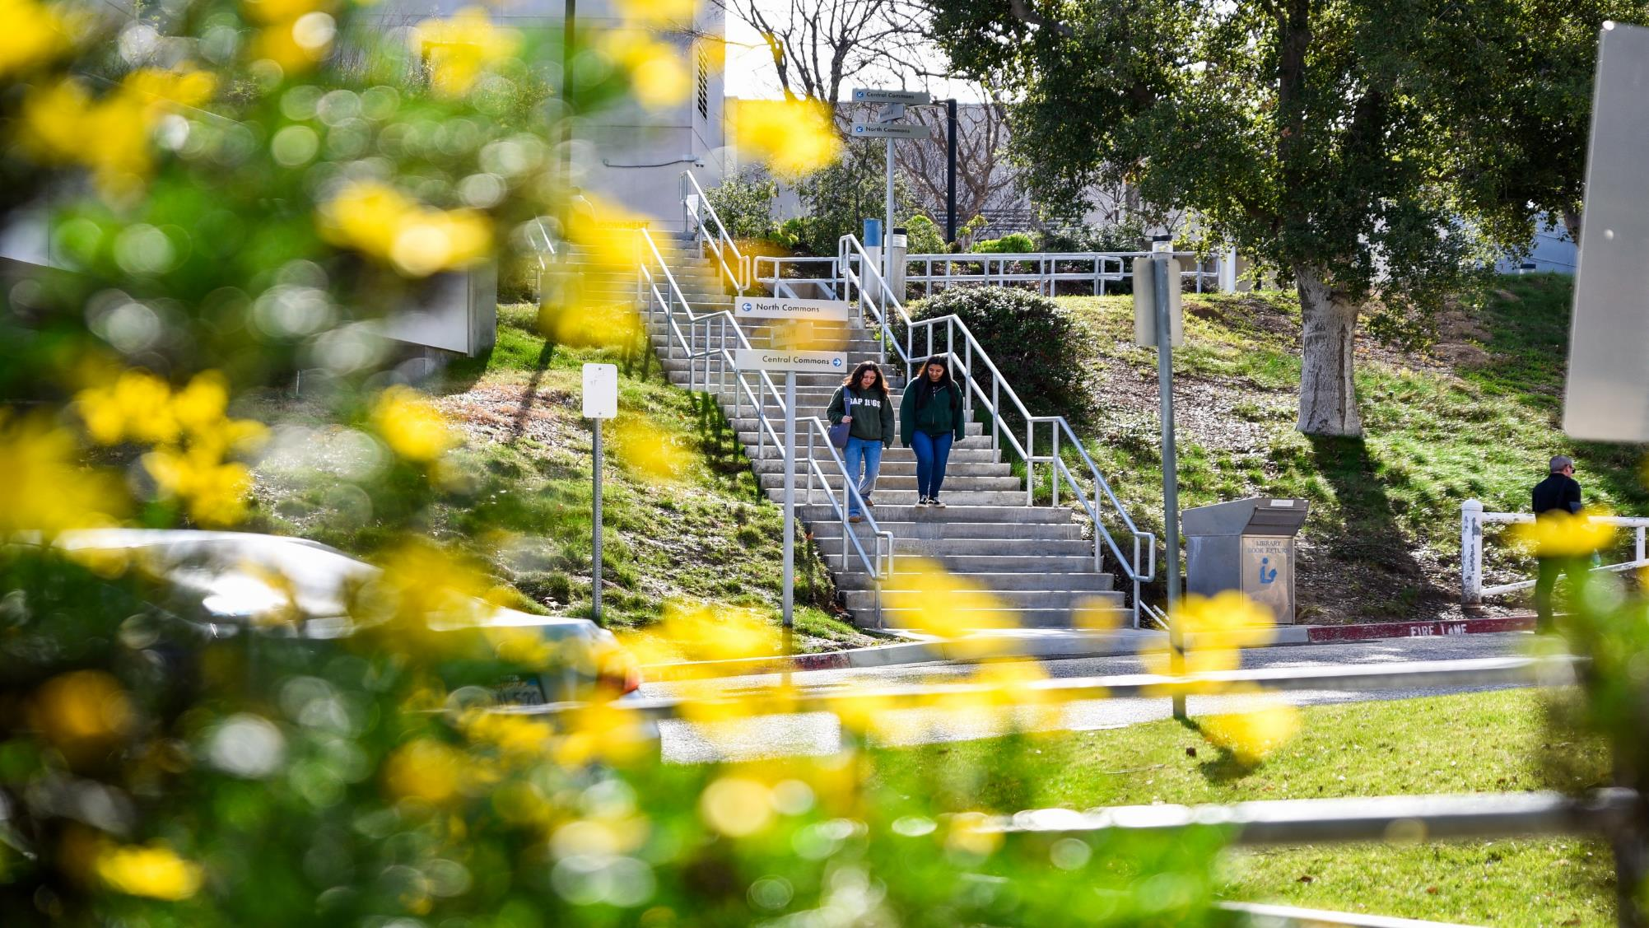

Foundation Board of Directors
March 26, 2024
Chancellor’s Report

Slide 2

Making an Impact

Slide 3


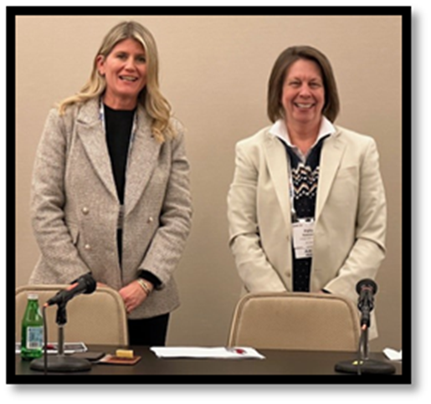
Faculty Member Receives Top Honor
Patty Robinson, along with colleague, Kimberly Rosenfeld from Cerritos College, gave a presentation on Hidden Stewards of Democracy: Untapping the Strength of California’s Community Colleges to Advance Civic Equity Among the Nation’s Most Marginalized Students at this year’s American Association of Colleges and Universities (AAC&C) Annual Meting, Jan. 17th-19th in Washington DC.
Patty and Kimberly focused on the critical need for the nation’s community colleges, especially California’s community colleges, to return to their “civic mission” and to advance the principles of democracy through practices of liberal education.
Practices accessible through transfer, career education, and co-curricular activities found throughout higher education.

Slide 4
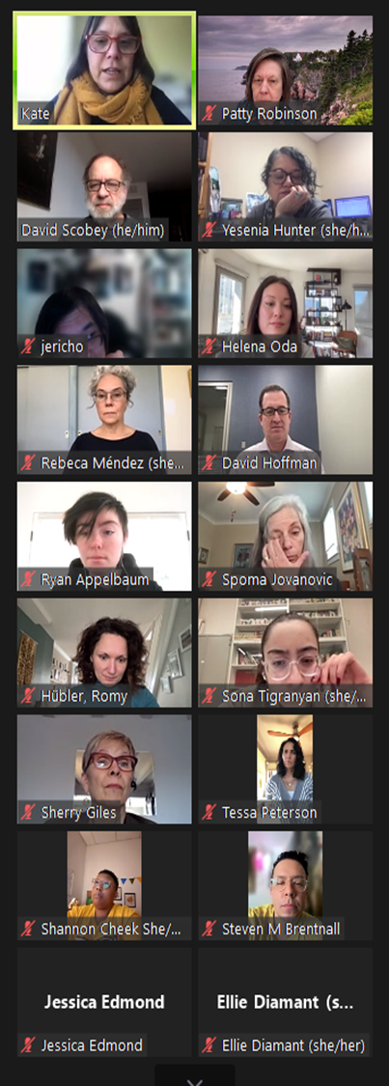


PLACE Collaboratory Book Launch
COC’s PLACE (Partnerships for Listening & Action by Communities and Educators) Action Team celebrated with authors David Scobey, Director, Bringing Theory to Practice and Kate Griffin, Associate Director, Bringing Theory to Practice, on January 29th, the official book launch of The PLACE Collaboratory: Higher Education, Community Engagement, and the Public Humanities.
As part of the 3-year Mellon Foundation Grant, Patty Robinson and Jessica Edmond, COC project-co leads, worked with an outstanding team of students and community partners, including Bridge to Home and the SCV Housing Committee, as co-creators addressing numerous community issues.
COC was the only community college to take part in this nationwide venture and discussed local projects with other campuses, including UNC-Greensboro, Rutgers-Newark, UM-Baltimore Campus, Pitzer College, USC, and UCLA.

Slide 5

Renard Thomas Honored
Renard Thomas, director of the Veterans Resource Center, was honored during the Single Mothers Outreach's Empowering HeArts Gala on Friday, Feb. 23rd.
Thomas and five fellow honorees had their stories shared in the form of a unique piece of art created by a local artist.
Upon meeting and engaging with their paired honoree, each artist designed an appropriate composition in their field of artistic expertise.
The annual fundraising event celebrated single parents who have changed lives and shaped their communities. The event was held at Sand Canyon Country Club.

Slide 6

COC Recognized for Student Engagement
College of the Canyons has earned ALL IN's Highly Established Action Plan recognition for developing a nonpartisan democratic engagement action plan rubric.
College of the Canyons is one of 93 campuses nationwide that earned the ALL IN Campus Democracy Challenge recognition for the 2024 election cycle.
ALL IN empowers colleges and universities to achieve excellence in nonpartisan student democratic engagement

Slide 7

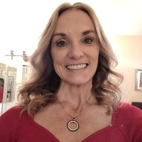
COC Faculty Nominated by NASA Team Students
For the second year in a row, COC faculty member, Teresa Ciardi was nominated for this year’s 2024 SCV Woman of the Year by her NASA Team students!
Current and past honorees of the Santa Clarita Valley Man & Woman of the Year Awards gathered together on Wednesday, March 6th for an evening of celebration at the“Paparazzi Party” event .
Teresa is one of 34 nominees - 17 women and 17 men.
This year’s Man & Woman of the Year will be announced at the Gala event on May 3rd at the Hyatt Regency Valencia.
Congratulations Teresa!

Slide 8
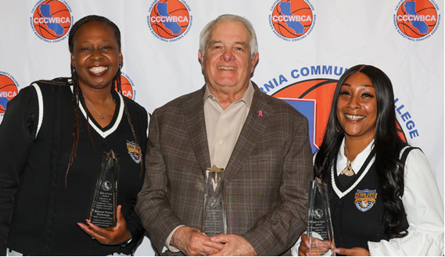
Herrick Inducted into Hall of Fame
Greg Herrick, the former longtime College of the Canyons women’s basketball coach who recorded 611 career wins while winning 16 conference titles, was inducted into the California Community College Women’s Basketball Coaches Association Hall of Fame during the organization’s annual Banquet of Champions at Mt. San Antonio College on Wednesday, March 13th.
Herrick retired in 2022 as one of the most successful head coaches in the association's history.
His teams also made 24 postseason appearances, including 21 straight appearances from 1994 to 2014.

Slide 9

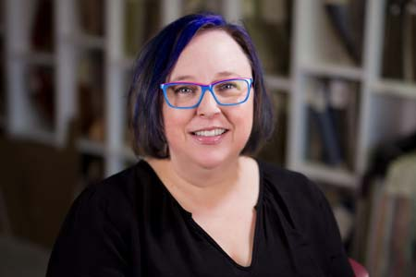
Instructor to Represent COC in Iceland
Holly Hitt-Zuniga, an architecture and interior design instructor at College of the Canyons, has been selected to represent the college and the National Science Foundation’s Center for Renewable Energy Advanced Technological Education (CREATE) in Iceland as part of a 10-person delegation of educators participating in an international education program focused on clean energy and electric transportation.
The CREATE delegation will research the convergence of clean energy and electric transportation technologies by meeting with faculty from the University of Reykjavik, industry representatives, and Icelandic energy leaders and policy makers.

Slide 10
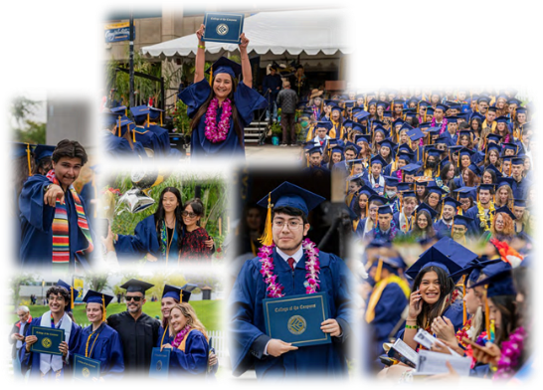
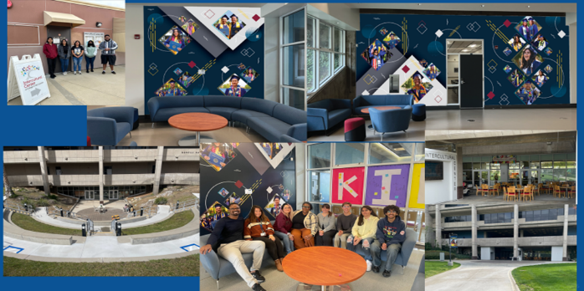
Presentation to the State Chancellor’s Office
The California Community College Chancellor’s Office invited College of the Canyons to provide a presentation on our Inclusion, Diversity, Equity, Accessibility and Anti-Racism (IDEAA) programs.
The presentation was via a webinar held at noon on March 26th. Presenters included: Myself, Dr. Jasmine Ruys, Dr. Diane Fiero, and Mr. David Andrus, Academic Senate President, Political Science Professor.
We highlighted:
Our long-standing commitment to our diverse students and employees;
The launching of our virtual, interim and permanent intercultural centers;
Highlighted our DEIA programming and integration through the campuses; and
The process and collaboration of the faculty on incorporating DEIA into their evaluations.

Slide 11
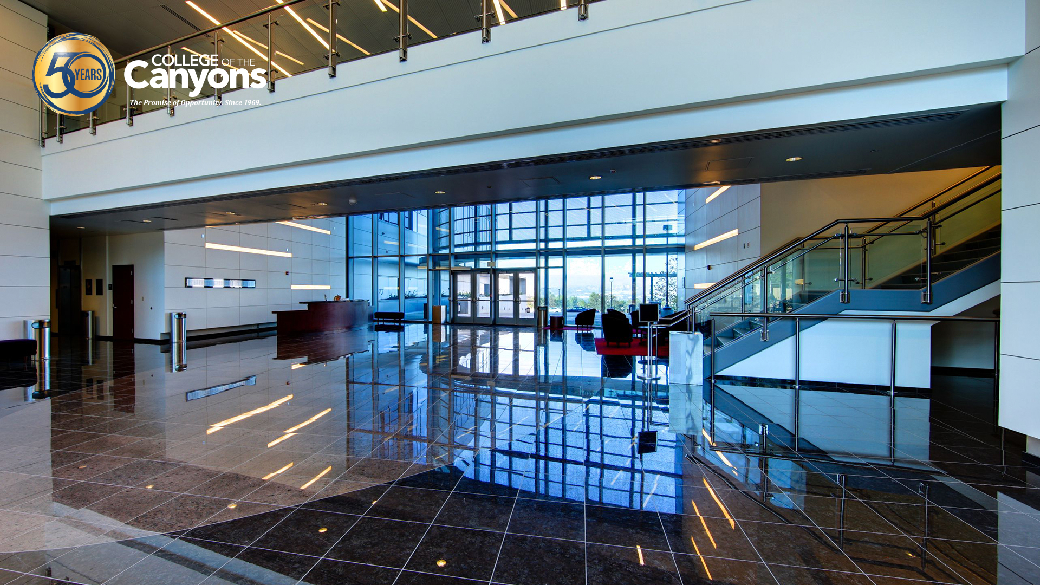
Grants
Update

Slide 12

Grant to Benefit Carpentry
College of the Canyons has been awarded a $50,000 grant from Stanley Black & Decker to expand its Construction Technology Program.
The Dewalt Growing the Trades grant will allow the college to acquire two self-contained carpentry trailers that will serve as mobile learning labs to train high school students in pre-apprenticeship carpentry programs.
The company previously awarded the college a $25,000 grant to support students in the construction technology pathway.

Slide 13
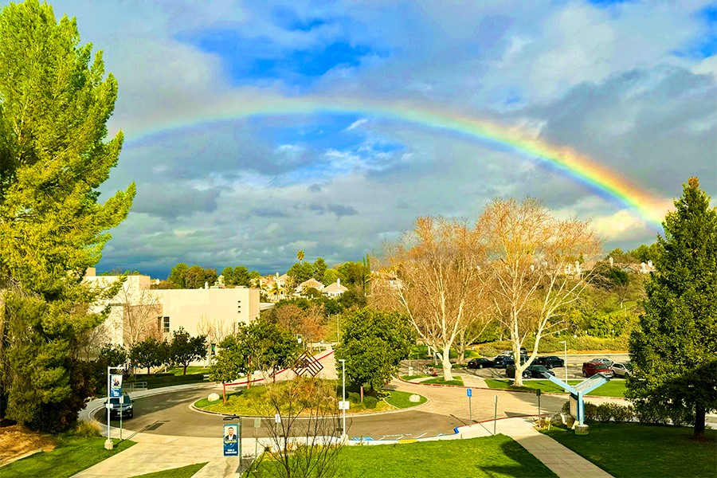
What’s New On And
Around our Campuses

Slide 14
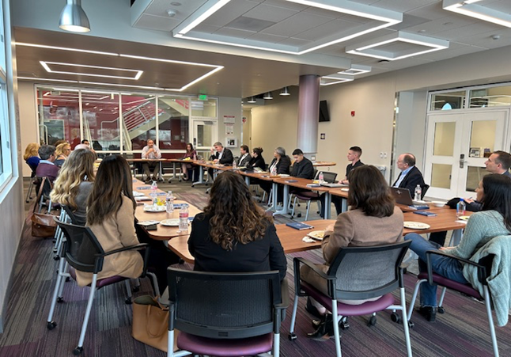
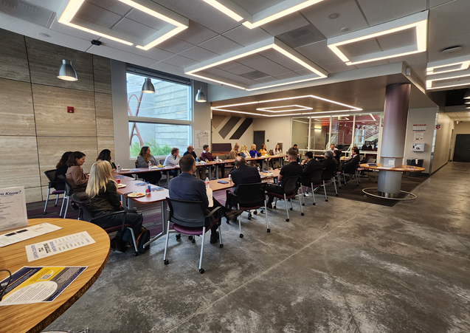
PIO Community Business Meeting
PIO hosted a luncheon for business community leaders on January 24th, in the lobby of the Canyon Country Campus Student Services & Learning Resources Center.
25 community members attended the luncheon to report out on events and initiatives that were coming up in 2024.
Attendees included a mix of public information officers, sports information directors, communications directors, and community liaisons from different businesses and organizations, in addition to field representatives from the offices of Congressman Mike Garcia, Senator Scott Wilk, Assemblywoman Pilar Schiavo, and Supervisor Kathryn Barger.
The luncheon ended with a short tour of the SS/LRC by Ryan Theule and Anthony Michaelides.

Slide 15
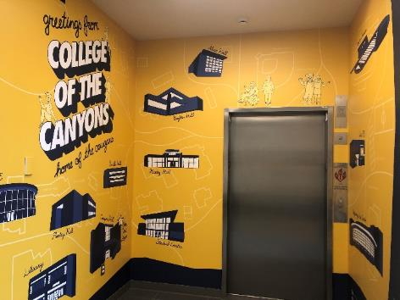
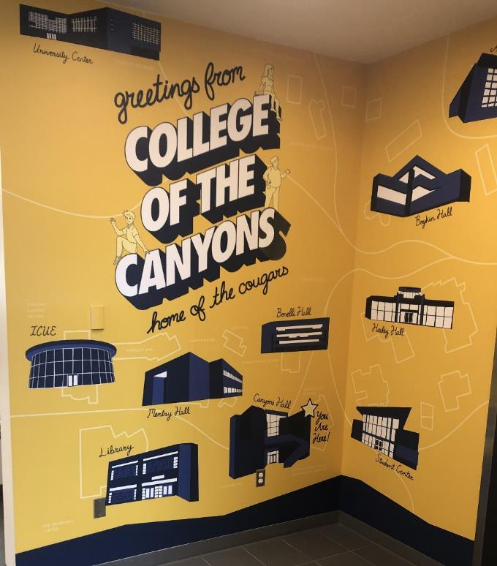
New Murals at Canyons Hall
With Canyons Hall being their first stop at COC, prospective students are now welcomed with an engaging display that not only familiarizes them with them the campus, but also illustrates the possibilities that await students at the college.
The project was a collaboration between PIO and Intersect, and the GMD Department’s student-run creative lab, during the fall 2023 semester. GMD Instructor Geir Foshaug served as the faculty advisor for Intersect.
PIO provided an overview of the project goals, and the students developed a number of initial concepts.
After review and discussion, the students selected a final concept, and moved forward with design.

Slide 16

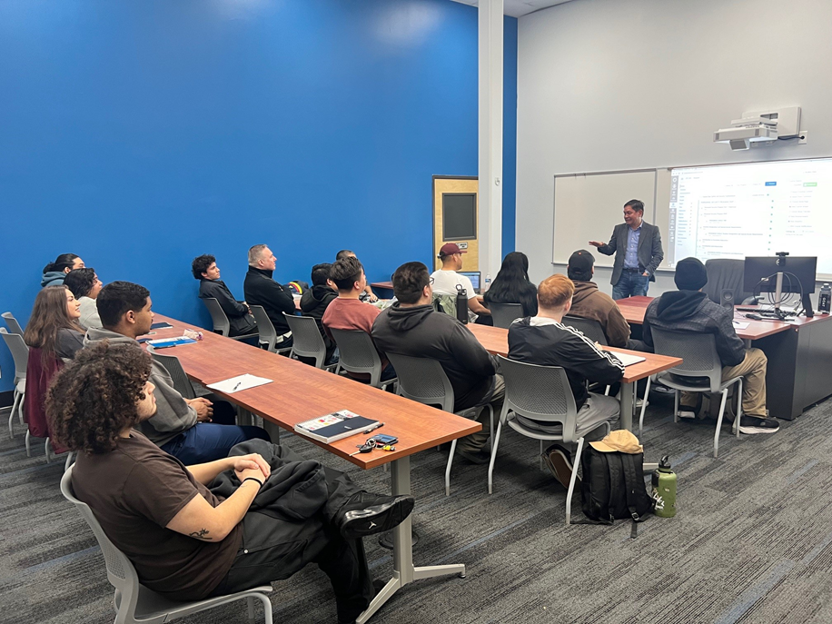
The 5th cohort of the Low Observable Technician Pathway launched on February 20th at the Advanced Technology Center (ATC).
This cohort has 17 participants who have all passed initial testing, pre-interviews, health tests and an initial background check.
One of our graduates from the 1st cohort was recently promoted to a Survivability Engineer!

Slide 17
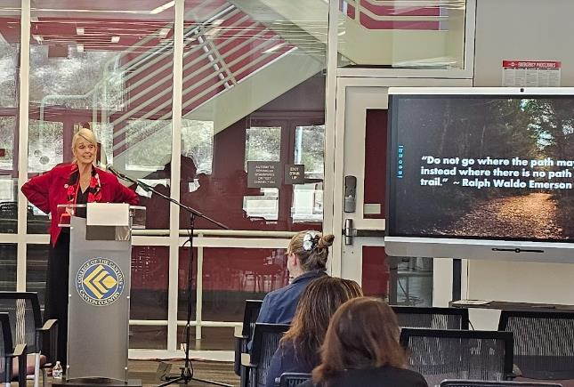
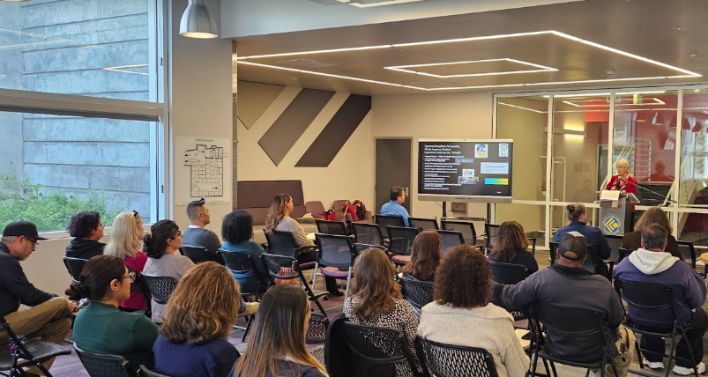
All College Meetings
I held two All-College Staff Meetings on Tuesday and Feb. 27th at the Canyon Country Campus and Wednesday, Feb. 28th at the Valencia Campus, that showcased the many ways that COC is growing, advancing, and thriving as a trailblazer shaping the future of education.
Topics included notable achievements, ways we have pioneered new programs, and transformative innovations, as well as the latest developments in workforce training, community partnerships, ongoing efforts to reduce the cost of education, finances, facilities, legislation, and exciting plans for student development.

Slide 18
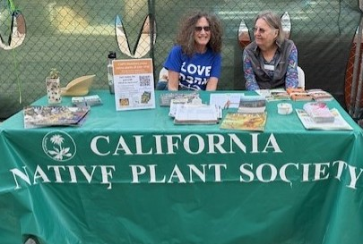

Eco-Film Festival
The SCV Eco Alliance hosted its first ever Eco-Film Festival on Saturday, March 9th.
Jeannie Chari and Cher Gilmore led the planning and organizing of the one-day event.
The day's events introduced attendees to some of the most pressing concerns facing our environment today. The six films were followed by engaging Q&A discussions.
Resources were made available from a variety of environmental groups ( e.g., Sierra Club, SCOPE—Santa Clarita Organization for Planning and the Environment, California Native Plant Society).

Slide 19

ICC Book Series
The Intercultural Center has begun a new Book Club series focused on raising awareness and celebrating the richness of our cultures.
To register for a book series reach out to the moderator leading the series of your choice or use the QR Code listed on the flyer.
All books are available for pick up at the Intercultural Center.

Slide 20



Celebrating Women’s History Month
Throughout the month of March, the Intercultural Center hosted a series of events to honor the historical contributions of women and celebrate their achievements, resilience, and ongoing progress during Women's History Month.
Rhetorical Analysis of Hip-Hop: Women in Hip-Hop – held on Tuesday, March 5th.
Fight Like a Girl – Wednesday, March 13th @ ICC.
Game-Changing Women in History – Monday, March 18th 2pm to 3:30pm @ ICC.
Two Dope Scientists: Black Women of Bioanthropology – Tuesday, March 19th 4:30pm to 6:30pm @ICC.

Slide 21
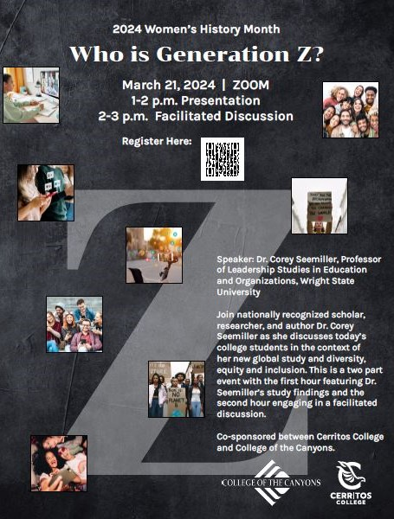
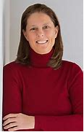
Gen Z Presentation
In honor of Women's History Month, COC hosted a virtual presentation and facilitated discussion with nationally recognized scholar, researcher, and author Dr. Corey Seemiller, Professor of Leadership Studies in Educaton and Organizations, Wright State University, on Thursday, March 21st.
COC's Center for Civic and Community Engagement partnered with Cerritos College to provide this joint campus event. Dr. Seemiller is a leading expert in the study of Generation Z.

Slide 22


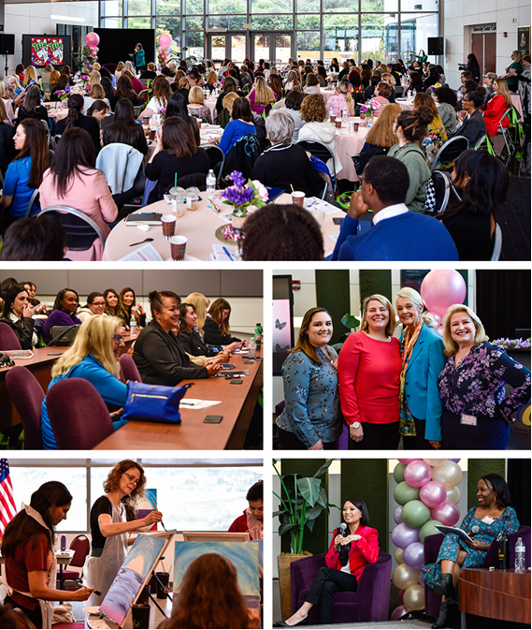
2024 Women’s Conference
The College of the Canyons Women's Conference returned to the University Center on Saturday, March 23rd, to a sold-out crowd.
The day-long event featured a keynote speech by communication expert and confidence cultivator Karen Laos.
A variety of workshops, panel discussions, and guest speakers focused on the theme "Flourish" were scheduled throughout the event, which also included breakfast, lunch, and the ever-popular vendor fair.

Slide 23

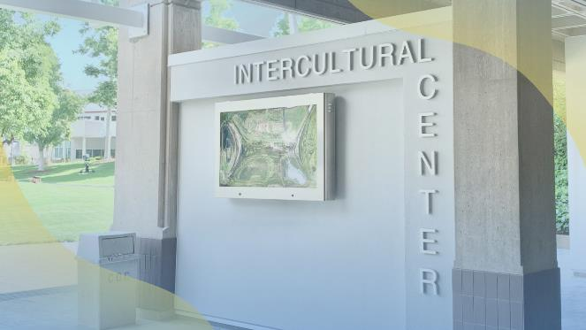
Native American Heritage
The Intercultural Center presented a variety of events in March in celebration of Native American heritage.
Native American Literary Series – Wednesday, March 13th. And continues every other Wednesday through May 15th 2pm to 3pm
Native American Film Series – Black Robe Thursday, March 21st
Native American Film Series – Nanook of the North Thursday, May 9th 2pm to 4pm @ Mentry Hall 305

Slide 24

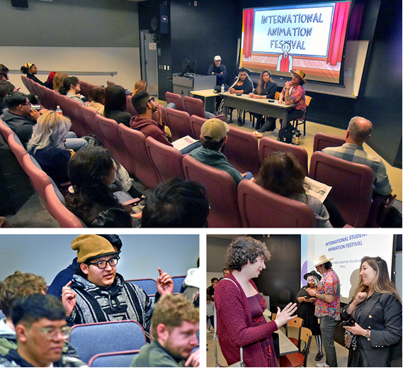
Festival Reaches Global Crowd
The second annual International Animation Festival kicked off Saturday, March 16th, with more than 600 student-created films from more than 70 countries.
Approximately 150 students attended screenings and panel discussions in Mentry Hall, and connected with industry professionals such as Carlos Daniel Vasquez, Sony Pictures Animation talent acquisition manager; Samantha Goff, Fourth Wall Management creative talent manager; March Sanchez, director and storyboard artist; and Kataneh Vahdani, director and professor.
Submissions connected with the festival's theme of social media issues and their relation to topics such as mental health, politics, and daily life.

Slide 25
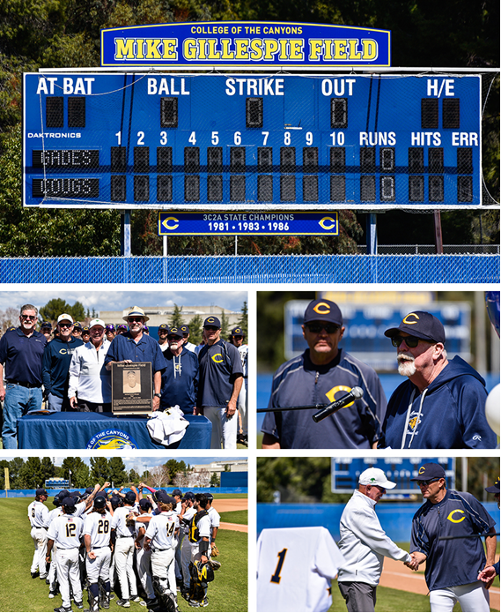
Gillespie Field Dedicated
College of the Canyons officially unveiled Mike Gillespie Field in honor of the legendary baseball coach on Saturday, March 16th.
The festivities included a luncheon in the Cougar Den and on-field ceremony prior to a Cougars baseball game against Bakersfield College.
Many of Gillespie's former players, colleagues, family members and friends attended the event.
Gillespie, who also taught English, physical education and health sciences at the college, guided the Cougars from 1971 to 1986.
He also served as athletic director and was a quarterback coach in the early days of the football program.
He compiled a 420-167 record, including three state championships and 11 conference titles.

Slide 26

Free Tax Preparation
Each Saturday, the Volunteer Income Tax Assistance (VITA) program has been offering free tax preparation services to qualified low- to mid-income individuals, and those with disabilities or limited English-speaking skills.
April 13th will be the last Saturday these services will be offered in Hasley Hall 233 and 234.
The COC-VITA volunteer program is sponsored by the IRS and includes COC students from a wide range of academic disciplines and community members.
Volunteers work under the supervision of experienced tax practitioners to assist with quality review.
For more information, please contact Ali Naddafpour at (661) 362-3330 or cocvita@canyons.edu.

Slide 27
New Life-Long Learning Program
COC will be launching a new community outreach opportunity – Canyons Emeritus and Life-Long Learning Opportunities Program (CELLO).
CELLO will offer comprehensive programming to involve experienced SCV community members in our campus community.
In addition to our 180 non-credit, free classes CELLO will provide:
  Visiting local museums and parks guided by our expert educators
  Participating as a student mentor
  Serving as a tutor
  Joining a choral group
  Leading events like book clubs and movie nights
  Dancing at social events
  Volunteering at our campus events like job fairs and graduation ceremonies
  The opportunities are endless to be involved, engaged and inspired!

Slide 28



Slide 29

Spring Star Party - April 12
The Canyon Country campus presents its Star Party and Science Showcase on Friday, April 12th.
The popular event, part of the Science Talks Series, will feature a guest speaker (TBA), telescopes to view the night sky, science presentations, and other activities.
The free event is scheduled 6:30 to 10 p.m.

Slide 30
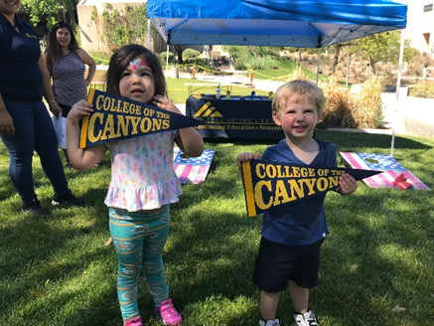
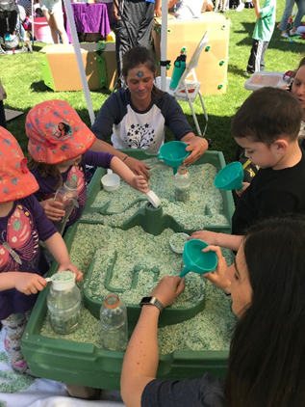

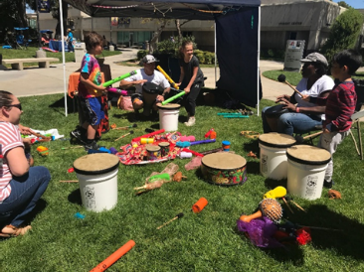
A Day for Children
The Department of Early Childhood Education invites you and your children to celebrate the Week of the Young Child with a Play Day on Saturday, April 13th.
Scheduled 10 a.m. to 2 p.m. at the Valencia campus, the event will include a variety of games and activities.
For more information, please contact Wendy Ruiz @ wendy.ruiz@canyons.edu.

Slide 31

Silver Spur
The College of the Canyons Foundation will honor Steve Corn with the Silver Spur Award for Community Service in recognition of his longtime college support and community service.
The 32nd Annual Silver Spur Celebration is scheduled Saturday, April 13th at Westlake Village Inn.
For more information, contact the College of the Canyons Foundation at (661) 362-3434 or email cocfoundation@canyons.edu.

Slide 32

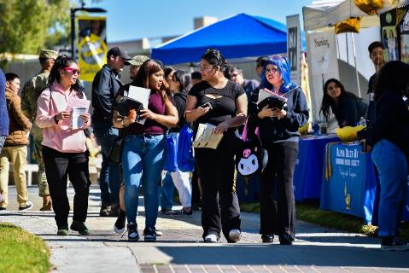
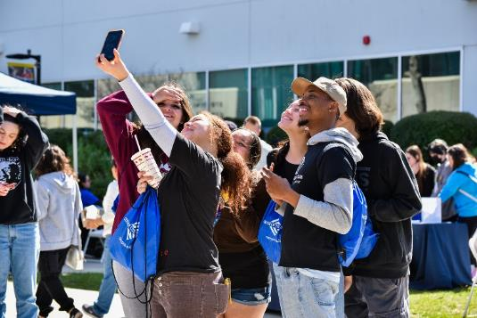
Explore the Possibilities
Discover Day returns to the Valencia campus Saturday, April 20th, offering current and prospective students workshops, information and resources about campus services, academic programs, and student life.
Complimentary food from The Habit will be available while supplies last.
The event is scheduled 9am to 1pm in the outdoor area between Canyons Hall and the Student Center.
For more information: https://www.canyons.edu/studentservices/enrollmentservices/discoverday/

Slide 33

Santa Clarita Job Fair
College of the Canyons will once again host the Santa Clarita Job Fair on Friday, April 26th.
The free event is scheduled 10am to 2pm in the West Gymnasium at the Valencia campus.
The event is open to all and presented in partnership with the City of Santa Clarita, SCV Chamber of Commerce, America's Job Center of California, and SCV Economic Development Corp.

Slide 34
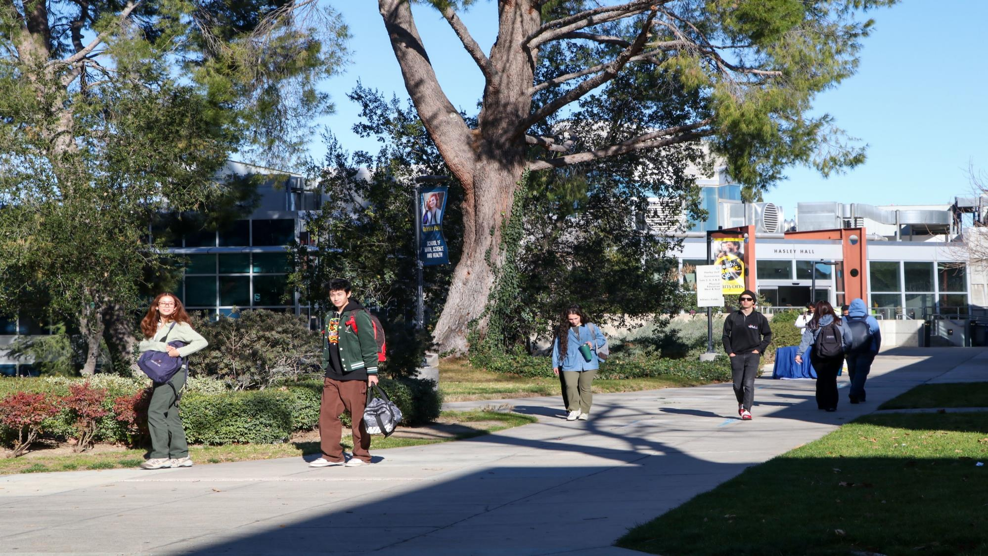
Have a Great Spring!

