Slide 1

Accessible
PowerPoint Presentations
College of the Canyons
Information gathered from:

Slide 2
Usability of PowerPoint
The steps outlined in this presentation will show how to make PowerPoint presentations more accessible if they are to be distributed electronically.
PowerPoint can be an effective tool to use during live demonstrations, presentations or webinars, but is not the best file format to use when taking into consideration both accessibility and usability issues.
When preparing a presentation, first consider developing a lengthier and more complete Word file to most effectively convey the information. Then from that document, develop a PowerPoint slideshow highlighting ‘bullet’ points and an outline of the ideas in the live presentation.

Slide 3
Step 1: Establish the Slide Layout
PowerPoint has built-in accessible styles called Layouts.
Choosing the correct Layout for each slide is the most significant step to ensure that a slideshow will be accessible.

Slide 4
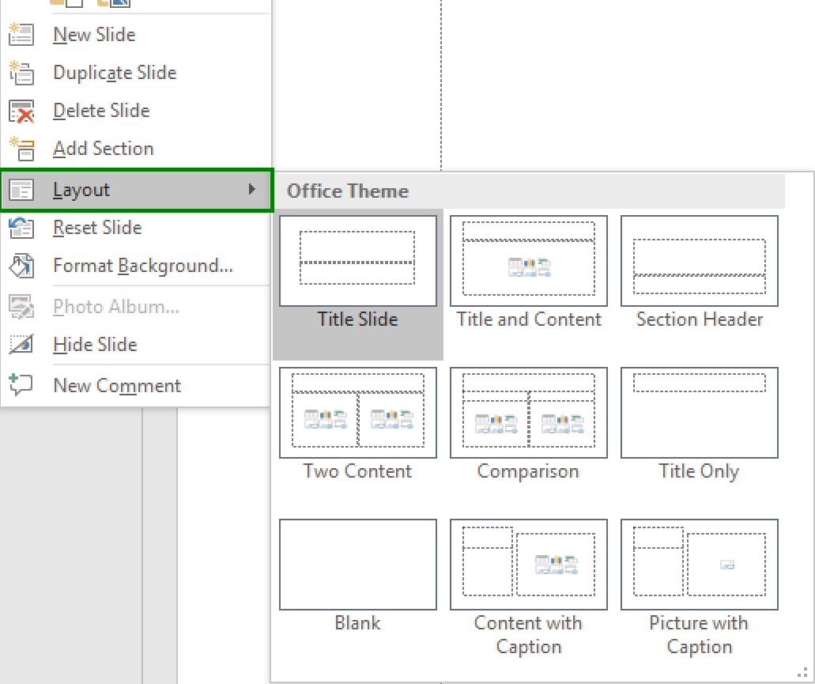
PowerPoint Layouts
To use a Layout:
In the slide thumbnail pane, Right Click a slide.
Select Layout.
Choose a layout design.

Slide 5
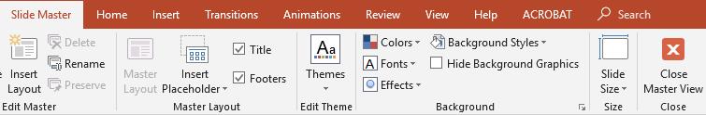
Layouts & Slide Master
Layouts may be customized in the Slide Master.
Images and designs inserted in the Slide Master Layouts will be ignored by Assistive Technology (AT).
​To access the Slide Master:
​In View tab
​Select Slide Master
in the Master Views group.
​You may use all other tabs to customize the Slide Master Layouts.
​Close Master View when finished.

Slide 6
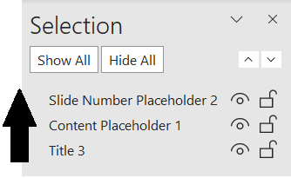
Reading Order
Content will be read according to the reading order displayed in the Selection Pane. The Selection Pane displays the reading order as the bottom list item read first and ending with the top list item.
To check the reading order:
In the Home tab, in the Drawing group, select Arrange.
Select ​Selection Pane.
You may drag a list item to a different location or use the arrow keys.

Slide 7
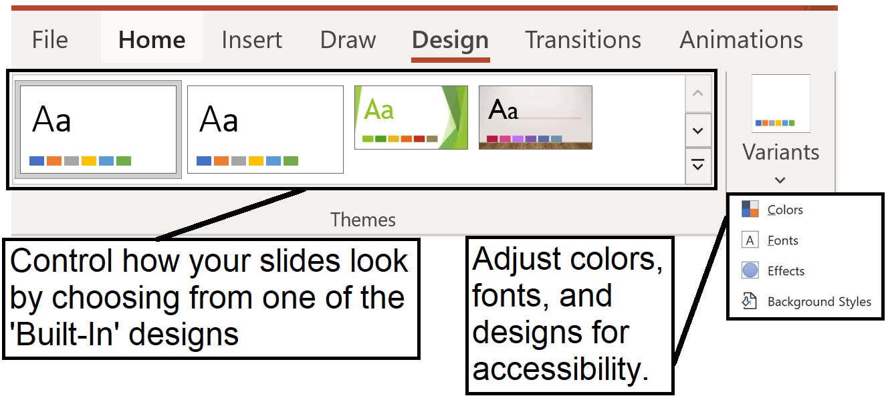
Step 2: Slide Design Considerations
PowerPoint offers design themes. To access these design themes, go to the Design tab and scroll through your options.
Most themes are NOT accessible! Always check color contrast, font style, etc.

Slide 8
Font Style and Size
Because they are the easiest to read, only use Sans Serif fonts, such as Arial or Verdana.
The minimum font size for a PowerPoint presentation should be 24 points.
Since a PowerPoint presentation will most likely be projected onto a large screen, consider how far the audience will be from the screen and choose a font size accordingly.

Slide 9
Use of Color and Contrast
Two Basic Rules for Using Color:
  Never use color alone to convey information.
  Text and background color has a sufficiently high level of contrast.

Slide 10
Data Tables
In PowerPoint, rows and columns can be styled so they appear as data tables, but one cannot add content in a way that will be identified by a screen reader.
For data tables to be accessible, the header row must be identified. If the slideshow contains more than the simplest tables, consider saving the presentation to PDF and adding the additional accessibility information in Adobe Acrobat Pro.

Slide 11
Animations, Transitions & Embedded Multimedia
If slides contain animations, ensure that they do not distract the audience away from the presentation.
Avoid automatic slide transitions.
Ensure any embedded video is captioned, and that the player controls are accessible.
Ensure any embedded audio includes a transcript.

Slide 12
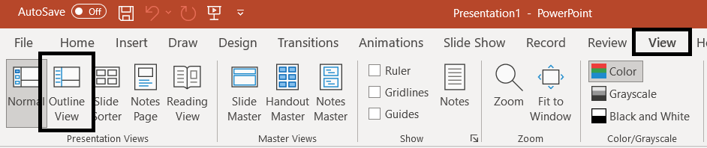
Step 3: Outline and Notes
Normal view will display thumbnails of all the slides with the design elements that have been added.
Content in layouts will be reflected in the Outline View.
The Notes section will not be displayed in the outline and will not be automatically read by a screen reader.
To access the Outline:
​View tab
In the Presentation Views group, select ​Outline View.

Slide 13
Text Boxes
It is recommended to avoid the use of Text Boxes. But, if you or your team has decided to add Text Boxes to a slide, make sure the reading order of the Text Box(es) makes sense. Text Boxes are always read by a screen reader after all content placed in the pre-existing Content Placeholders. More than one Text Box will really complicate predicting their reading order.
Also know that text placed in Text Boxes will not appear in the Outline view therefore complicating converting your PowerPoint to HTML.

Slide 14
Step 4: Add Alternative Text
Images in the slideshow that provide context, must be given a text alternative (Alt Text).
Images that are simply present for decoration, are redundant or add no value to the presentation do not need Alt Text.

Slide 15

Step 5: Use Meaningful Hyperlink Text
Hyperlink text should provide a clear description of the link destination. Whenever you provide a Uniform Resource Locator (URL) or link, you want to make the link description meaningful.

Slide 16
Step 6: Convert to other Formats
PowerPoint files can be large, and users must either have Microsoft Office or a special plug-in in order to view them. The slides by themselves usually do not offer a complete summary of the information conveyed.
It is often recommended that a more accessible way of distributing PowerPoint slideshows is by exporting them into either Portable Document Format (PDF) or HyperText Markup Language (HTML).
Both of these other formats can be made to be more accessible for persons using assistive technologies, and they are smaller file sizes for downloading.

Slide 17
Convert to PDF
To save the accessible functionality of the PowerPoint document that has been created, it can be saved as a PDF. To Save As a PDF, choose the Save As option, then choose PDF as the file type (By Keyboard; Alt, F, A). Click on the Options button, and ensure both boxes in the Include non-printing information section are checked. Click OK to close the Options box and then click Save. All the accessibility that was built into the PowerPoint slideshow (such as Alt Text, Hyperlinks, reading order) will be saved in the PDF file.

Slide 18
Convert to HTML (1 of 2)
Some versions of PowerPoint have a Save As Web Page option. This will NOT create accessible HTML content. For anyone skilled in HTML and Cascading Style Sheets (CSS), consider creating slides in HTML.

Slide 19
Convert to HTML (2 of 2)
To create an HTML version:
Select and copy the contents of the Outline panel (remember text in Text Boxes will not be in the Outline panel, nor will anything from your Notes section).
Paste it into an HTML editor such as Dreamweaver.
Clean up the content.
Add additional information to the outline, such as images.
Create next and previous buttons and make sure the links are accurate.

Slide 20
Step 7: Check Accessibility
Perform a test of the accessibility using the built-in accessibility checker (In the File tab, click on Info, Check for Issues, then Check Accessibility).
Use a screen reader (JAWS, NVDA, etc.) to finalize accessibility.
If possible, develop a group of accessibility testers, or send the document to an end-user for testing.
Never rely solely on the built-in checkers!

Slide 21
Questions?
Access Coordinator: Scott McAfee
Phone: (661) 362-3356
Email: scott.mcafee@canyons.edu

