Slide 1
Welcome to
Building Community Online
January 31, 2022
www.canyons.edu/onlinefaculty

Slide 2
Why Build Community?
Positive relationships form the connection between students, engagement, and rigor
Relationships
Community building
Humanizing
Trust
Belonging
Learning
Notes:
Research tells us the lack of instructor-student relationships in many online courses exacerbates equity gaps.
Positive instructor-student relationships are leveraged to hold students to high standards, validate their effort and ability, and support them with achieving their goals.
When we invest in relationships, community building, and humanizing, this builds trust and belonging which supports student learning

Slide 3
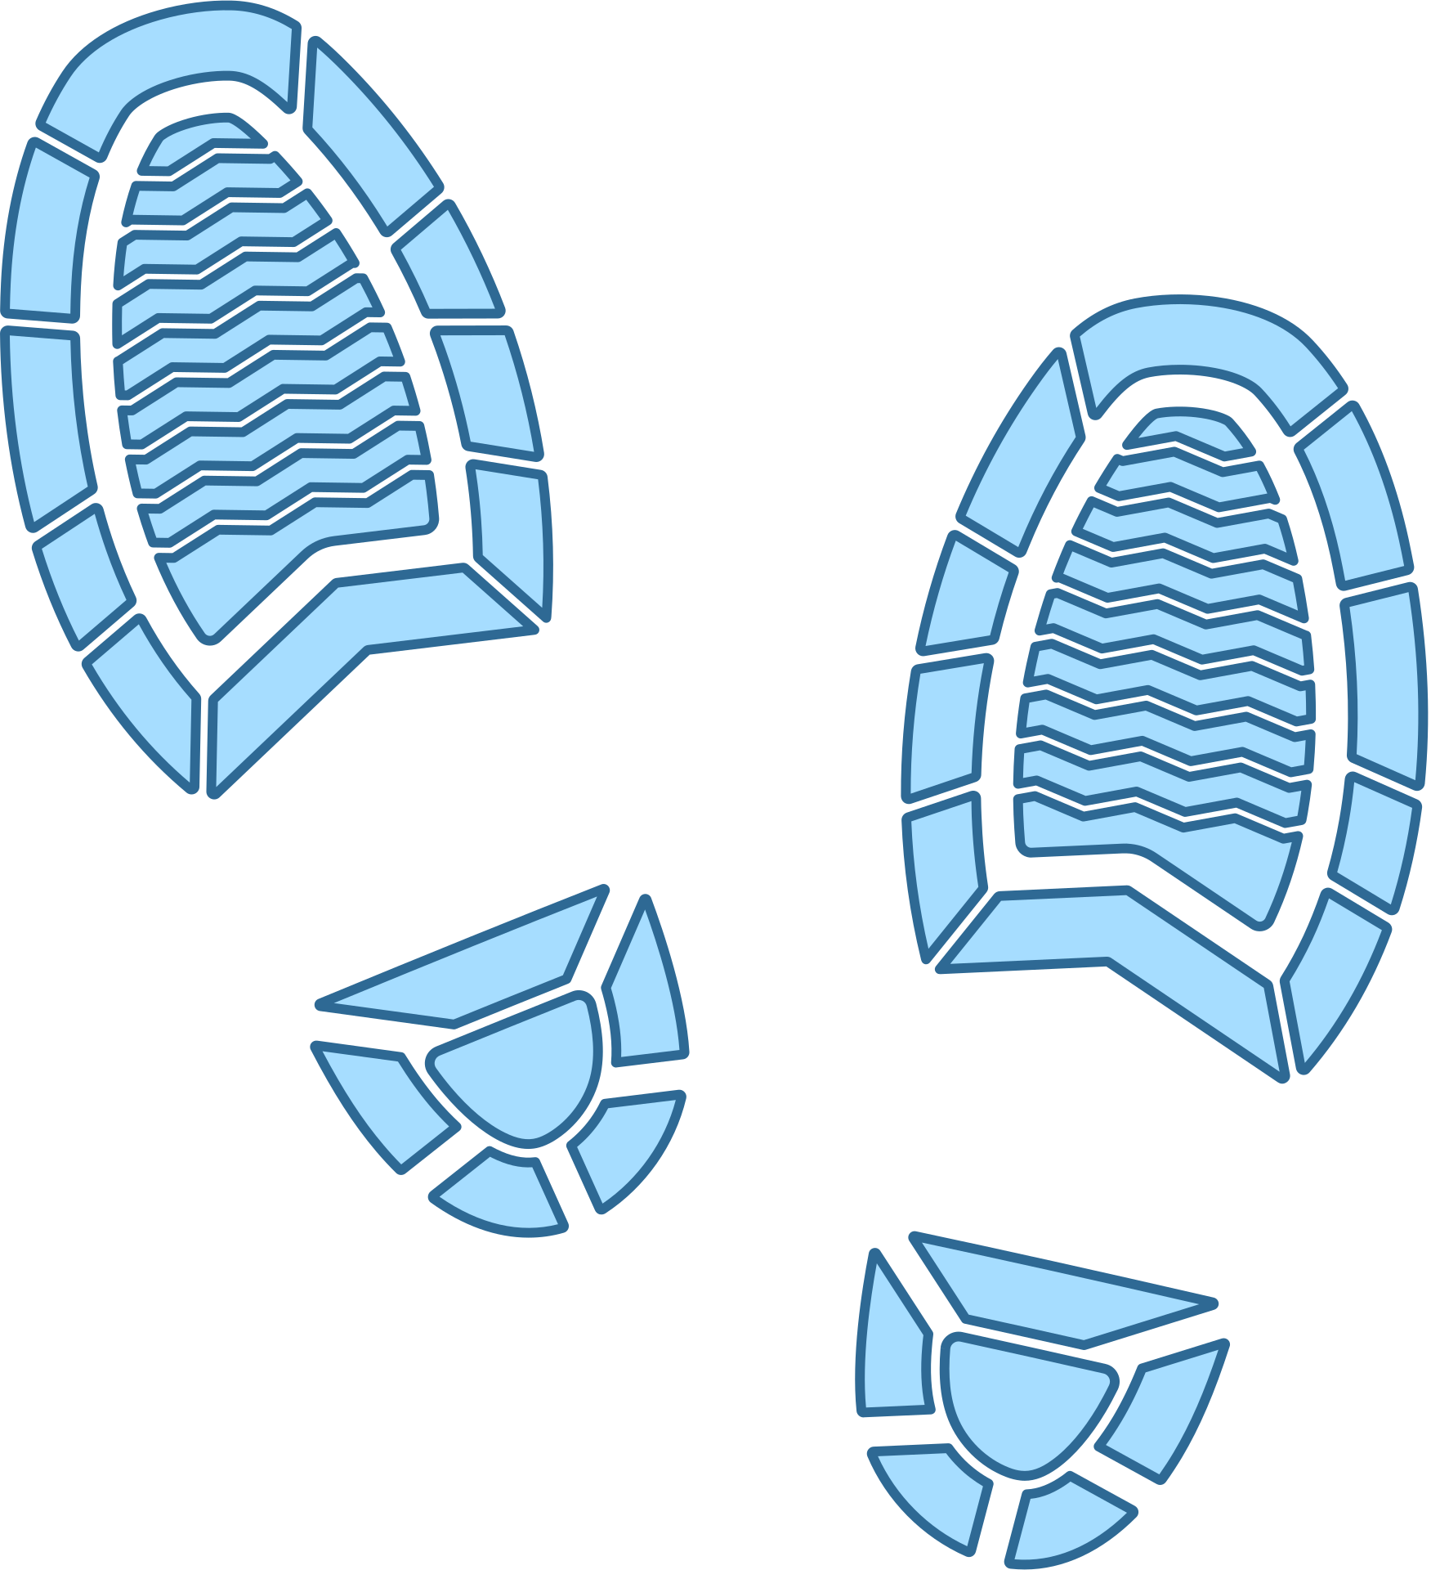
The Online Student
Experience
Memorable
Meaningful
Connected
Rich with Interaction
Lonley
Disconnected
Lost
Confused
Notes:
Online courses do not have to be passive environments defined by video lectures or limited to text-based interaction. In fact, online courses, like any meaningful learning experience, should be rich with interaction.
In this workshop, we'll look specifically at what we, as instructors, can do to develop social presence, and create a learning environment where strong connections lead to meaningful interaction and satisfying learning.

Slide 4
Why do students struggle more in fully online courses?
"Practitioners and scholars increasingly acknowledge two crucial challenges to successful learning in an online environment: requirement of higher-level self-directed learning skills and greater difficulties in enabling effective human interactions."

Slide 5
Connections
Enabling
with students begins by Establishing
Social Presence
Notes:
In its simplest form, enabling connectedness with students begins by establishing social presence. This means we (instructors) project and interact with our online students with the same warmth and empathy we can so effortlessly project in a face-to-face class. While also creating space and opportunity for students to interact with their peers as real humans.

Slide 6
3 Essential Connections
Connection to...
1) Peers
2) Content
3) Instructor

Slide 7
3 Essential Connections
Connection to...
1) Peers
2) Content
3) Instructor

Slide 8
Make Learning
Connection to
PEERS
Social
Ice Breakers
Watercooler Space
Reading Groups
Friends don't let friends read alone. Collaborate on a google doc or reading assignment
Conduct these at the start of class and new group activities.
Encourage comments of non-academic nature.
Notes:
Ice Breakers:
Begin a new group assignment with an online ice breaker discussion or video sharing activity.
Water Cooler Space:
Include 'norms' to guide behavior.
Encourage participation with bonus points for posting
Reading Groups:
Make annotating a piece of reading, which is typically an individual endeavor, more engaging by grouping students on a shared document to annotate collaboratively. You can do this by using a Google Document. Students can highlight keywords and phrases in the text and capture their annotations.
As they work they can use the chat feature inside of the document to discuss the reading if they are working synchronously or insert comments with questions for the other members of the group to answer. This adds a social component to the learning task, which can help students who are working on the assignment at home feel connected to their peers.

Slide 9
Questions?
Let's Brainstorm!
Notes:
ice breaker activity
https://jamboard.google.com/d/1ysWP-7e2lteQnoBY4l1KvcwBAAeX0jcqYl7N1Y4FH0c/edit?usp=sharing

Slide 10
3 Essential Connections
Connection to...
1) Peers
2) Content
3) Instructor

Slide 11
Connection to
Plan for Learner Variability
CONTENT
Providing choice, lets students connect with content in the way that works best for them.
One size does not fit all
Notes:
A benefit of online instruction is the ease with which we can present information in multiple ways (i.e. text and images). This lets students choose the path that best fits their learning needs.

Slide 12
Variability in Assignments
Connection to
CONTENT
Universal Design for Learning (UDL) guidelines include providing multiple means of engagement, representation, action & expression.
autonomy
choice
alternatives
Give students Options!
Notes:
The goal is to provide students choices, options, alternatives, which increases autonomy -
in both learning (consuming content) and in demonstrating learning
Visual assignment,
written representation,
audio, etc.

Slide 13
Planning for Variability
Variability in Assignments
Connection to
CONTENT
Keep in mind the rule of
EITHER / OR
If you present something visually, make sure you provide a text alternative.
If you present something only in text, make sure you provide an alternative (i.e. image, video or recording).

Slide 14
Variability in Discussions
Connection to
CONTENT
Make a creative and Catchy Title
Layer your questions
to achieve a subtle differentiation for students at different levels. Ask the most academically rigorous question first. Follow this first question with two additional questions that allow students more entry points into the conversation.
Vary your question types
Analytical
Synthesize
Debate
Insert Media into your question
Compare
Cause & Effect
Reflective
Include directions for student participation.
Once they post their response to your question, what do they need to do? How many peers should they respond to?

Slide 15
Questions?
Let's Brainstorm!
Notes:
https://jamboard.google.com/d/1ysWP-7e2lteQnoBY4l1KvcwBAAeX0jcqYl7N1Y4FH0c/edit?usp=sharing
What strategies do you use? (video, audio, multiple
Which strategies do you think you'd like to try?
Which strategies do you think your students would most appreciate?
Which seem 'easy' to put into practice?

Slide 16
3 Essential Connections
Connection to...
1) Peers
2) Content
3) Instructor

Slide 17
Connection to
INSTRUCTOR
3 ways to
be human online
Presence
Awareness
Empathy
Notes:
Teaching a student-centered online class is a lot of work, and although we may spend a significant amount of time setting up our course content, these behind-the-scenes actions do not convey a sense of who you are as a real person to your students.
Establishing your presence in a class is done throughout the semester through engagement with your students.
Michelle Pacansky-Brock suggests three principles and related strategies will help faculty keep humans front-and-center of their online courses...

Slide 18
Presence
Connection to
INSTRUCTOR
Assuring students know you are in this journey with them through imperfect videos
Verbal and nonverbal cues add context to your communications, which is important to support culturally diverse students
Don't be a robot!

Slide 19
Awareness
Connection to
INSTRUCTOR
Learning about who your students are and how you can support them
Try:
Course surveys
Fun, low-stakes icebreakers
Q&A
Notes:
Course surveys include:
Week 1 "getting to know you" and surveys throughout the course (see course)

Slide 20
Empathy
Connection to
INSTRUCTOR
Calling upon your awareness of your students to offer support when they need it
extending flexibility
being approachable
check in with students individually

Slide 21
Connection to
INSTRUCTOR
How do you 'hear' this phrase when you read it to yourself?
"What were you thinking when you wrote this sentence?"
Notes:
How long does it take to write comments? Have you written and deleted agonizing over how it will be 'read'? There is so much we can communicate through affective nonverbal cues - voice tone, facial expression, even phrasing and pacing. Video feedback may save you time and avoid uncomfortable miscommunication.
Audio and video comments just may save time and potentially being 'misunderstood.'
(reflect on how people initially interpreted it, and have volunteers read out loud.
Ideas for Uses of Video/Audio
A weekly module overview
Weekly announcements
Assignment / Gradebook feedback
A dramatic reading of poetry/literature
Add an audio option to written directions
Virtual field trips
etc.

Slide 22
Connection to
Establish a social presence
INSTRUCTOR
Emotive:
Interactive:
Cohesive:
Expression of emotion; use of humor; self-disclosure
Continuing a thread; quoting and/ or referring explicitly to others’ messages; asking questions; compliments, expressions of appreciation or agreement.
Use of vocatives; use of inclusive pronouns to address the group; salutations
Example:
Example:
Example:
"Your reflection resonates with me because..."
"I appreciate you sharing with me a bit about your family. I can relate to the challenges of balancing work and family responsibilities"
"If you haven’t already, please read Lilly’s analysis of this week’s chapter and the current event she used as an anecdote."
"Thank you everyone for submitting your drafts on time!"
"Hi folks!; Let’s get started!"
"We are making progress!"
Notes:
A review of the literature shows that strong instructor social presence is a significant factor in online student success.
Research has identified three categories within communication that convey the immediacy, or the ability to close psychological distance between individuals: Affective, Interactive, and Cohesive. Let’s look at examples of this.
Content from: https://coc.instructure.com/courses/37154/pages/the-science-of-social-presence?module_item_id=2307961

Slide 23
Think and Share
Step 1:
Think about any activities you've done online that have helped create community. And/Or, think of challenges you've experieced or questions your have
1
2
Step 2
In breakout group, talk about this with your group members.
Notes:
Show resources in Canvas - Ice breaker activities, example discussion prompt for water cooler,
Directions
Give people a minute or two to think about or write down an example of an activity

Slide 24
Thank
You
Contact us:
Joy Shoemate
Carol Johnston
Chloe McGinley
www.canyons.edu/onlinefaculty
online@canyons.edu
Notes:
Share Canvas resources

