Slide 1
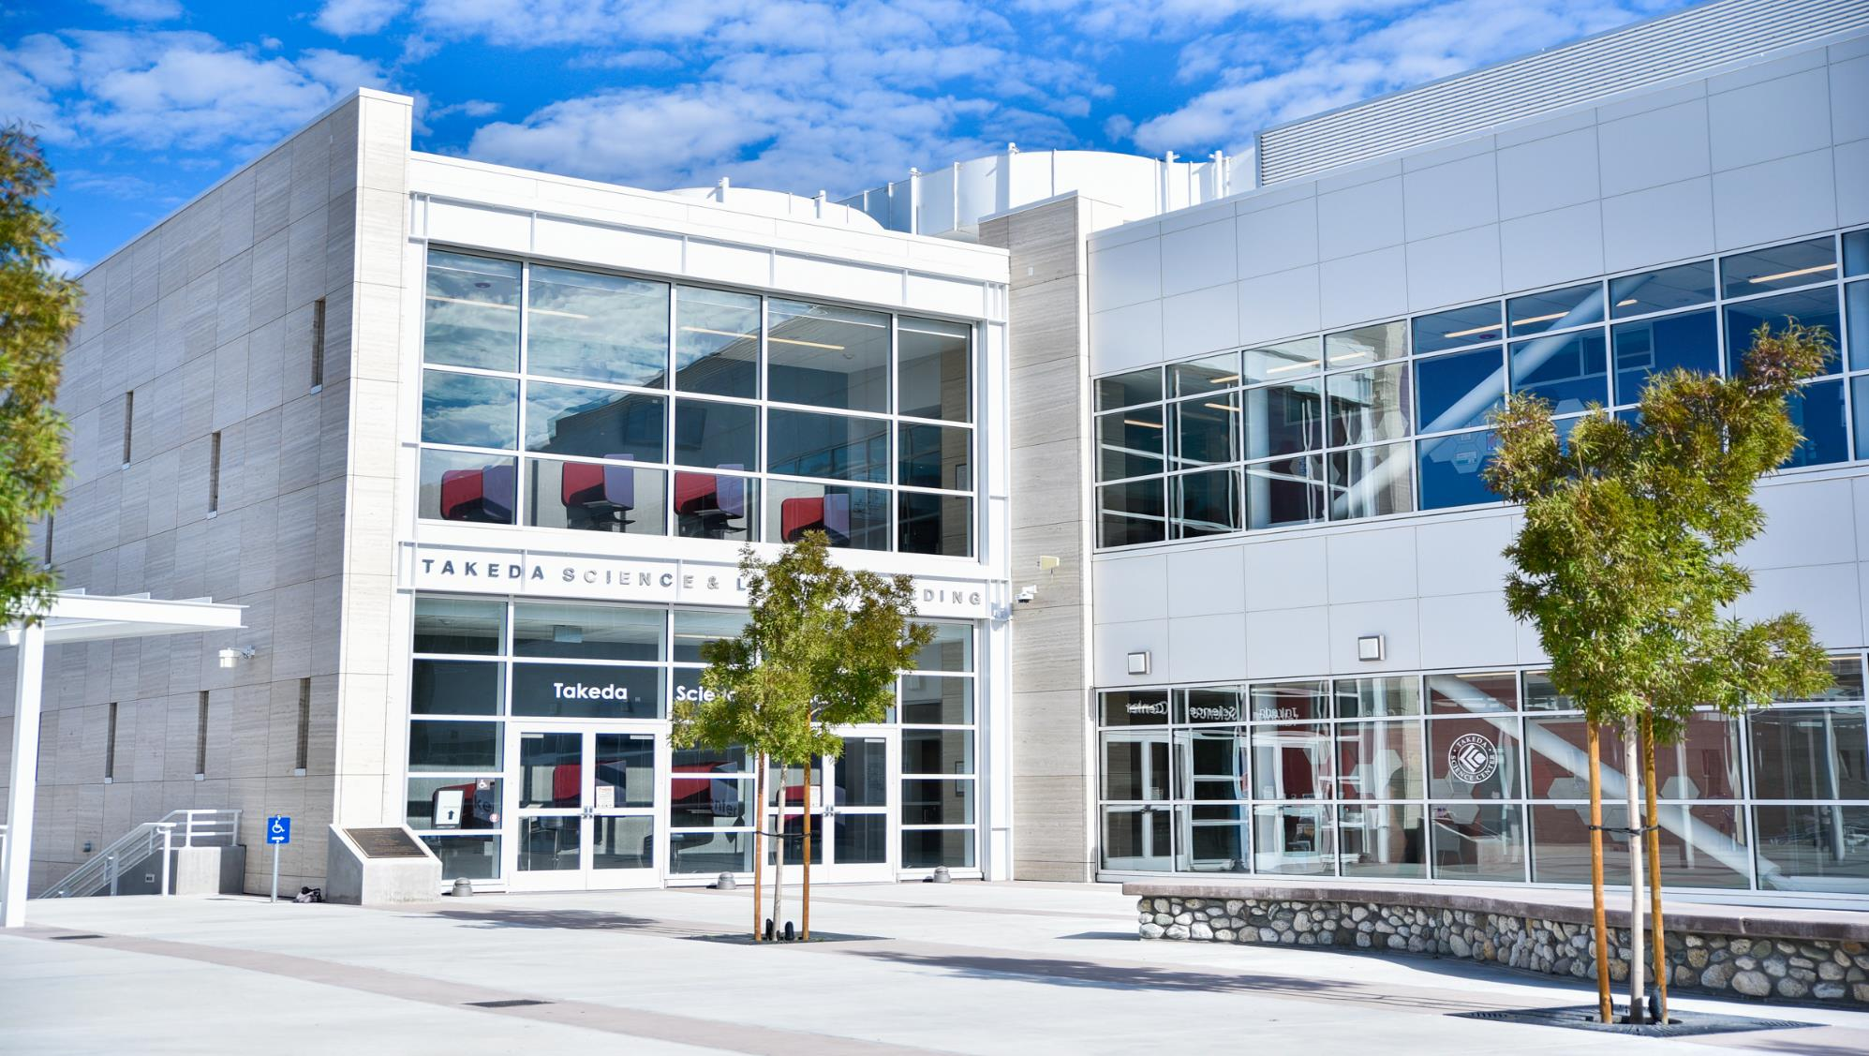
Foundation Board of Directors
September 25, 2023
Chancellor’s Report

Slide 2
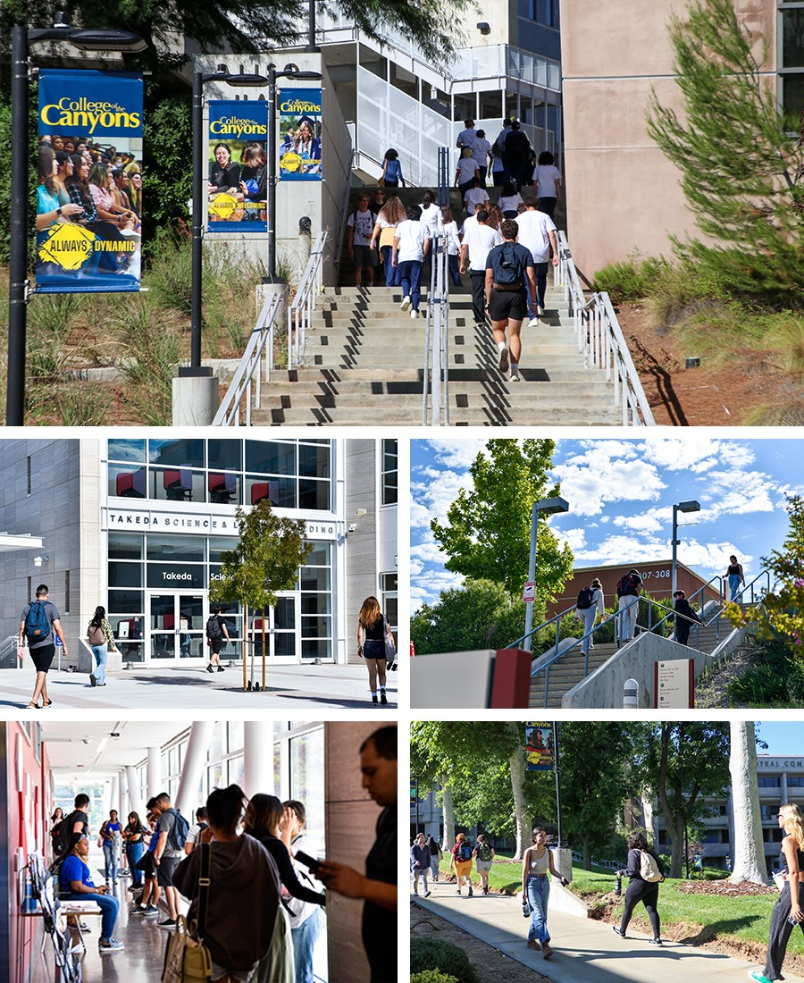
What’s New on our Campuses

Slide 3
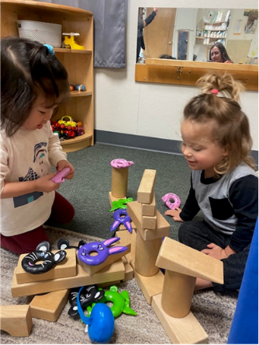
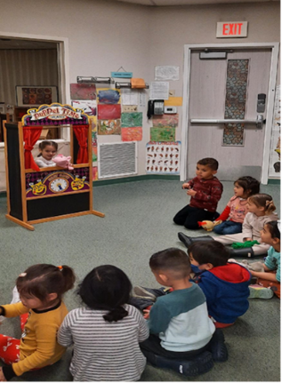
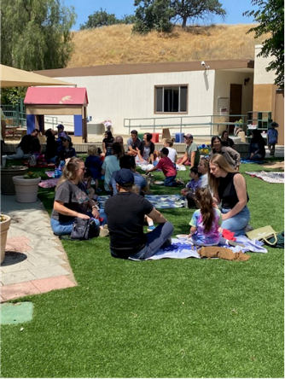
TK Pathway for Teachers
In response to the significant demand for Transitional Kindergarten (TK) teachers, COC will offer an additional pathway for currently credentialed teachers to earn the 24 Early Childhood Education (ECE) units required to teach TK.
The growing need for TK teachers is the result of state legislation that is gradually expanding TK over a four-year period.
With more than 300,000 students expected to enroll in TK, school districts will need to hire up to 15,600 additional lead TK teachers to meet demand, according to the Learning Policy Institute.
Originally offered as an accelerated 10-month pathway in 2022-23, the upcoming pathway will allow teachers to complete the pathway’s nine courses, one at time, in a fully online format, from fall, 2023 through spring, 2025

Slide 4
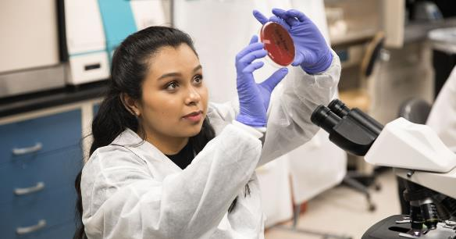
Fall Registration Features New Programs
College of the Canyons is offering new degrees and certificates this fall that are designed to help students launch careers in growing fields.
Classes in the new programs are among more than 1,700 sections available in the fall semester, which runs from Aug. 21st to Dec. 9th.
The programs include commercial photography (associate of arts), cybersecurity (associate of science), clinical laboratory scientist (certificate of achievement), and entrepreneurship (certificate of specialization).
These offerings add to the college’s robust career education programs that equip students with the skills needed to transition from the classroom into well-paying job.
Students who completed career education courses at College of the Canyons in 2021-22 saw their median wage increase by 23 percent.

Slide 5
Grants Update
$15,769,722 already secured for FY23/24. Recent grant highlights include:
US Dept of Ed (DOE): $1,437,000 Upward Bound Veterans grant to support veteran postsecondary education success
CA Workforce Dev Board (WDB): $500,000 High Road Training Partnership grant to support partnership development with regional industry
Chancellor’s Office (CCCCO): $200,000 Zero Textbook Cost Acceleration grant for Sustainable Design/Development Certificate
Chancellor’s Office (CCCCO): $200,000 Zero Textbook Cost Acceleration grant for Land Surveying Certificate
US Dept of Ed (DOE): $125,000 Title V Subaward with CSUN for culturally responsive training
National Science Foundation (NSF): $83,000 subaward with Madison Tech on study of clean energy and EV
Kaiser Permanente: $10,000 for early childhood education mental health assessment.

Slide 6
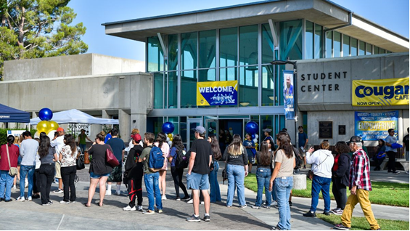
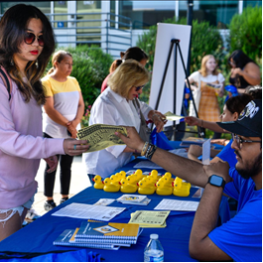
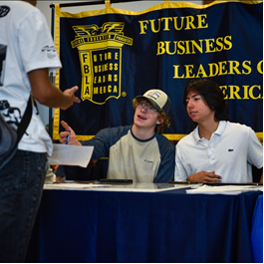
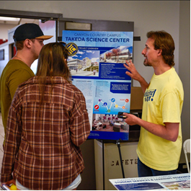
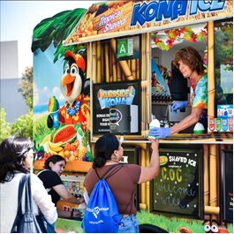
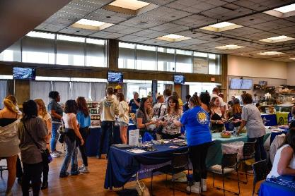
Welcome Day Draws Hundreds of Visitors
The Valencia campus was bustling on Friday, Aug. 11th, for Welcome Day, as new and prospective students visited the campus to learn about majors, career programs, clubs, and student services.
Canyons Hall, the Student Center, and Intercultural Center were packed with tables where visitors had a chance to meet with college faculty, staff, and students to learn more about the opportunities available at both campuses this fall.
Representatives were also on hand to help students apply and register, and get information about financial aid.
Visitors who received at last five stamps on their passport cards earned a free Kona Ice.

Slide 7
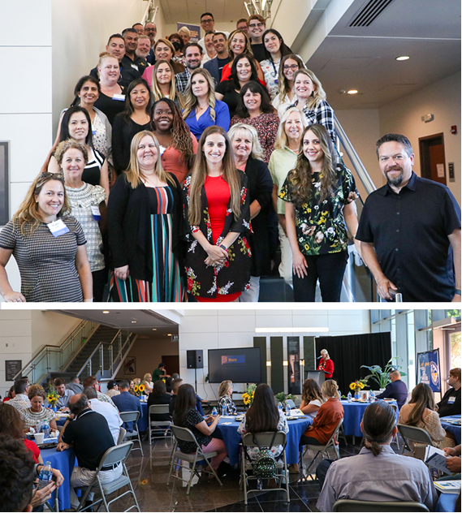
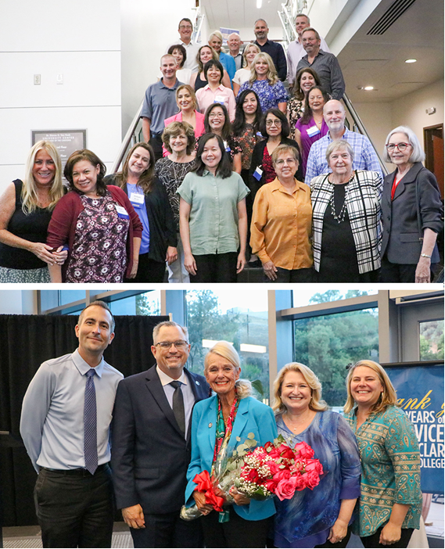
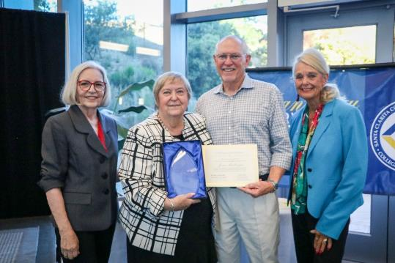
Employees Honored for Service
Employees were honored for their years of service during two celebrations at the University Center on August 14th and 15th.
Employees celebrating 5 and 10 years of service were honored at a luncheon on Monday, August 15th.
Those marking 15 and more years of service were honored at a dinner celebration on Tuesday, August 16th.
Joan MacGregor was honored for her 3o years of service to the District.

Slide 8
CVC Exchange Teaching College
College of the Canyons is now a CVC Exchange Teaching College, making it easier for students across California to register for COC's online classes in one easy step, lowering barriers to higher education, and helping boost enrollment.
The college went live as a Teaching College on Wednesday, Aug. 16th.
A team composed of representatives from IT, Admissions, Financial Aid, Student Business Office, and Online Education worked for several months to secure Teaching College status.
The CVC (California Virtual Campus) Exchange means that students who attend another California Community College won’t need to fill out a COC application to enroll into our online classes. It is breaking down barriers for students to access classes across our state!

Slide 9
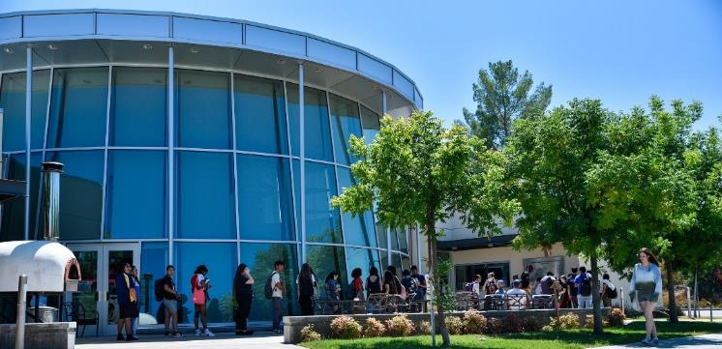
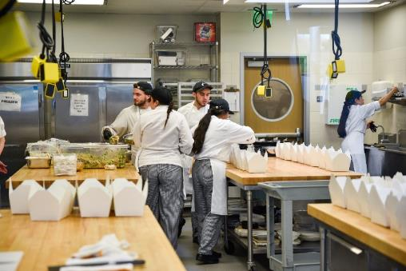
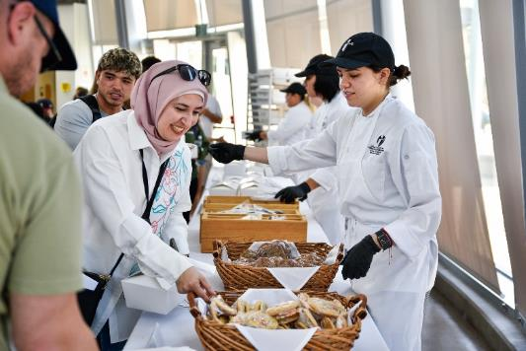
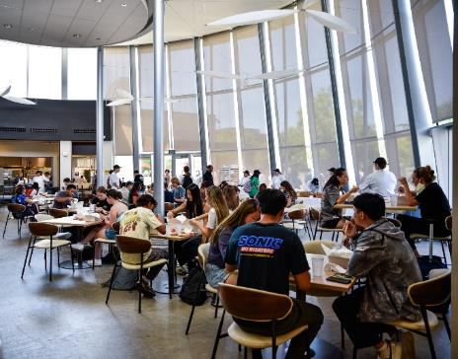
Students Invited to 'Fuel Up'
The College of the Canyons Institute for Culinary Education provided free meals to students during its "Fuel Up" event on Thursday, Aug. 24th.
This year, over 500 students were treated to a delicious Mediterranean style box lunch.
The meals were prepared by students in the Advanced Catering class from noon to 1:30 p.m.

Slide 10
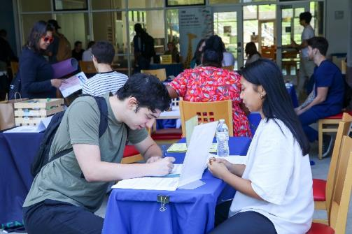
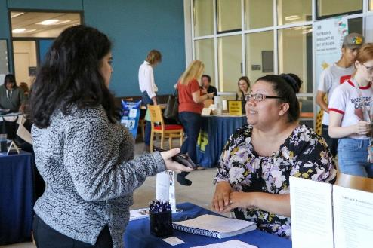
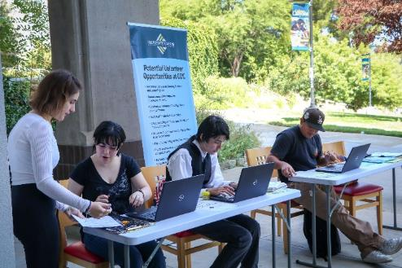
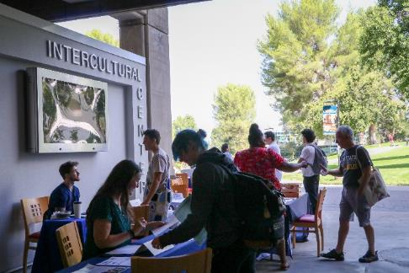
Student Employment Expo
The Volunteer Bureau and Student Employment Office worked in collaboration with the Intercultural Center to host the Student Employment & Volunteer Expo on Wednesday, September 6th.
30 departments and programs showcased their student employment and volunteer opportunities.
250 – 300 students visited the Expo, which took place in the newly established Intercultural Center.
Students had the opportunity to connect, engage, and converse with our campus community to learn more about available opportunities.

Slide 11
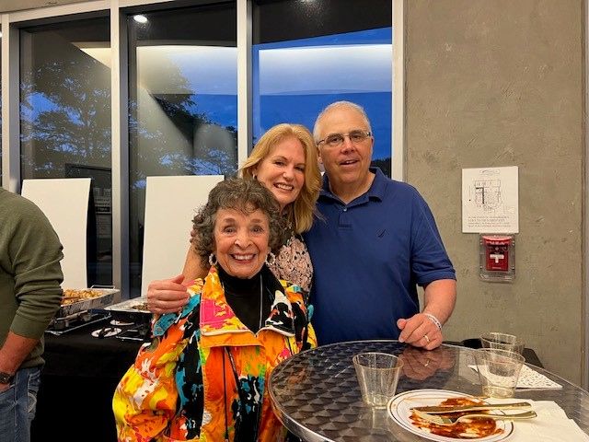
PAC Season Kick-Off
On Saturday, September 9th the COC Foundation Patrons of the Arts Committee hosted a pre-show cocktail hour for POA Members, their guests, and a limited number of tickets were also sold to community members. Attendees enjoyed appetizers and beverages prior to watching Five for Fighting perform.

Slide 12
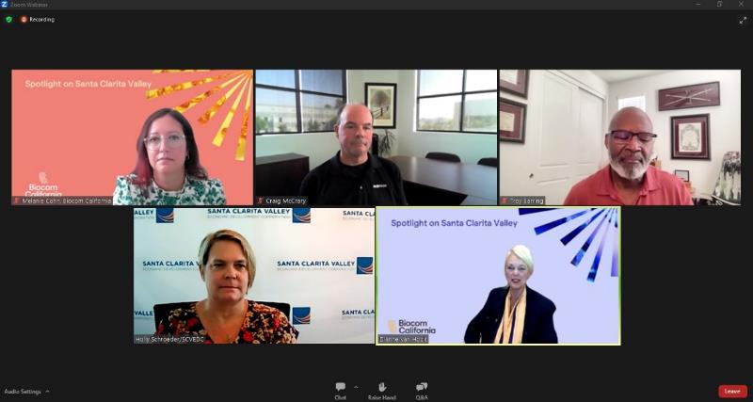
Spotlight on the Santa Clarita Valley
On Wednesday, September 13th I participated in a panel discussion for the Spotlight on the Santa Clarita Valley webinar series.
I spoke on the role of academic institutions in Santa Clarita, and more specifically, the role College of the Canyons has in supporting talent development and the Advanced Techology Center (ATC).
Also on the panel were:
Troy Barring, CEO & Founder, TAB Diagnostics
Holly Schroder, President & CEO, Santa Clarita Valley EDC
Craig McCary, President & COO, NeoTech
Supervisor Kathryn Barger and Mayor Jason Gibbs provided keynote remarks.
Over 70 participants from the business community participated in the webinar.

Slide 13
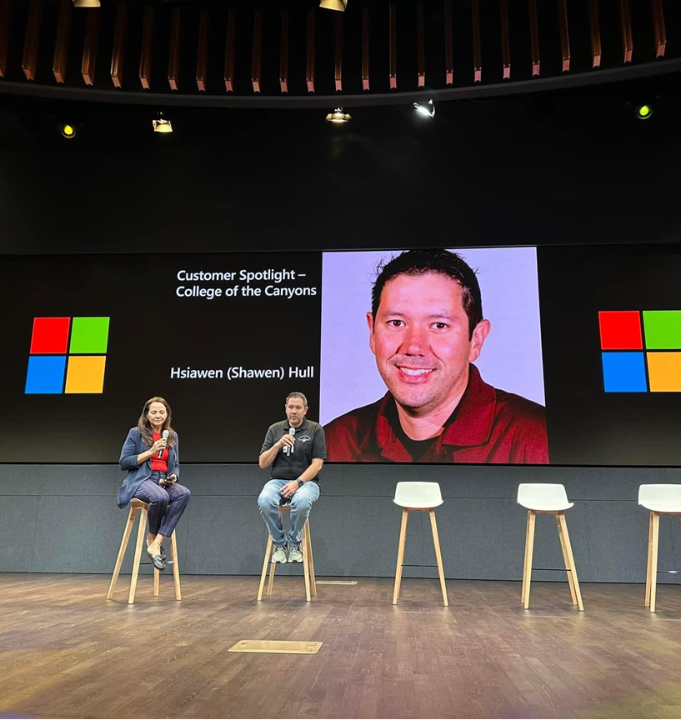
Cal Education Technology Summit
College of the Canyons was asked by Microsoft to be their Customer Spotlight at their event in Silicon Valley this week.
We were selected because of the great work Hsiawen Hull has been doing to better protect our campus from Cyber threats utilizing Microsoft solutions.

Slide 14
Intercultural Center Opens
The ceremonial ribbon was cut for the Intercultural Center on Wednesday, Sept. 13, officially opening a new facility designed as a place to meet, build community, and serve as a bridge to student resources.
Guest speaker for the event was Dr. Abdimalik Buul, visiting executive of education excellence, California Community Colleges Chancellor's Office.
The Intercultural Center is located on the ground level of Bonelli Hall.

Slide 15
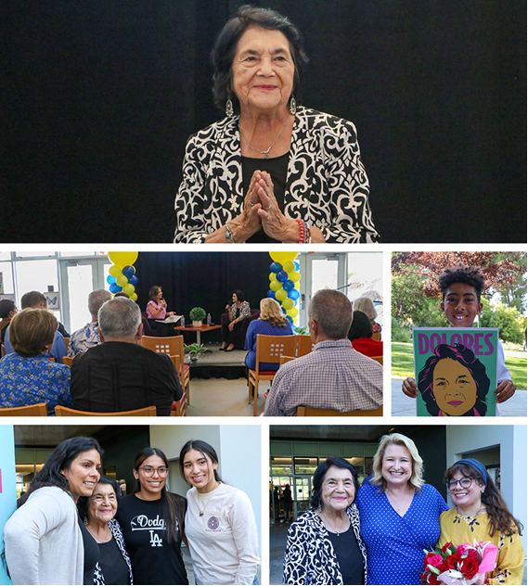
Huerta Reflects on Career
Labor leader Dolores Huerta spoke to a full crowd at the Intercultural Center on Tuesday, Sept. 19th, to mark Hispanic Heritage Month and Labor Day.
Huerta discussed the evolution of public policy, social justice, and advocacy during her labor and community organizing career, as well as how young people can best serve their communities.

Slide 16
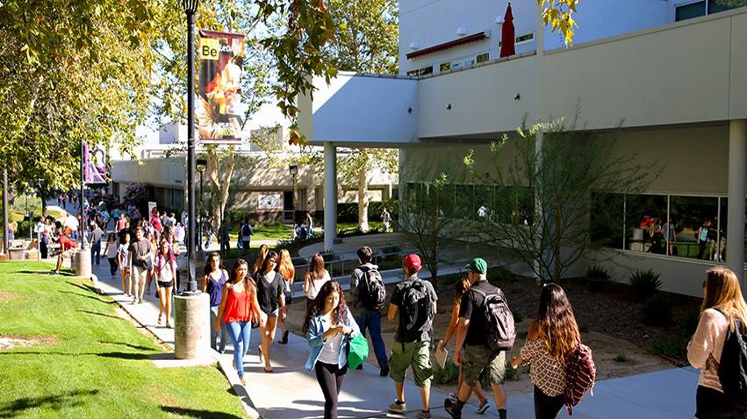
Enjoy the Fall Semester!

