Slide 1

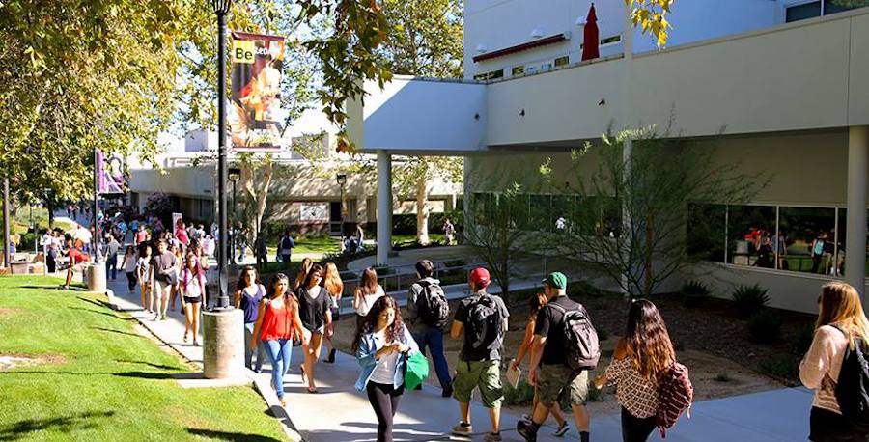

Foundation Board of Directors
September 27, 2022

Slide 2

COC Grads are Doing Amazing Things!

Slide 3

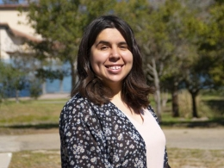
Former COC Student Wins Excellence Award
Elizabeth Lopez, a former COC student who transferred last year to UC Santa Barbara recently won the Thomas More Storke Award for Excellence, the university’s highest honor!
Elizabeth, a first-generation college student, was recognized last June for her scholarly excellence and positive contributions to the campus community at UC Santa Barbara, where she promoted better access for underrepresented groups in math and science.
Her pursuit of challenging academic goals, her persistence through adversity and her dedication to fostering opportunities for others are what led to her selection for the university’s highest honor.

Slide 4

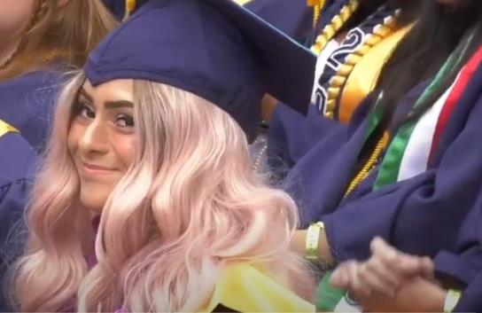
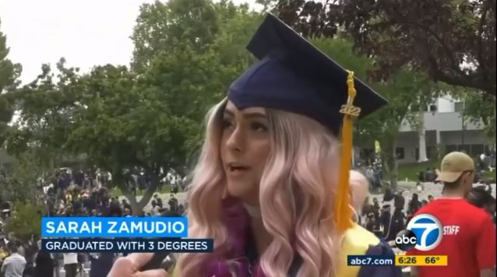
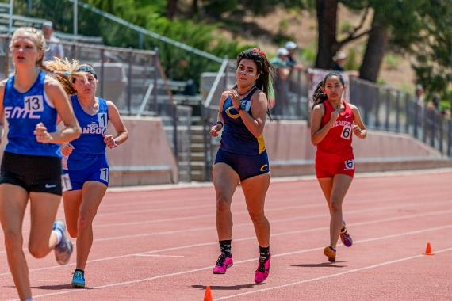
COC Graduate Featured on ABC7!
Last June, ABC7 News aired an inspirational feature on 2022 graduate Sarah Zamudio highlighting her determination and tenacity in pursuing three degrees under very challenging conditions.
This fall, Zamudio plans on transferring to a University to study art and continue running at the four-year level. She hopes to become a college counselor and art professor.
We are so very proud of you, Sarah!

Slide 5
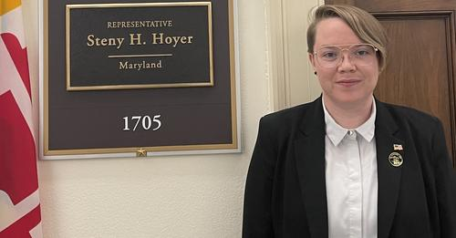
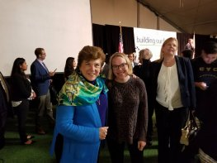
Graduate Advocates for Foster Youth
This summer, former COC Political Science and Paralegal Studies graduate April Barcus did a nine-week Foster Youth Internship with the Congressional Coalition on Adoption Institute (CCAI) in Washington, D.C.
During their internship, April had the opportunity to work for U.S. House Majority Leader Steny Hoyer (D-Md.), meet Sen. Amy Klobuchar (D-Minn.) and hear Speaker of the House Nancy Pelosi (D-Calif.) address an audience from several feet away.
April is currently writing a policy report about the correlation between disability and foster care, with recommendations on how Congress, the Biden Administration and the private sector can help improve healthcare access and treatment for foster youth with disabilities.
Way to go April!

Slide 6

COC Stands Out!

Slide 7

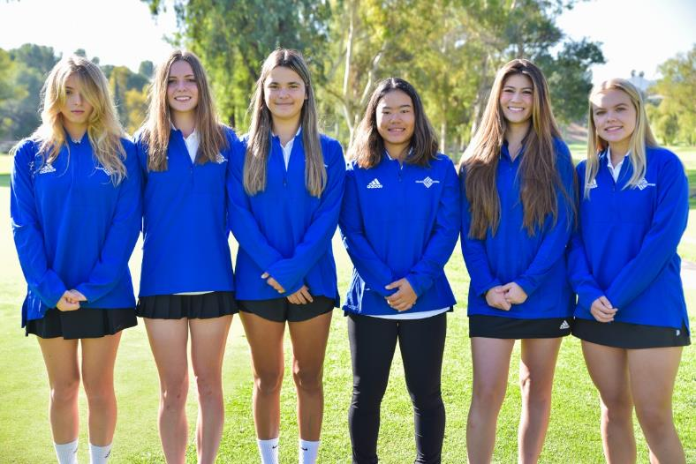
Athletics Off to a Bright Start
Women’s Golf Wins WSC Opener
College of the Canyons teed off the 2022 campaign with an impressive 19-stroke victory over host Santa Barbara City College while seeing all four scoring players finish in the top-10 of the individual standings.
COC freshman Motoko Shimoji was the event medalist with a stellar opening round of 77 at Santa Barbara Golf Club.
Fellow Canyons freshman Flora Peugnet was next with a round of 79 to finish second in the field of 35 players.
Canyons continues its conference schedule on Monday, Sept. 19th at San Dimas Country Club.

Slide 8


Athletics
Canyons Football Ranked No. 4 in the State
The Cougars have opened the season 2-0 with a pair of convincing victories to position themselves among the state’s best teams.
COC defeated Antelope Valley 44-13 in week one … Last Saturday, Canyons was a 43-7 winner over Southwestern College at Cougar Stadium.
No. 4 Canyons will host No. 14 Fullerton at 6 p.m. on Saturday
Check out the games – via live stream – on our Canyons Athletics website. Links can be found at www.COCathletics.com

Slide 9

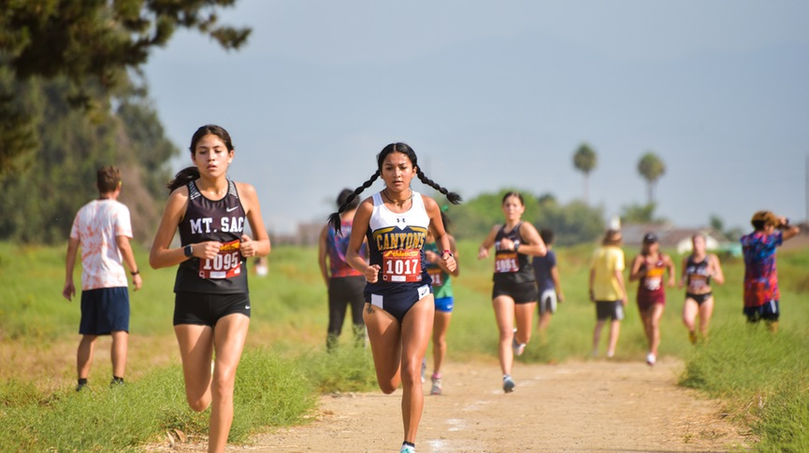
Athletics
Cross Country on the Run
Canyons ran at the Oxnard College Invitational on Sept. 9th, its second meet of the season.
COC’s men’s team finished sixth in the field of eight schools.
Milca Osorio represented the women’s team by placing third in the individual standings. Osorio’s time was 20:05.6.
The Cougars next run at the Golden West Invitational on Friday.

Slide 10
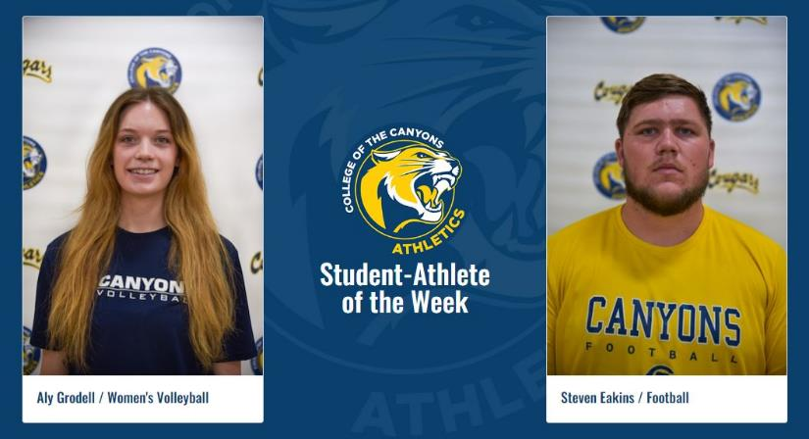
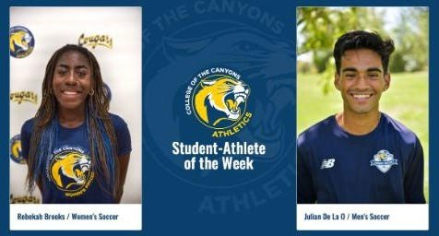
Athletics
Student Athletes of the Week #2
College of the Canyons student-athletes Aly Grodell (women's volleyball) and Steven Eakins (football) have been named the COC Athletic Department's Women's & Men's Student Athletes of the Week for the period running Sept. 5-10th.
Grodell and Eakins are the second set of honorees for the fall 2022 semester.
The first set were Rebekah Brooks (women's soccer) and Julian De La O (men's soccer).

Slide 11


New Trainings for Our Workforce!

Slide 12



New ETP Sub-Contract with Logix Federal Credit Union
The Employee Training Institute launched an ETP Sub-Contract Agreement with Logix to supplement the training they already provide to their employees.
They are the first Credit Union to obtain ETP approval for COC.
15 new hires are participating in over 90 hours of training.
We are now planning additional cohorts to partake in the ETP Sub-Contract.

Slide 13

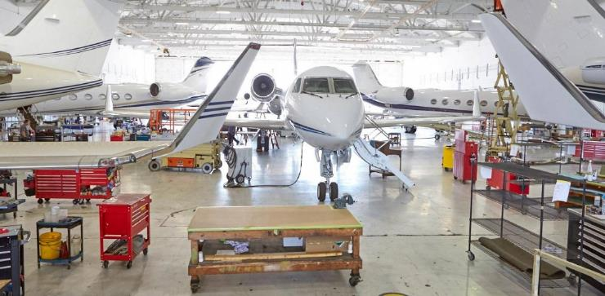
New ETP Sub-Contract: Western Jet Aviation
Western Jet Aviation developed their own Aircraft Maintenance Training program and have partnered with ETI to create an ETP-Sub Contracting Agreement.
The pilot cohort consists of 12 employees taking over 400 hours of training.
200 hours will be covered under ETP and the remaining hours will be covered by Incumbent Worker Training (IWT) funds that the AJCC administers.
We are now planning additional cohorts to partake in the ETP Sub-Contract.

Slide 14
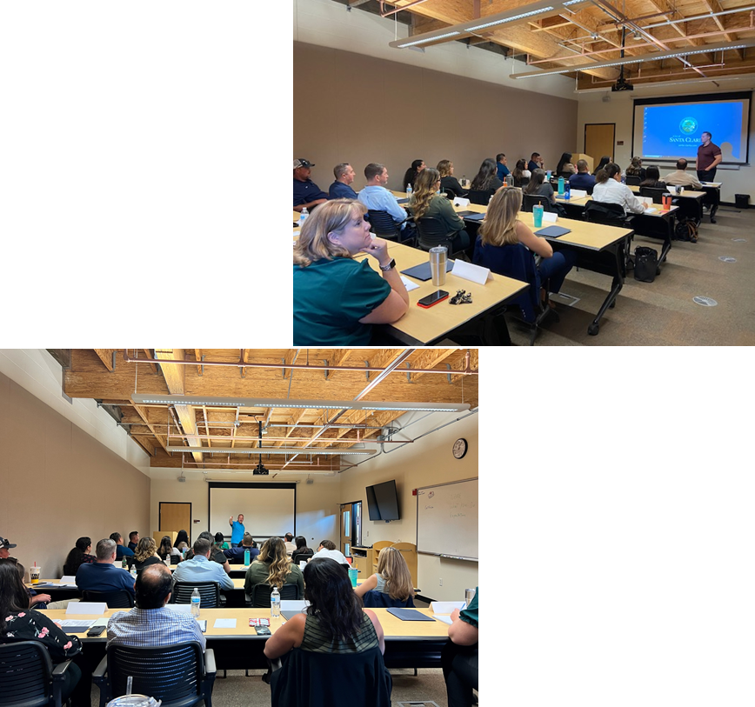
New ETP Training: City of Santa Clarita
ETI Launched a 40 hour Project Leadership & Management training program in partnership with the City of Santa Clarita.
26 City employees are participating in this training program.
This is the first time the City of Santa Clarita has been eligible to use ETP funding.

Slide 15
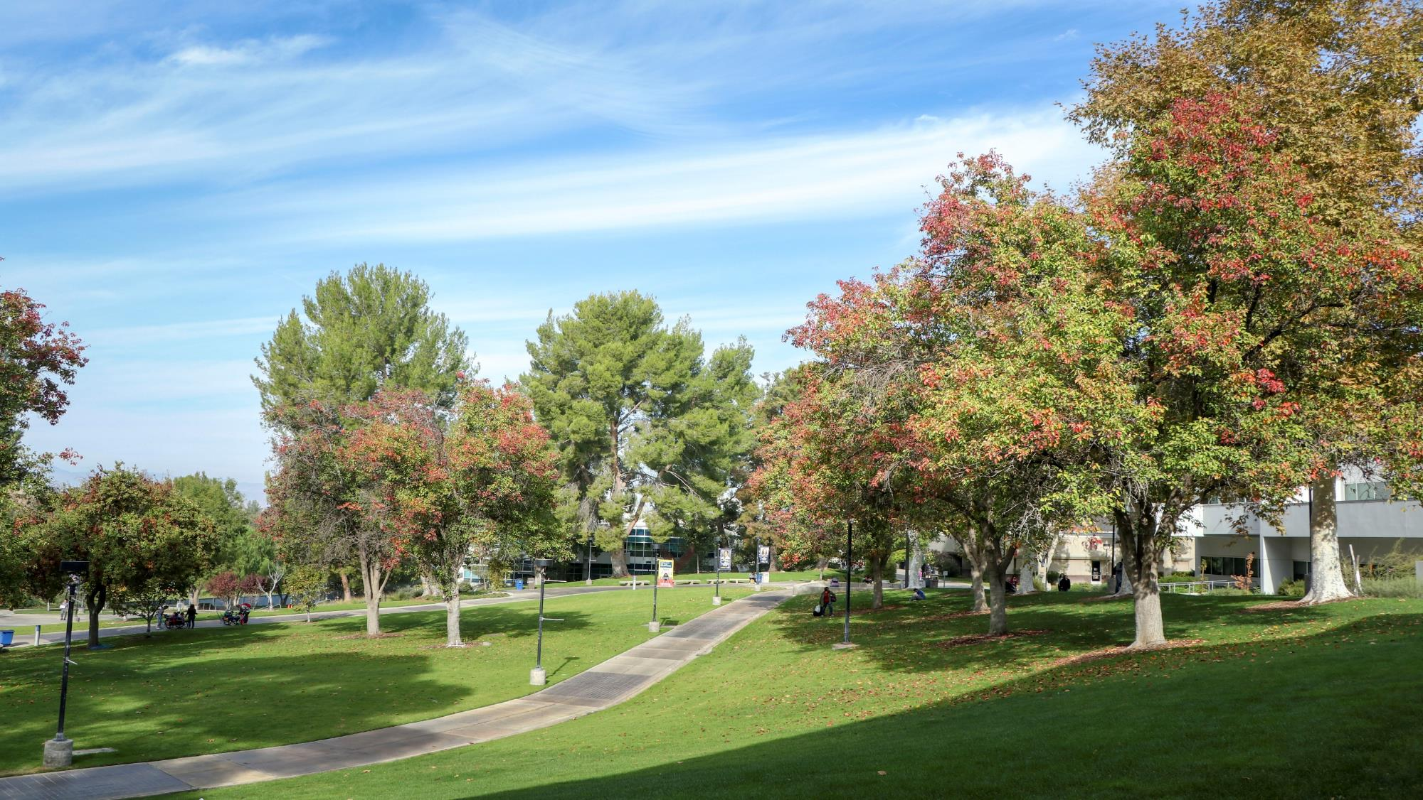
What’s New On And
Around our Campuses

Slide 16

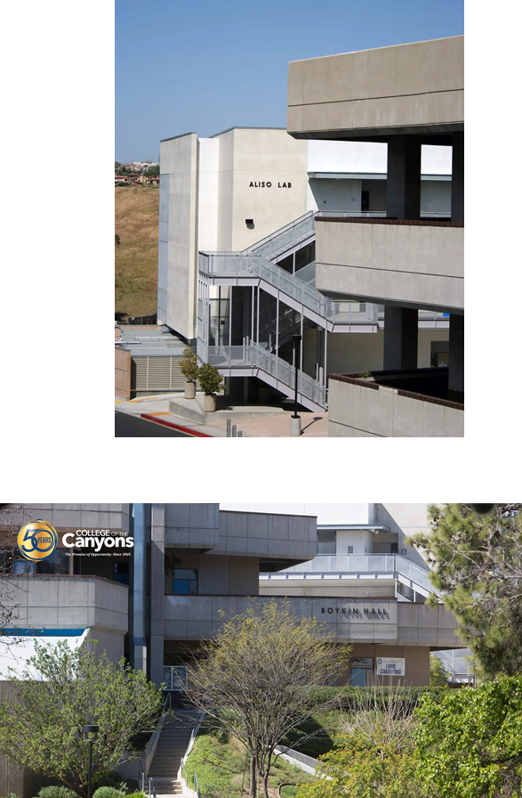


Modernization Project Approved

Slide 17

Accelerated TK Credential Pathway
College of the Canyons' new accelerated Transitional Kindergarten (TK) credential pathway for teachers launched on Monday, July 11th, to address an anticipated increase in demand.
This one-time pathway was created due to a request from the local school districts. The state is implementing Universal Transitional Kindergarten, resulting in a huge increase in demand for TK teachers.
Each of the pathway’s nine courses will be offered in five-week, fully online formats through next spring.

Slide 18

Nuts, Bolts & Thingamajigs
During the week of July 11th – 15th incoming 9th – 12th grade students considering careers in manufacturing participated in the Nuts, Bolts & Thingamajigs Metal Mania II summer camp at the Valencia campus.
Students cut, drilled, shaped, and welded using the Welding Technology Department's state-of-the-art equipment.
The next camp, Metal Mania for Girls II, was held on July 25th – 29th.
For more info about the event, go to: https://www.canyons.edu/academics/communityeducation/careercamps/nuts.php

Slide 19
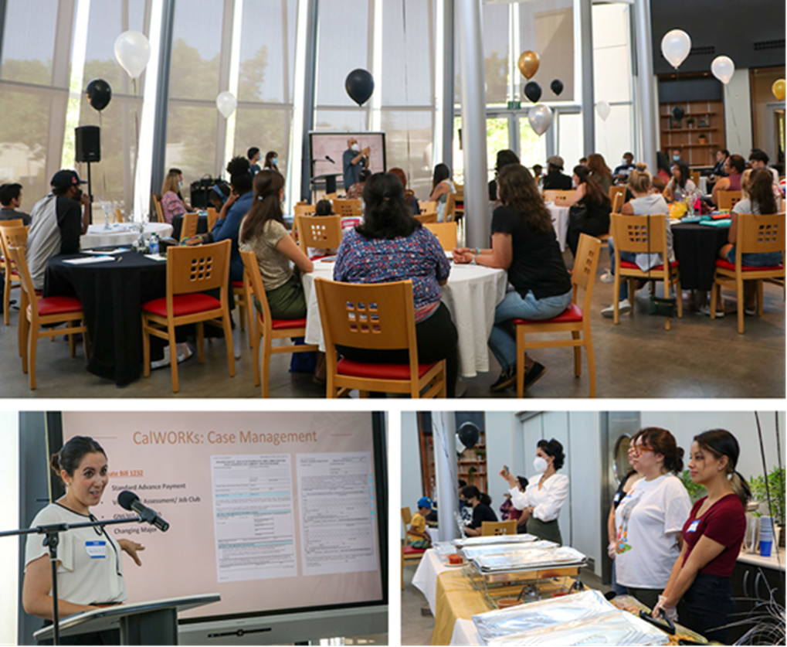
CalWORKS Welcomes Students
CalWORKS held a Lunch & Learn event in the Culinary Arts Cafe on Friday, July 15th to welcome students back to campus.
The event served as an introduction of the CalWORKS team and overview of the program, and included case management updates, counseling information, and department and student presentations.

Slide 20
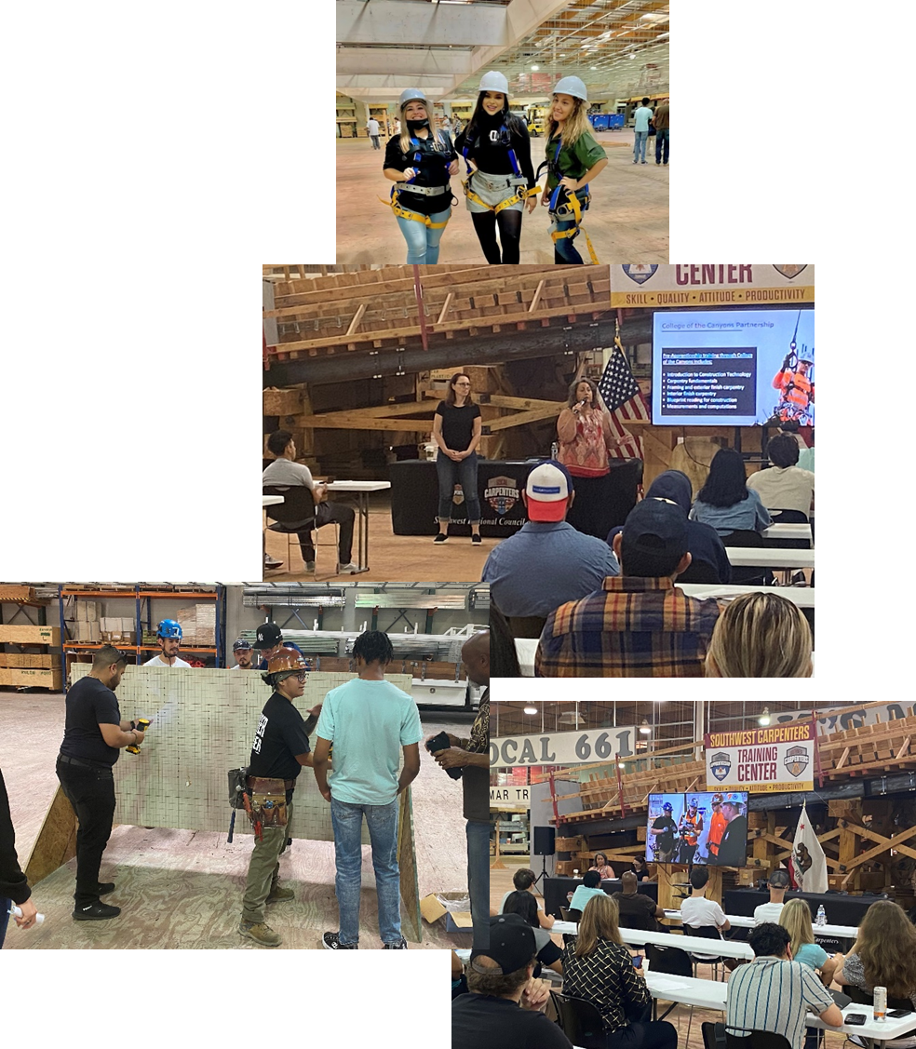
Pre-Apprenticeship Program
COC is partnering with the Southwest Regional Council of Carpenters (SWRCC) to create a pathway to a Registered Apprenticeship program with their union.
On Saturday, July 16th we hosted an “Open House” event at the Carpenters Training Center for the community to learn about the program and had over 70 people attend!
The Pre-Apprenticeship will launch in Fall 2022.

Slide 21
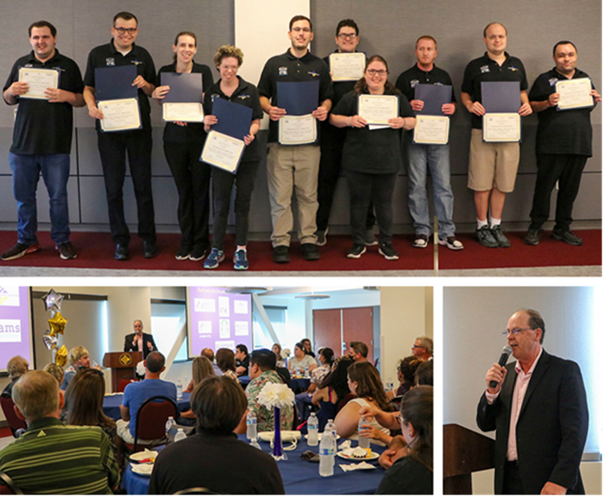
Ready to Work Academy Graduation
10 special needs students from the Ready To Work Academy at College of the Canyons participated in a graduation ceremony held in the Dianne G Van Hook University Center on Wednesday, August 3rd.
The students were honored for completing the 15-week program, and received Certificates of Completion from John Milburn, interim VP of Workforce and Economic Advancement and Camryn Gelfo, program coordinator for Carousel Ranch.
They were also presented with special certificates from Supervisor Kathryn Barger’s office and were congratulated by Supervisor Barger’s Assistant Field Deputy, Natalie Vartanian.
Local business partners who participated in the program included Holiday Inn Express, Starbucks, Bluemark, AMS Fulfillment and the COC Warehouse.

Slide 22
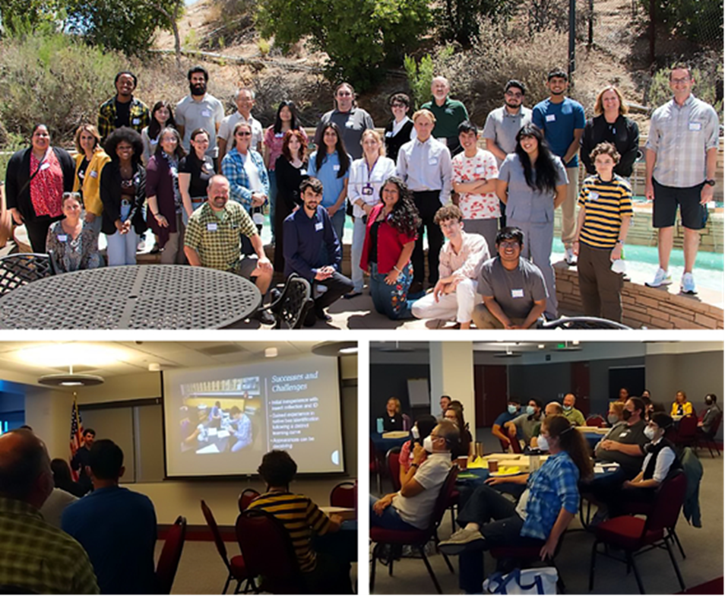
Bee Research Presented
College of the Canyons hosted the final workshop of its Campus as a Living Lab (CALL) initiative on Sunday, Aug. 7th to study native bee biodiversity.
11 faculty members and 23 students from 9 community colleges participated in the daylong program, which included presentations by students and researchers.
Funded by the National Science Foundation, the project was designed to involve underrepresented students in undergraduate research, develop a database of native bees on community college campuses, and develop habitat-enrichment plans to increase native bee biodiversity.

Slide 23

The Canyon Country Campus Celebrates 15 Years!
The start of the Fall 2022 semester brings the milestone of the 15th anniversary of the Canyon Country Campus, which opened in August 2007.
More than 67,000 different students have earned course credit here, befitting the access to higher education envisioned for the campus at its inception.
The first fifteen years have been full of memorable milestones, and the semesters ahead are also full of opportunities to keep these impacts going!
Campus events and activities this academic year will include an ongoing theme of anniversary celebration and engagement, so stay tuned for the latest schedule at www.canyons.edu/canyoncountry

Slide 24
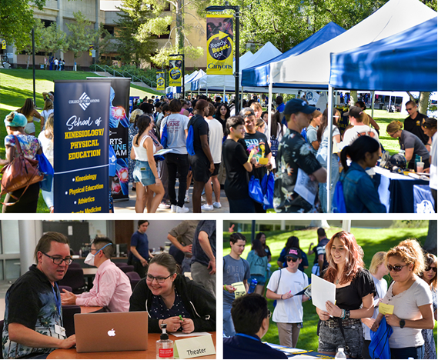
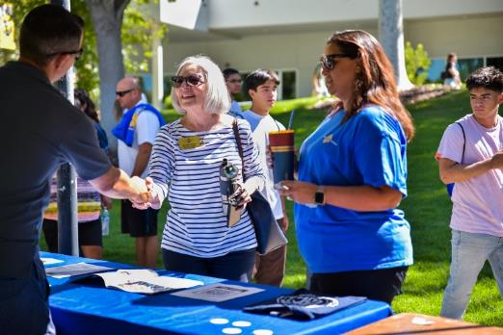
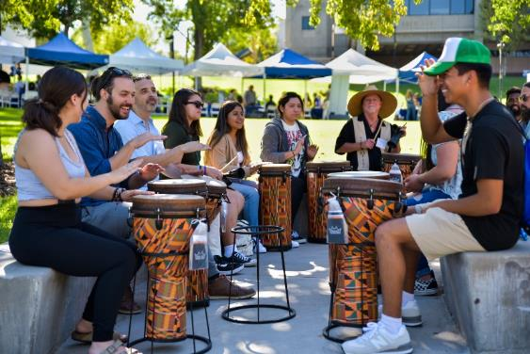
Welcome Day Draws a Great Crowd!
Hundreds of current and future students and their families converged on the Valencia campus Friday, Aug. 12th for Welcome Day, a four-hour event that connected them with campus departments, faculty members, resources, and services.

Slide 25
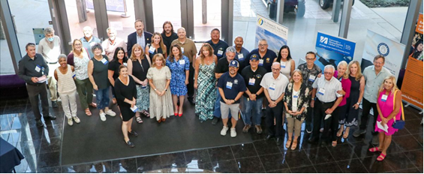
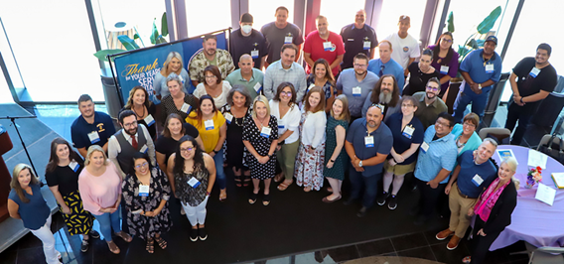
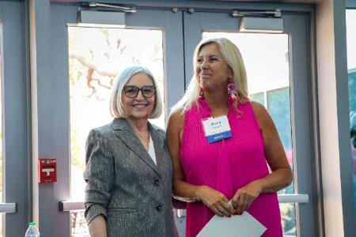
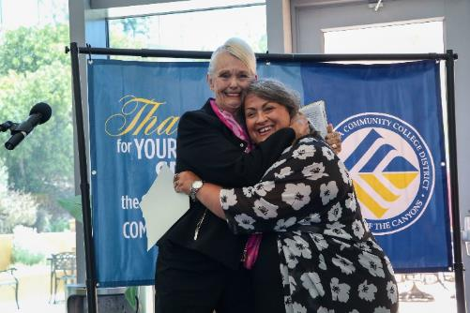
Employees Honored for Service
Employees were honored for their years of service during two luncheon celebrations at the University Center on August 15th and 16th.
Employees celebrating 5 and 10 years of service were honored on Monday, August 15th.
Those marking 15 and more years of service were honored Tuesday, August 16th.
Congratulations to all of our honorees!

Slide 26

Opening Day Festivities
Employees gathered in the Honor Grove Friday, August 19th to kick off the new academic year at the annual Opening Day Celebration. The festivities included:
A hearty breakfast from ISSI;
An encouraging reminder that "Everything is Better When We Stick Together;
Foundation announcements of Mini-grant Awards to faculty; and
An original performance from COC's own Cover Charge band.
Guests stuck around afterwards to join a drum circle led by Professor Bill MacPherson.

Slide 27
A Busy First Week!
With the start of the fall semester on August 22nd, College of the Canyons welcomed students back to the Valencia and Canyon Country campuses in numbers not seen since the onset of the COVID-19 pandemic in spring 2020.
Counseling, TLC, Admissions and Records, and Financial Aid were all bustling with activity again, and faculty, staff and administrators were on hand to help new students navigate the campus.

Slide 28
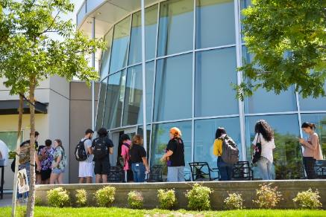
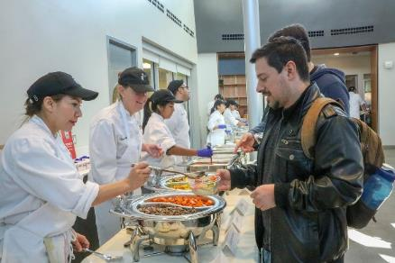
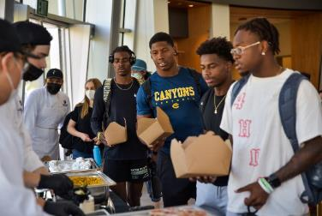
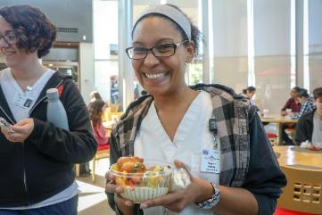

Things Are Heating Up in iCUE
The College of the Canyons Institute for Culinary Education (iCUE) has a number of events lined up throughout the fall semester.
Fuel Up Station
  All students were invited to enjoy a free lunch prepared by iCUE students on Thursday, Aug. 25th at the iCUE.
  Buffet Lunches
  On Sept. 1st the iCUE Cafe once again began offering weekly buffet lunches from 11am to 12:30pm. Reservations are currently being accepted for Sept. 22nd and Oct. 6th. www.canyons.edu/academics/culinary/reservations_page.php
Dinners Coming Soon
  iCUE will be offering dinner service beginning at the end of October.
  Stay tuned for details!

Slide 29

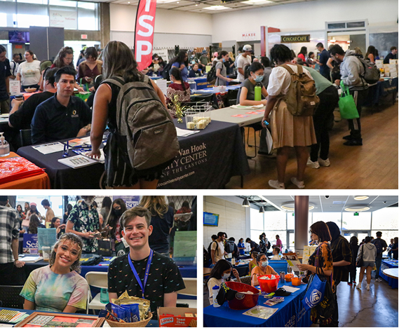
Fall 2022 Cougar Fest
Campus Life and Student Engagement hosted Cougar Fest (formerly Welcome Week) on Monday, Aug. 29th at the Valencia campus and Thursday, Sept. 1st at the Canyon Country campus.
600+ students were connected to our 30+ campus resources and 16 student clubs/alliances between both events.
As we continue to have more students attend classes on campus, they are seeing more of the value in being on campus.
300 Subway boxed lunches and over 200 Regal movie tickets were distributed to participating students at each campus.
A special thanks to our wonderful COC staff who support our students!

Slide 30

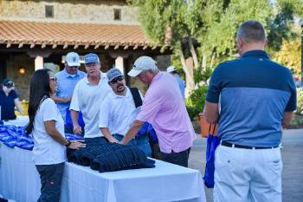




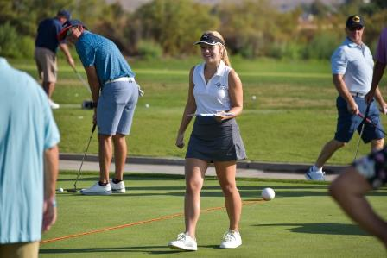
College of the Canyons Foundation Annual Golf Tournament
The College of the Canyons Foundation’s “Swing for Student Success” Golf Tournament took place on August 29th at The Oaks Country Club. The day started with breakfast burritos from Nealie’s Skillet, sponsored by Fred Little Construction. After a long hot day of golf, the players returned for a reception and awards.
Proceeds from this year’s tournament will help support COC student scholarships and other support programs, which provide life-changing opportunities and impact a broad range of individuals.
Funds were raised through a variety of Sponsorship Opportunities, as well as sales of day-of player packages & raffle tickets. The Tournament raised over $60,000 for students!

Slide 31
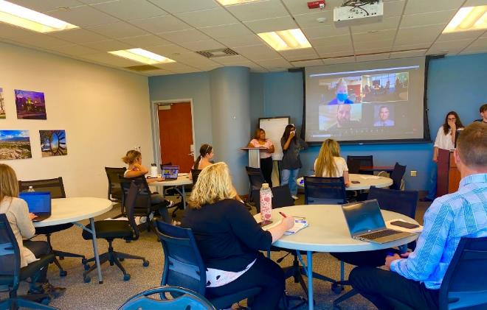
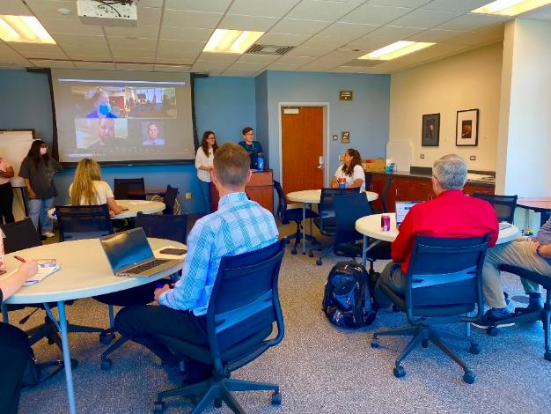
Executive Cabinet and ASG Share Ideas
The Associated Student Government officers and members of Executive Cabinet have regular meetings planned throughout the fall semester to discuss and exchange ideas for enhancing student access, engagement and success.
Discussion during the first meeting focused on creating resources for prospective students that would help them better understand and navigate the enrollment process and learn about programs and services on campus designed to support student success.
In addition, the students shared their suggestions for enhancing outreach and communication with ESL and AB 540 students.

Slide 32

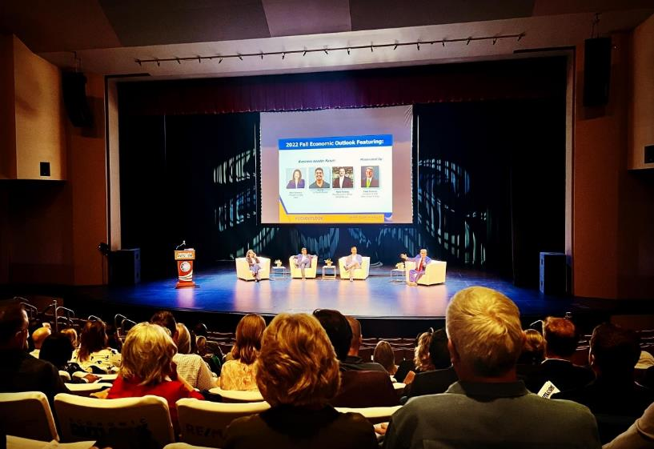



Economic Outlook Hosted in the PAC
This year’s 2022 Economic Outlook for the Santa Clarita Valley was held at the Performing Arts Center on Friday, Sept. 9th.
Business leaders discussed corporate resilience and innovation in the face of unique challenges, and economist Mark Schniepp presented an economic forecast.
More info forthcoming

Slide 33
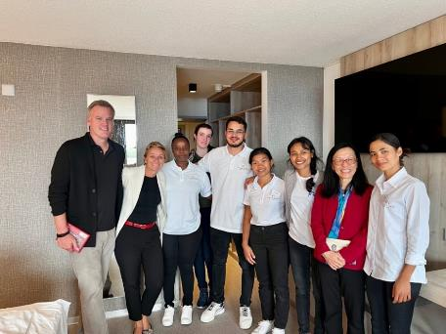
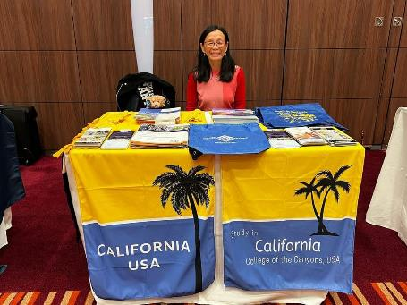
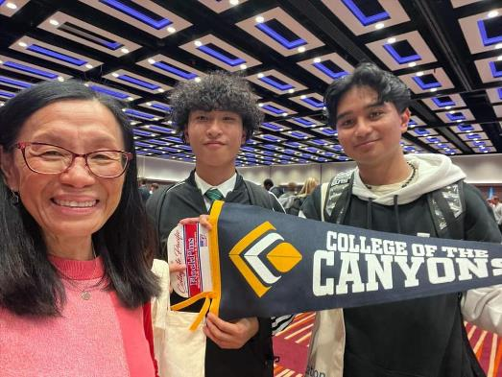
Europe In-Person Meetings Lead to Improved COC Student Mobility Opportunities
Faculty member Brent Riffel is working with ISP to create COC student mobility opportunities. Jia-Yi and Brent are visiting a dozen European institutions interested in partnering with COC for scholarship-based semester abroad and degree transfer opportunities. 2+2 is now also, 2+ Europe!
Last week they successfully inked an agreement for a full-scholarship, iCUE transfer, to Villars Academy, a 5-star resort and school in Switzerland.
It is not all indoors! Brent had 3 hours this week to see some of the sights.
Some of the areas of focus are Nursing, Culinary Arts, Animation, Psychology, and Business.

Slide 34



Slide 35


2022/23 PAC Season on Sale Now
Grab your tickets for the Performing Arts Center's 2022/23 Season. The season officially kicked off with a sold out performance of "Weird Al" Yankovic on September 17th.
This Saturday, October 1st will feature a performance by The Doo Wop Project, and Revisiting Creedence on Nov. 4th, Richard Marx on Jan. 13th, Naturally 7 on Feb. 10th, Jon Secada on April 1st, Perondi’s Stunt Dog Experience on May 21st, and Lisa Loeb on June 3rd.
For a complete listing go to: https://pac.canyons.edu/shows/.

Slide 36

Save the Date: EMT Celebration
Mark your calendar for Thursday, Sept. 29th to celebrate the Emergency Medical Technician Program’s 50th Anniversary.
The Celebration is planned 9am to 10:30am at the outdoor plaza near the College of the Canyon’s Institute for Culinary Education.
The event will feature breakfast catered by the College of the Canyons Institute for Culinary Education, teaching demonstrations, and information about career paths into hospital emergency rooms, ambulance training, and other careers.

Slide 37
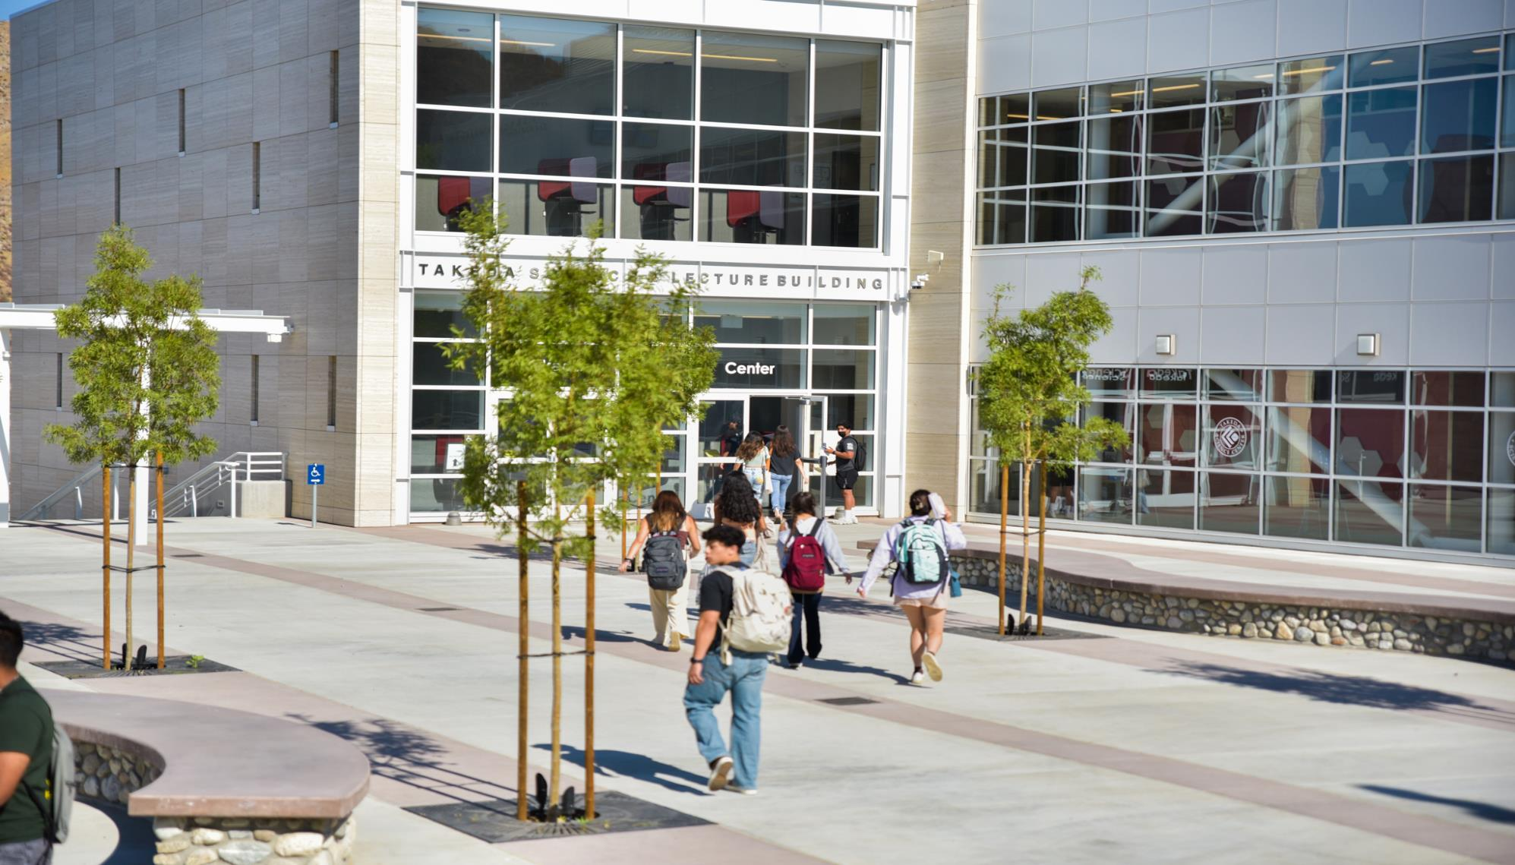
Enjoy the Fall Semester!

