Slide 1
New Adjunct Faculty Orientation to
Online Education at College of the Canyons
Online Education Department
online@canyons.edu

Slide 2
Learning Outcome
By the end of this presentation, you will be able to explain the different class Distance Education (DE) formats at College of the Canyons.
College of the Canyons Faculty Orientation
2

Slide 3
Distance Education Programs offered at College of the Canyons
Online Classes
Hybrid Classes
OnlineLIVE Classes
HyFlex Classes
Web-Enhanced Classes (formally, not DE)

Slide 4
Online Classes
Students enrolled in an online class are able to complete all coursework and activities online without needing to physically attend a class (in-person or via Zoom)
Instructors of online classes utilize the Canvas LMS and online tools to combine course design strategies and online pedagogy to support learners.
Instructors initiate regular and substantive interaction with students.
College of the Canyons Instructors must be ‘Online & Hybrid Instructor Certified’ to teach an online course.

Slide 5
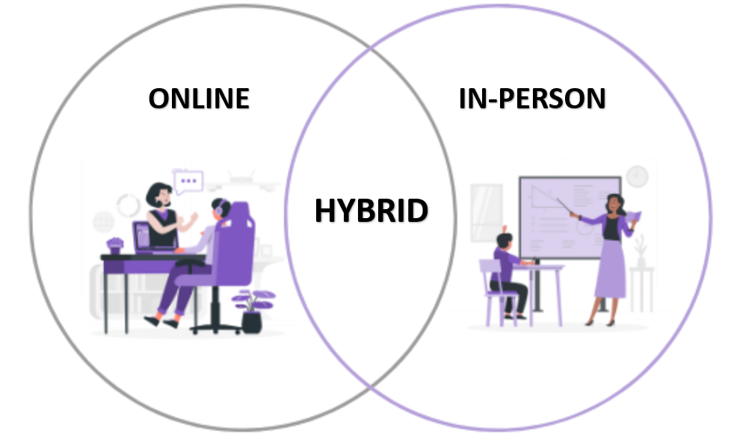
Hybrid Classes
In a hybrid class, instructional time is conducted partially online and partially in-person.
Hybrid classes combine the learning formats of online and on-campus classes. Hybrid classes have defined on-campus meetings as well as coursework to be completed independently online.
Instructors initiate regular and substantive interaction with students.
College of the Canyons Instructors must be ‘Online & Hybrid Instructor Certified’ to teach a hybrid course.

Slide 6
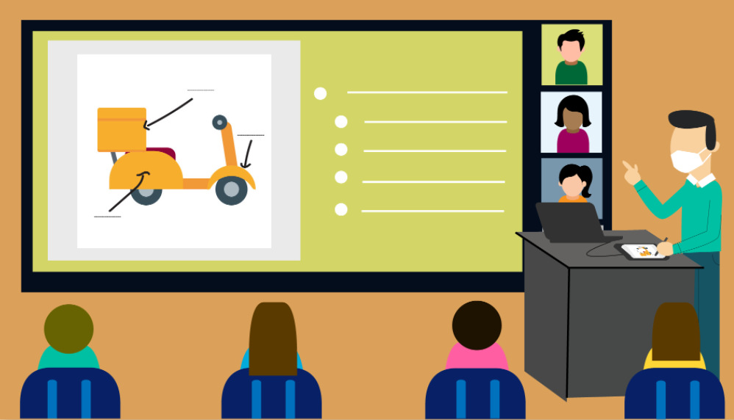
HyFlex Classes
In a HyFlex class, instructional time is conducted in a physical classroom, which students are able to join either in-person or via Zoom.
Instructors provide regular, weekly instruction on a physical campus in a classroom that can accommodate the entire capacity of enrollment. Students may choose to attend each class either in-person or via remote synchronous technology.
College of the Canyons Instructors must be ‘HyFlex Certified’ to teach a HyFlex course.

Slide 7
OnlineLIVE Classes
OnlineLIVE is a distance education modality in which students and the instructor meet synchronously online (via Zoom) during scheduled class times.
Students enrolled in an OnlineLIVE class are able to complete all coursework and activities online without needing to physically attend a class.
Instructors initiate regular and substantive interaction with students
College of the Canyons Instructors must be ‘OnlineLIVE Certified’ to teach an OnlineLIVE course.

Slide 8
Web-Enhanced Classes
Web-Enhanced classes are those in which an instructor teaching a face-to-face course utilizes the Canvas LMS to provide students with online course materials, textbooks, and/or resources to communicate with students.
College of the Canyons Instructors must be ‘Canvas Certified’ to web enhance a face-to-face class.

Slide 9
Online Growth Trends at COC
100% Online sections represented 3% of all sections in Fall 2006 and grew to represent 21% of all sections in Fall 2019
Online and Hybrid sections represented 26.5% of enrollments in Fall 2019

Slide 10
Online Enrollment Trends at COC
100% Online Student Enrollments Fall 2006-Fall 2020
Growth in Student Enrollments (duplicated)

Slide 11
Online Student Success Rates at COC - Disaggregated
Success rates for students in each group are steadily increasing!

Slide 12
Online Student Success Rates at COC - Disaggregated
Success rates for students in each group are steadily increasing!

Slide 13
Online Student Retention Rates at COC - Disaggregated

Slide 14
DE Instructor Certifications
Prior to teaching online, hybrid, OnlineLIVE, or web-enhancing with Canvas, College of the Canyons instructors must complete training specific to the teaching format.
Canvas Certification
Required to web-enhance a face-to-face course with Canvas
Complete Intro to Teaching with Canvas self-paced, 5 hour course with Section 508 Accessibility component.
OnlineLIVE Instructor Certification
Required to teach OnlineLIVE courses
Complete Intro to Teaching with Canvas, plus Online, 2-week, 9 hour, Intro to OnlineLIVE Teaching & Learning course
HyFlex Instructor Certification
Required to teach HyFlex courses
Complete Intro to Teaching with Canvas, plus Online, 2-week, 9 hour, Intro to OnlineLIVE Teaching & Learning course, and HyFlex Tech Training
Online/Hybrid Instructor Certification
Required to teach Online and Hybrid courses
Complete Intro to Teaching with Canvas, plus Online, 5-week, 36 hour, Introduction to Online Instruction (IOI) course
Renew every 3 years with 2-hour self-paced ‘refresher’ course.
Visit www.canyons.edu/teachonline for more information on these trainings and how to enroll.

Slide 15
The Benefits of Online Learning to Our Students and Community
Convenience and flexibility
Flexible schedule/ease of access: Students can access the course at any time, so they can continue to fulfill work, family and other commitments!
Control of study time: Unlike more static, face-to-face meeting formats, students can choose how long to devote to coursework in a single sitting.

Slide 16
Benefits of Online Learning (continued)
Student enrichment
Time to absorb material: Due to the more flexible schedule of online classes, students can take more time to review or revisit presented material, etc.
Online communication: Some students may be more inclined to approach an instructor in an online setting rather than speaking in front of classmates.
Interaction Opportunities: Some students may feel more comfortable interacting in the online space than they would in a face-to-face class. Students may have more time to think about a response, which can increase interaction as well.

Slide 17
Benefits of Online Learning (continued)
Cost-effectiveness
Transportation costs
Child care
Parking passes
Open Educational Resources (including textbooks)

Slide 18
Online Education Services and Support
Instructional design
Orientation letters
Online/OnlineLIVE Instructor Certification
Course templates
Accessibility and course design guides
DECT Captioning Grant
Open Educational Resources (OER) for Zero Textbook Cost (ZTC)
Workshops
Canvas Open Labs
One-on-one online instruction & Canvas support
Online course design
Student engagement strategies
Canvas training (for online or face-to-face instructors)
Visit www.canyons.edu/facultysupport for more information

Slide 19
Instructor Orientation Letters
Instructors teaching Distance Education classes must submit an orientation letter to Online Education’s Orientation Letter Form prior to the start of the term, for each course they teach.
When students browse the schedule of classes or register for a Distance Learning course, they are directed read their Instructor's Orientation Letter.
Instructors teaching Distance Education classes must have an orientation letter posted on the Online Education’s Orientation Letter Form prior to the start of the term, for each course they teach.
Orientation Letters help students to understand course requirements, plan their schedules around any mandatory class sessions, and anticipate time commitments and technology needed in your course.
How to Post a New Letter:
Visit your My Orientation Letter Portal (in MyCanyons - Log-in with your CanyonsID).
Click on the ‘Orientation Letter Submission Form’.
Fill out the fields on the Orientation Letter form. Then click ‘Save’.
How to Edit an Existing Letter
Visit your My Orientation Letter Portal (Log-in using your CanyonsID).
Click on the letter's Edit Link to open your letter.
Make your changes, then click Save.
To learn more, please visit Online Education’s Instructor Guide to Orientation Letters.

Slide 20
Questions?
Contact us at online@canyons.edu And visit our website: www.canyons.edu/online

