Slide 1
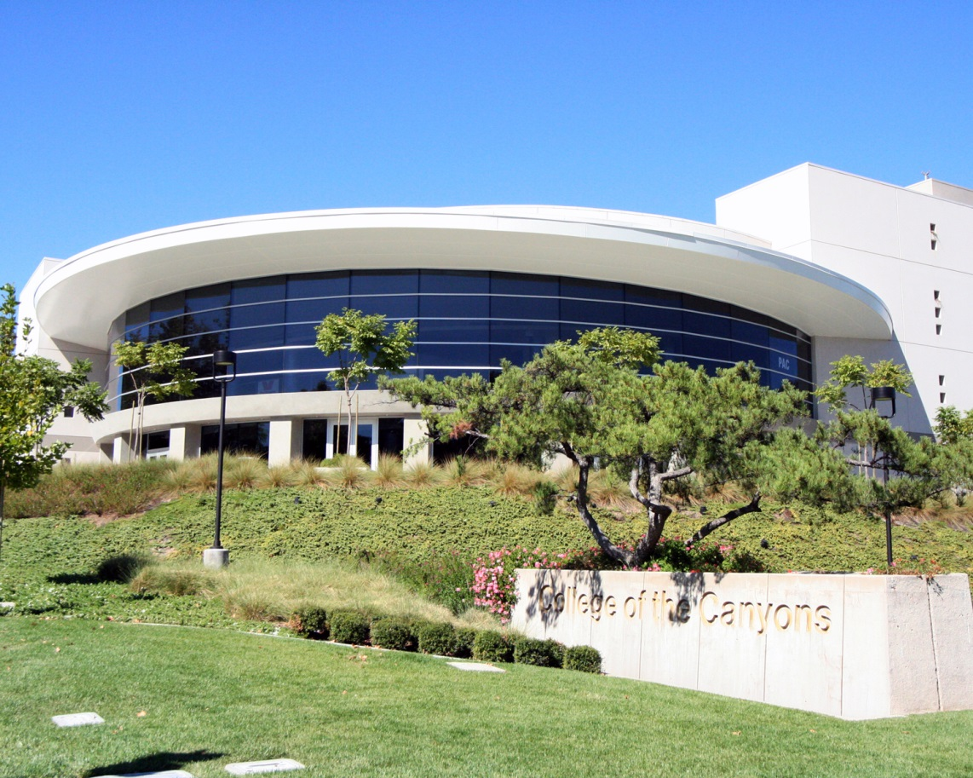
New Adjunct Faculty Orientation: Introduction to Instruction
August 2022

Slide 2
Instruction Office
Dr. Omar Torres………………………Assistant Superintendent/Vice President, Instruction
Jeff Gregor….………………………...Interim Associate Vice President, Instruction
Instructional Dean | Unit
Nadia Cotti | School of Applied Technologies
Nadia Cotti | School of Business
Dianne Avery | School of Personal and Professional Learning
Andy McCutcheon | School of Humanities
Andy McCutcheon | School of Social & Behavioral Sciences
Dr. Kathy Bakhit | School of Health Professions & Public Safety
Steve Ruys | School of Math, Science, & Engineering
Steve Ruys | School of Kinesiology & Athletics
Dr. Jennifer Smolos | School of Visual & Performing Arts
James Glapa-Grossklag Mojdeh Mahn (Associate Dean) | Learning Resources

Slide 3
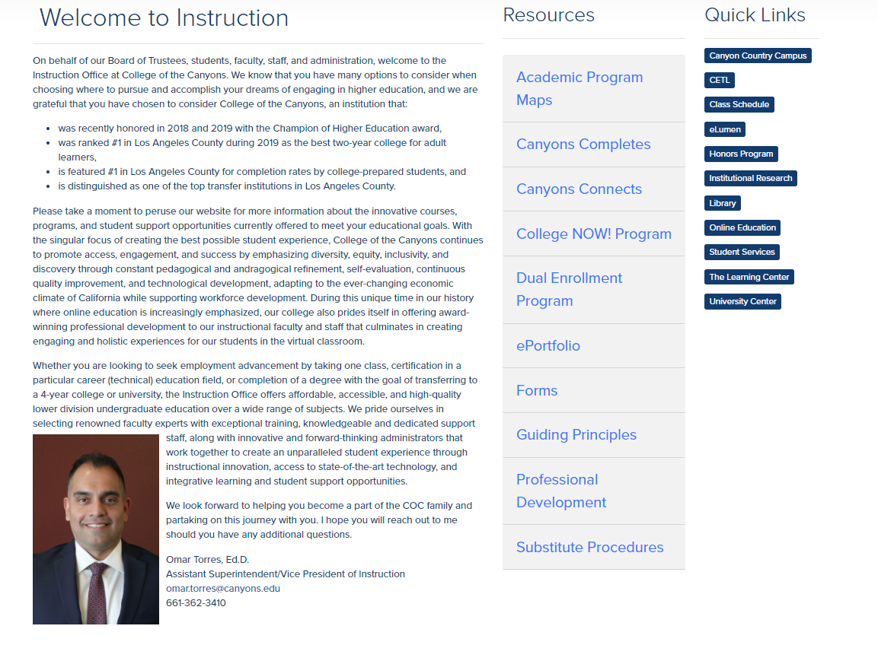
Instruction Website
CLICK HERE FOR WEBSITE

Slide 4
Introduction to Campus
Classroom Keys Available from the Administrative Assistant for your School (Humanities, Applied Tech, etc.) or CCC Quad 5 Switchboard (Canyon Country).
Parking Permit Campus Safety X8 (Valencia) or Quad 7 Room 700A (Canyon Country) Email
Account already set up once hired; contact Dean or Admin. Assistant. Security or Emergency Dial “7” from any Valencia campus phone or “6” from any CCC campus phone
Off campus or external: 661- 362-3229 then 7, 6

Slide 5
Introduction to Campus
Mailbox Will be issued either at Valencia Communication Center (switchboard) or CCC Communication Center (switchboard), depending on primary teaching assignment location IT Help Desk Dial extension 3953 (Valencia) or extension 3533 (CCC)
Zoom: https://intranet.canyons.edu/departments/it/ - You’ll need to login to the intranet to access support.
Notes:
Yes, we will be returning 8 am to 9pm M-Th, 5:30 Friday, and 3:30 on Sat at Valencia; M-Th until 7:30, 5:30pm Friday at CCC (First week of class CCC will be open until 9pm M-Th)”

Slide 6
Evening Support Services
Evening Administrator Dial Switchboard at either campus Valencia: Dial “7” CCC: Dial “6” Campus SAFETY Valencia: Dial “7” CCC: Dial “6” Facilities Maintenance During regular hours, Facilities Maintenance should be reported to your Dean, who can place a Work Order. During the evenings, you can also dial the following if immediate assistance is required Valencia: Dial “7” CCC: Dial “6”

Slide 7
Teaching And Learning
Click here for “COR”
Course Outline of Record (COR) Available from http://canyons.elumenapp.com/public/ Student Learning Outcomes Available on the COR, must appear on your syllabus (an Accreditation requirement) and will be assessed based on department assessment schedule Length of Classes and Final Exams No formal Final Exams Week at College of the Canyons; finals are given during the last class period of the semester or term, and classes should meet for the entire duration each meeting Grading and Incompletes Refer to the COR for Methods of Evaluation for your course. Incompletes should only be assigned at the end of the semester or term for emergency purposes if the student is passing the course. Attendance versus Participation Students can be dropped from a course if they miss class for one more time than the class meets for one week (regular semester). Otherwise, attendance should not be used to determine a student’s grade, only participation.

Slide 8
Office Hours (credit faculty)
CLICK HERE FOR AFT CONTRACT
On-Campus Units per week | Number of Scheduled Office Hours (minutes) | Number of Unscheduled Office Hours (minutes) | Total Office Hours per Week (minutes)
3 | 30 | 30 | 60
4 | 40 | 40 | 80
5 | 50 | 50 | 100
6 | 60 | 60 | 120
7 | 70 | 70 | 140
SEE PAGES 40-41 of the AFT CONTRACT

Slide 9
Online Education Services and Support
Instructional design
Orientation letters
Online/OnlineLIVE Instructor Certification
Course templates
Accessibility and course design guides
DECT Captioning Grant
Open Educational Resources (OER) for Zero Textbook Cost (ZTC)
Workshops
Canvas Open Labs
One-on-one online instruction & Canvas support
Online course design
Student engagement strategies
Canvas training (for online or face-to-face instructors)
Visit www.canyons.edu/facultysupport for more information

Slide 10
Instructional Resources
Reprographics Submitted online via Repro@canyons.edu (Valencia) or cccrepro@canyons.edu (CCC); can also be submitted in person (BONH-125) in Valencia or (CCC-502A) at CCC. Textbooks Contact your department chair or full-time lead discipline faculty member for copies of the textbook. Alternatively, books can also be ordered from the Publisher. The Campus Bookstore can no longer lend textbooks to faculty. Printing Faculty can print in the Adjunct office (BONH-312) in Valencia; on the Canyon Country Campus, please go to either CCC-205 or CCC-507. Absences Notify the administrative assistant for your School and Dean both electronically and via telephone. It is helpful if you also contact your department chair and dean, as a substitute may be arranged if you are absent for more than one class period at the dean’s discretion. Before 9am or after 5pm or weekends, please also communicate with the Communication Center (switchboard) , Dean, administrative assistant and department chair.

Slide 11
"Canyons Connects"
​
https://www.canyons.edu/studentservices/connects/index.php
Canyons Connects (Powered by Starfish) is a student support program intended to improve student retention and success.
The program allows for an instantaneous referral to help connect a student to support they need to succeed in your course.
The software connects instructors, students, and campus services together under one umbrella.
At any time in the course, instructors can "raise flags" to encourage students to seek academic assistance from the instructor or from the TLC, Counseling, or other services on campus.
Instructors can send "KUDOS" (praise) to students to recognize their good work.
For full-term courses like most dual enrollment classes, faculty will also receive requests to complete PROGRESS SURVEYS on their students within the first few weeks, prior to the midterm point, and before the withdrawal date for the course.
Notes:
Paul

Slide 12
Evaluations
CLICK HERE FOR AFT CONTRACT
Frequency New credit and noncredit faculty are evaluated during the first semester and thereafter at least once every 4 semesters of employment Evaluator For credit faculty, designated by the department chair; for noncredit faculty, a full-time faculty member in the related credit department or appropriate educational administrator, assigned by the Dean OF SCHOOL FOR PERSONAL AND PROFESSIONAL LEARNING (or designed) Components of Evaluation For both credit and noncredit faculty: student evaluation, evaluation report, and self-reflection; professionalism report is optional Conference Both credit and noncredit faculty may submit a written, signed response regarding any component of the evaluation to the division dean within ten (10) calendar days after the Evaluation Conference
Notes:
See ARTICLE 8
and Appendix B
of the AFT Contract

Slide 13
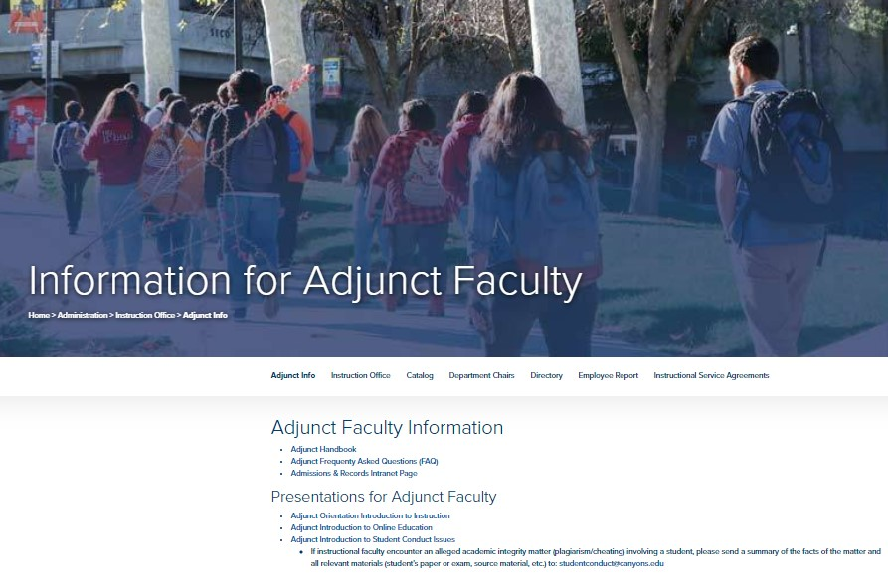
QUESTIONS?
CLICK FOR WEBSITE

