Slide 1
How to Create surveys, and ensure Data Security?
August 14th, 2023
Fall FLEX
Presenters:
Daylene Meuschke, Preeta Saxena, & Hsiawen Hull
Infrastructure and Information Security
&
Institutional Research, Planning & Institutional Effectiveness (IRPIE)
Notes:
Daylene

Slide 2
Description If you are someone who has to track, or collect, information from students as part of your courses and/or programs, this session will provide an overview of the existing tools and resources that are 'low risk' and District approved. As a bonus, we will share an overview of tips for designing surveys to yield intended results.
Workshop Learning Outcome(s) Participants will be trained on existing 'form' tools that are available to all district employees and will learn how to assess when to use which tool, and how to ask questions on those tools.
Notes:
Tools available…
Daylene

Slide 3
Types of Data Collection
Join Bowling League?
Classified Luncheon- Food Satisfaction
In- class surveys (data security, IRB implications)
Research/Assessment
District/Institutional Implications
When in doubt contact IRPIE.
Examples
Notes:
Daylene

Slide 4
Survey/Form 101 Tips
The Who
Students (sub population)
Department Faculty
Committee Members
How will the contact information be obtained and used in data collection
The Why
Identify
Purpose, including decisions survey results will inform
Scope
Implications
Class project
Elections/Voting
Notes:
Preeta
*Anonymous can still collect and provide identifying information in ‘open’ ended responses
Scope- will the results be shared, how/why?

Slide 5
Survey/Form 101 Tips, Cont'd
The What (who/why)
Questions
Sensitive topics, providing resources to address risks)
Never ask SSN/Home Address
Consider the cognitive load of your respondents, limit to no more than 10 questions when possible.
Question Wording:
Research the topic to know response options (e.g. Gender Identity)
Pre-test the question items
Avoid…
Double barreled questions -asking two questions at the same time (e.g. “Do you believe there are a variety of course offerings within your major and the times they are offered meet your needs?”) Yes/No.
Leading and Biased questions e.g. “How much do you think enrollment should be capped at College of the Canyons?”.
Negative wording (e.g. “What factors would make you decide not to attend COC?”).
Ambiguous terminology
Notes:
Preeta
Informed by the Who, and the Why?
Exhaustive list of response alternatives
If selecting only on, make sure they are mutually exclusive.
eliminate the really egregious errors. But your survey questionnaire will never be 100% clean. ---Iterative process…pre-test

Slide 6
When to involve IRPIE?
When is IR involved?
Number of intended responses, number of questions
Tied to a larger institutional decision
Part of accreditation
Grant evaluations
Pool of Respondents involves institutional data
IF IR is administering on your behalf…
Will coordinate with other scheduled surveys
Will need around 2 weeks for programming*, reviewing question wording and testing before launch
*this can be longer depending on existing office workload and surveys already in the queue
Notes:
Preeta

Slide 7
Using non-district-owned tools/platforms to collect data that involves personally identifying information (PII)* is a threat to information security. *Personally Identifying Information (PII) includes Name, Address, Phone Numbers, IDs, SSNs, Personal Emails
Warning
Notes:
Hsiawen

Slide 8
Information Security
Collector has the Liability of…
Protecting the Respondents’ Information
Protecting the Collector’s process and protocols
Protecting the District from data security incidents
Notes:
Hsiawen

Slide 9
How to choose the right form tool?
Purpose of the form/ data collected
Content of the questions
Asking any personally identifying information (PII)? Or information that can be used to identify PII (e.g. Facebook Polls).
Technical features
Do you need folks to attach documents?
Notes:
Hsiawen
What questions to ask to determine what tool to use?

Slide 10
Available District-Supported Form Tools
CANVAS QUIZZES/SURVEYS
DRUPAL
OU/OMNI CMS
MICROSOFT FORMS
SURVEY MONKEY*
GOOGLE FORMS**
After keeping in mind Best practices/Tips, decide on the tool
*Not District supported for personal SurveyMonkey accounts, only District paid accounts are supported.
**Google Forms are not District supported.
Notes:
@Hsiawen

Slide 11
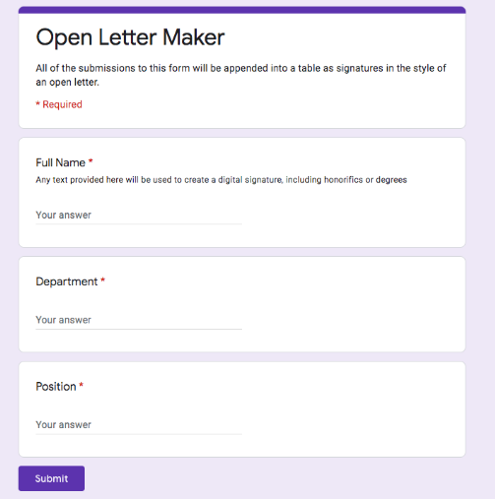
GOOGLE FORMS- See Microsoft Forms
WHERE TO FIND IT?- Don’t ☺
Not recommended
Notes:
Preeta/Daylene
IRPIE’s journey----discouraged from using Google Forms---transitioned to OU---now exploring MS Forms will enable attachments and to integrate into Teams

Slide 12
SURVEY MONKEY
WHERE TO FIND IT?
Contact IRPIE institutionalresearch@canyons.edu www.surveymonkey.com
Free individual account (non IRPIE)- Not Recommended for District related data
Limited number of intended responses, number of questions
Notes:
Preeta

Slide 13
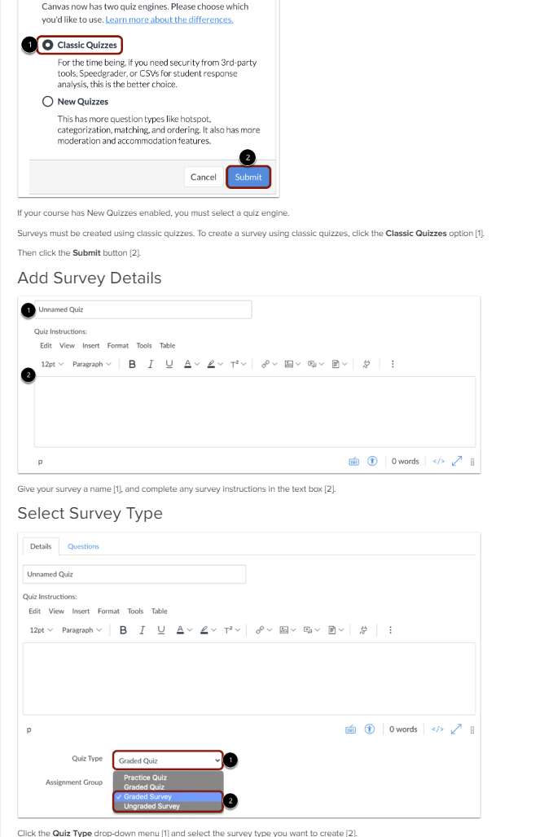
CANVAS
Using Classic Quizzes to create Surveys
Method of Administration and Tool for creating a survey
Notes:
Preeta

Slide 14
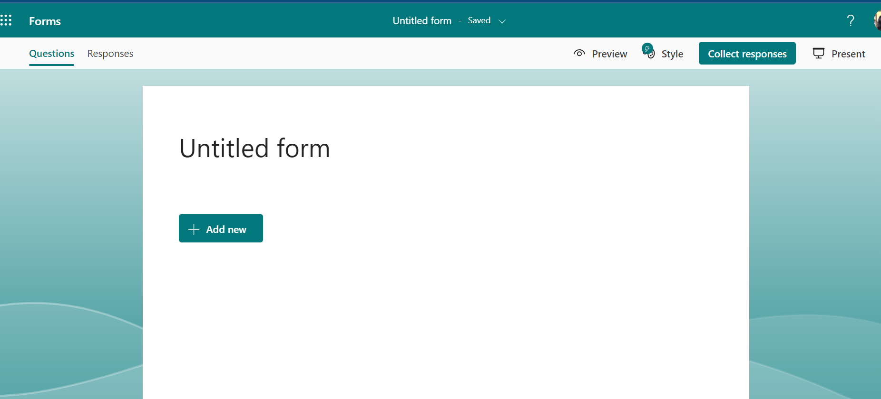
MICROSOFT FORMS
WHERE TO FIND IT: forms.microsoft.com
Use for internal informal forms.
Allows for district control over the data in case there is a need to
for low level PII/PHI…-low risk, can include names/contact info. but should not include highly protected PII (i.e. SSNs, home addresses etc.) ---use this in place of Google forms
Not accessible and may not be best for public use (don’t post on website)
Using Microsoft Forms to Create Surveys and Polls
Notes:
Hsiawen

Slide 15
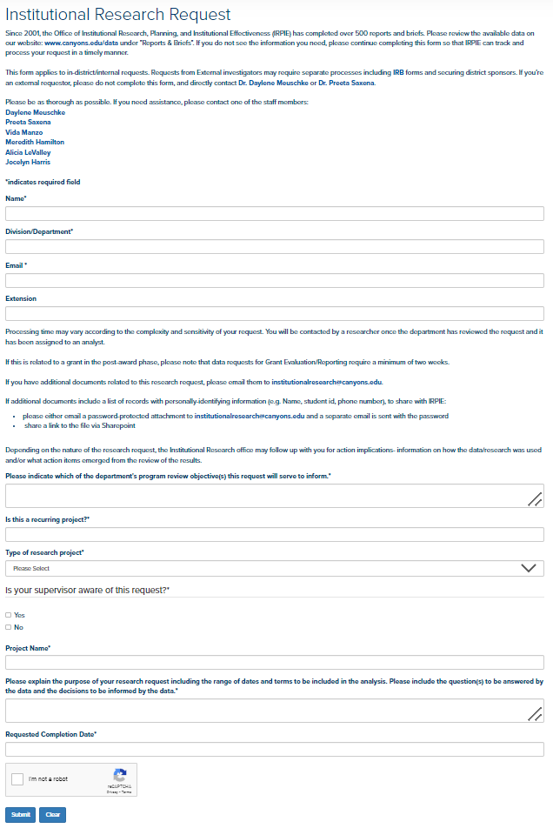
OU/OMNI CMS CAMPUS
For Simple forms
Cannot attach files
WHERE TO FIND IT?
Direct to Stephen Burns, Stephen.burns@canyons.edu if there is no content manager-someone who is familiar with OU Campus (webpage design) in your department
Notes:
Hsiawen

Slide 16
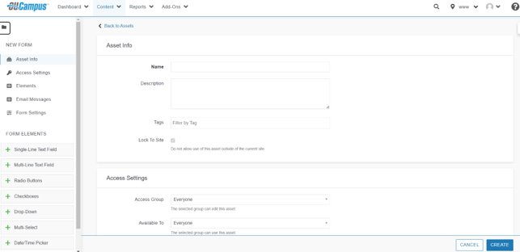
DRUPAL
WHERE TO FIND IT? Contact: Stephen Burns Stephen.burns@canyons.edu
For complex forms (various Question Types)
District Sensitive Information, (e.g. can include SSN)
PII/PHI
Allows attachments
Commonly used for Elections (CSEA etc.)
Can be customized for shared data.
Notes:
Hsiawen

Slide 17
Helpful Reminders from Today's Session
Determine if a survey is needed. If yes, then
Select appropriate District-supported tool. If you're unsure, contact IRPIE or Stephen Burns.
Ensure purpose statement is included in the introduction of the survey
Ensure alignment of questions with the purpose of the survey (i.e., decisions being made from the results)
Identify the target population/audience
If sensitive questions are being asked, consult IRPIE for data collection and Institutional Review Board (IRB) implications
To the extent possible avoid asking personally identifying information
Ensure results/data are stored in a secure manner
Consult IRPIE if you are unsure if this is a survey that can be done without their involvement
IRPIE is available to consult on survey item development and reviewing draft surveys even when they are not deploying the survey
Notes:
Daylene

Slide 18
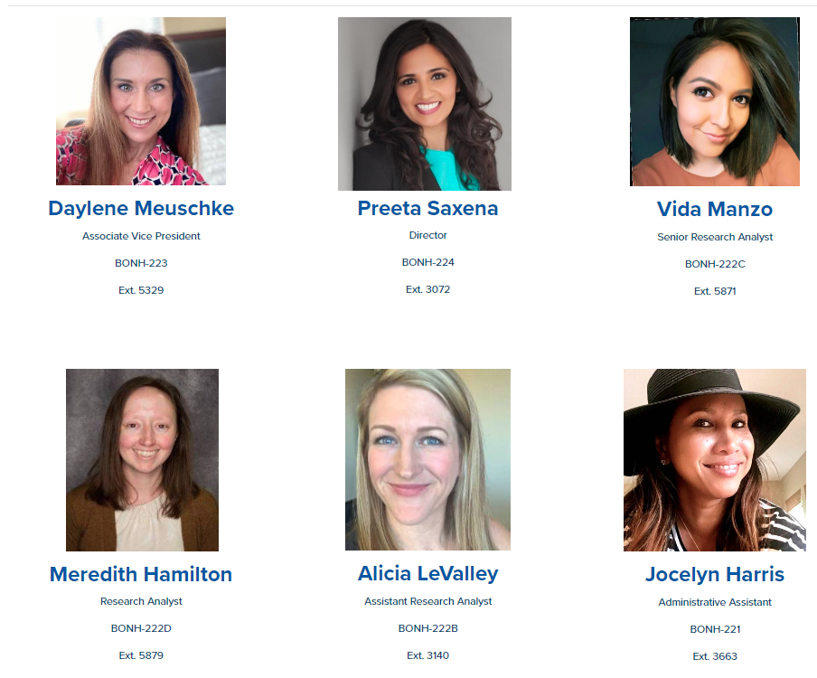
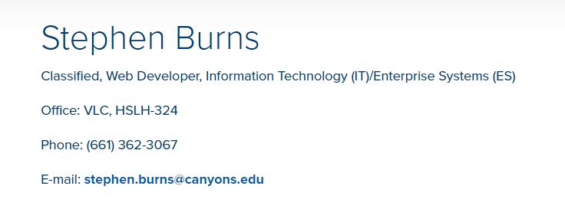
Phone/Email or Zoom an IRPIE friend or IIS friend (Infrastructure and Information Security)
Notes:
Daylene

