Slide 1
SELF-CARE & AVOID BURNOUT
Doris Marie Zimmer
COC Virtual Women’s Conference
25-27 March 2021

Slide 2
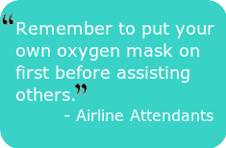

Slide 3
The PROBLEM
With putting others FIRST…
I TEACH them that I will always come SECOND
I create my reality

Slide 4
EMPOWERED WOMEN EMPOWER WOMEN
Promote:
SELF-WORTH
MAKE CHOICES & CONTROL their DESTINY
INFLUENCE SOCIAL CHANGE to benefit themselves and others
COMPETE for EDUCATION, EMPLOYMENT, SERVICES, GROUPS, SELF-ACTUALIZATION and HOLD positions of INFLUENCE
EMPOWERMENT DRIVES: Self-Care attitudes, dreams, behaviors, disciplines and practices. Our entire life.

Slide 5
I FLY IN A LIMITLESS LIFE… I AM

Slide 6
EMPOWERED WOMEN:
TIME for Self-Care
STAND on Her Own
MAKE NO EXCUSES
No TIME to COMPLAIN
CHALLENGES SELF
KNOW OWN FINANCES
OPEN MIND & LOVE LEARNING
IMPROVE ALL FACETS,OF LIFE NOT JUST JOB
HELP OTHERS
MANAGE TIME WISELY
ARE SELF-MOTIVATING

Slide 7
FOR TODAY’S TALK
PRESUMPTION: We ALL know about OUR wellness, AND we have all we need to achieve it
PERSPECTIVE create a Self-Care PRACTICE, a Discipline
IGNORE SELF CARE: Consequences are dire
STRESS, Illness, Disease, Hopeless, Dissatisfaction, Stress, BLUE LIfe
PRACTICE SELF-CARE DISCIPLINES?
Outcome: Healthy Mind, Body, Emotion/Spirit
Rewarding Life & Balance in obligations and entertainment
MOST IMPORTANTLY: Not everything will apply or work for you. So, just BE with the information and Pick one or two for you to use

Slide 8
STRESS FRIEND OR FOE?

Slide 9
STRESS: MY SABOTEUR PARTNER
WHAT CAUSES STRESS?
Values conflict
Overwhelm, overwork, overpromise,
No time, no joy, no fun, no love
ACUTE versus CHRONIC
Acute is normal, when return to stasis, rest
Chronic health problem
Underlying anxiety and depression
Feeling out of control
No bounce back to resting/relaxation

Slide 10
TOXIC DOWNERS UNDERMINE WELLNESS
MULTI-TASKING
OVERWHELM
MENTAL FOG
OUT OF CONTROL
HOPELESS
TIME SINKHOLES
BOUNDARY VIOLATIONS
TOXIC RELATIONSHIPS
NEGATIVE SELF-TALK
ROLE BLENDING
STRESS
UNRELIEVED
LEADS TO BURNOUT

Slide 11
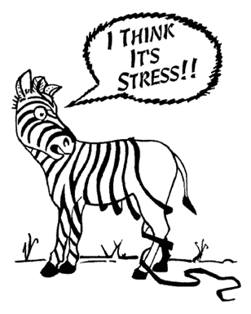
WHEN LIFE SPINS OUT
….WELCOME STRESS IN

Slide 12
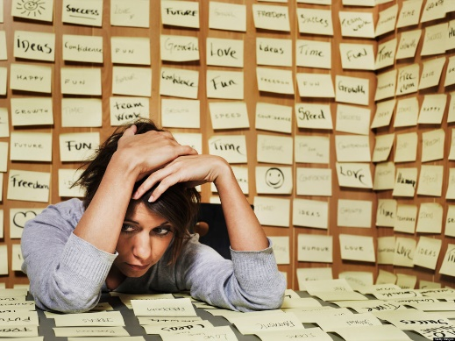
BURNOUT… Must AVOID
SEVERE STRESS CONDITION:
PHYSICAL, MENTAL & EMOTIONAL EXHAUSTION
NO ABILITY TO COPE WITH NEW STRESS
TAKING ON TOO MUCH FOR TOO LONG
NOTHING left to GIVE: ON EMPTY
Does NOT self-resolve
UNTREATED: Depression,
Heart Disease, Diabetes

Slide 13
WHAT SELF-CARE IS NOT!
As popular print/online magazines suggest:
“HOW TO” OR “TO DO” LISTS
‘7 tips to self-care’
Get better sleep
Beautiful People 1st Class Diet
Ultimate Exercise with 5 minutes a day
LISTS of recognized ACTIVITIES
Meditate, Exercise,
Treat Yourself Activities: Go to Spa, get nails done
THIS IS GREAT AND FUN (a place in life)
Simply Indulgences, Escapes or Timeouts.
When complete, we are back where we began; needing a get-a-way
WHAT IN COMMON: Easy Fixes, No Purpose/Plan
CONSIDER, instead. . .

Slide 14
Mentanoia: Change Your Mind and Behavior
Align values & behavior
Reframe events & beliefs
Make and DO you own self-care
Notes:
What will the audience be able to do after this training is complete? Briefly describe each objective how the audience will benefit from this presentation.

Slide 15
LEARN: a De-STRESS model
Laughter
Exercise
Attitude
Relaxation
Nutrition
Carole Klein, EmpowHER.com treatment model: L.E.A.R.N

Slide 16
OUR SELF-CARE: AS UNIQUE AS WE
We know what our own wellness and happiness requires
We already have everything we need to create a self-sustaining well-lived and well-Being LIFE PRACTICE

Slide 17
SELF-CARE, UNIQUELY ME
DECIDE to do the WORK and the DISCIPLINE
COMMIT to CREATE A PRACTICE
WRITE the PLAN
DO THE PLAN
ENJOY sustainable WELLNESS
Take FIRST STEP, Look WITHIN
WORKING AND NOT WORKING
WHAT DO YOU NEED MORE OR LESS
We EACH are UNIQUE, even if we are ‘identical’ genetically we have different history, experience, thinking, self-concept & relationships
My approach is grounded in our UNIQUENESS

Slide 18
Life Inventory: what is WORKING VS. NOT WORKING
MAKE A LIST: Mind, Body, Spirit, Relationships, Work, Hobbies, Routines….
Write down EVERYTHING & Rate if works or not for you
IMAGINE:
What Does My WELL & HAPPY Look Like?
WORKING = Happy, Positive, Adventurous
Appropriate STRESS, RESOLVES & RESILIENT
What Does My UNWELL & SAD Look Like?
NON-WORKING = Stressed, Sad, Fear
NEGATIVE STRESS, HANGS ON AND NOT RESILIENT

Slide 19
DESIGNING MY PLAN
Do the WORKING/NON-WORKING INVENTORY
Do VALUES align with TIME I spend (Pie of Life)
Decide: What does my WELLNESS life look like
What am I doing, how much, how long:
What am I doing that undermines my wellbeing?
What am I doing that supports wellbeing?
What do I want to add to be the optimum ME?
Start the PLAN: List what changes you want to do and the goal
NOW….DO NOT CHOOSE TO DO IT ALL AT ONE TIME!
Select ONE or TWO goals that give the best outcome
Complete S.M.A.R.T. GOALS
START NOW! Take is slow…Rome not built in a Day,
This is YOUR LIFE – YOU HAVE ALL THE TIME YOU NEED.
DO IT & CELEBRATE MILESTONES!

Slide 20
PIE OF LIFE: Compare Time Activities to Values Identifying VALUES Conflict Source of STRESS
COMPLETE- 24 hour/7 day activity record
ADD up hours by categories
MAKE a pie chart on time categories
DECIDE: Does behavior ALIGN with Values
ELIMINATE what does NOT, or decide to change Value
CHOOSE behaviors to align Values & Dreams

Slide 21
S.M.A.R.T. Goals:
 | CATEGORY | DESCRIPTION
S | SPECIFIC | What do you want to achieve? Who, What, How? Does it need to be chunked?
M | MEASURABLE | How will you and others know if progress is made and goal is complete?
A | ATTAINABLE | Realistic with effort & commitment Do you rely on others? Who? Do you need to reframe?
R | RELEVANT | Does goal support your purpose? Values? Intention? Dreams? WHY IS IT IMPORTANT TO ME???
T | TIME BOUND | The DATE and TIME goal is done Dates of progress milestones CELEBRATION

Slide 23
MY LAST OVERHAUL
THIRTY GOALS on 8 1/2x11” spreadsheet, color coded
16-HOUR DAY
FOOD DIARY
DAILY CHECK IN WITH PARTNER
REVIEW EVALUATE….
LASTED ONE WEEK!
OVENEARLY KILLED ME!

Slide 24
WITH A LITTLE HELP…

Slide 25
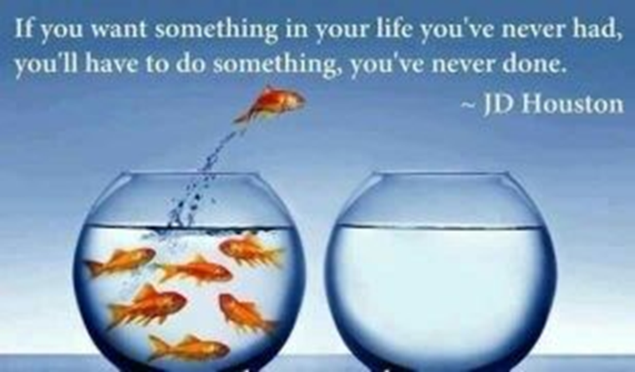

Slide 26
CONTEXT FOR BEING GROUNDED IN THE WORLD
FOUR AGREEMENTS of Don Miguel Ruiz
BE IMPECCABLE WITH YOUR WORD
DON’T TAKE ANYTHING PERSONALLY
DON’T MAKE ASSUMPTIONS
ALWAYS DO YOUR BEST
INTENTIONAL RELATIONSHIPS
COMMITMENT
TRUST
COMMUNICATION
I AM A Courageous, Inspiring, Generous & Playful Woman

Slide 27
ATTITUDE & PRACTICES
ATTITUDE
BE HERE NOW: Yesterday Gone, Tomorrow Fantasy, Reality is Now
REFRAME: Negative to Positive, Fear to Courage, Silver Lining.
Hat On & Hat Off, Discrete Roles
Gratitude & Acknowledgment (Journal)

Slide 28
ATTITUDE & PRACTICES
PRACTICES
INTENTIONAL Days & Reflection
DAILY Walks Trusted Source
5 MINUTE Vacation, Yoga, Meditation
Eat Healthy & Take a Break & Exercise

Slide 29
OPEN & CLOSE SPACE FOR ME
Goddess & Gremlin
Self-Enhancing & Self-Limiting Self Talk
Boundaries Violation
Draw your line in the sand
Say NO or YES, Stick to it
OVERWHELM:
When time and activities are more than manageable
Chunk it Down, bite sized pieces

Slide 30
OPEN & CLOSE SPACE FOR ME
COMPLETES & INCOMPLETES
LIST all the Incompletes in you life
Those that must be completed
Set a deadline, do it & Check-off
If never going to do it, mark it complete, and move on
DECLUTTER
ID 3 bags: ‘give’, ‘trash’, ‘put away’
Set timer or number limit: 15 minutes or 20+ items

Slide 32
THANK YOU FOR JOINING ME
SELF-CARE & AVOID BURNOUT
Doris Marie Zimmer
COC Virtual Women’s Conference
25-27 March 2021
PowerPoint Notes & SMART Goals may be downloaded from Canyons.edu

