Slide 1
How to Navigate, Search, and Apply for LA County Jobs
Countywide Talent Assessment
Talent Solutions
August 12, 2020

Slide 2
Job Search
https://hr.lacounty.gov

Slide 3
Job Search
www.governmentjobs.com
Lots of organizations!

Slide 4
Job Search

Slide 5
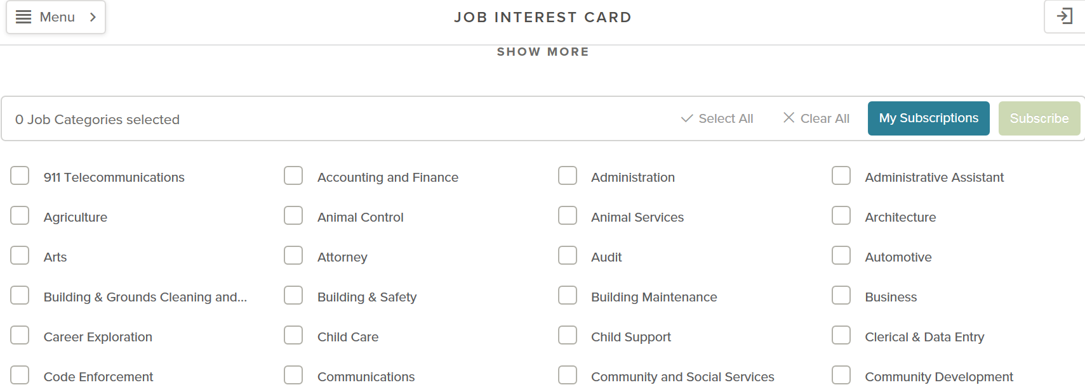
Job Interest Card
by Category

Slide 6
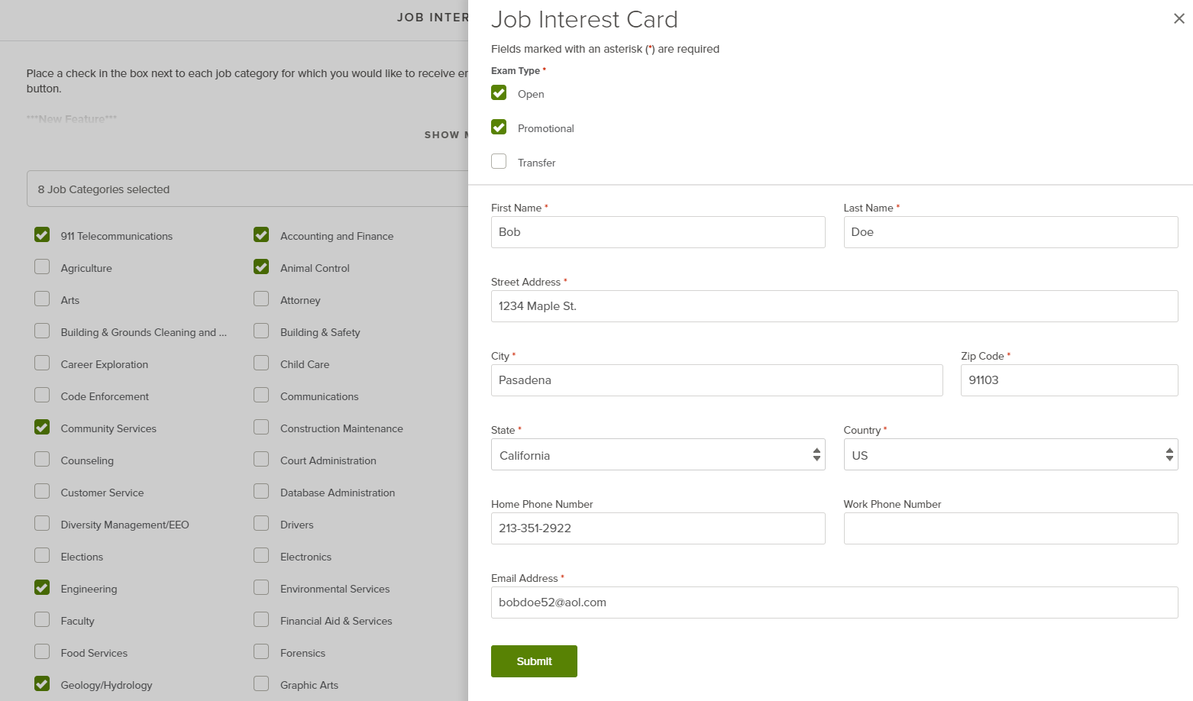
Job Interest Card

Slide 7
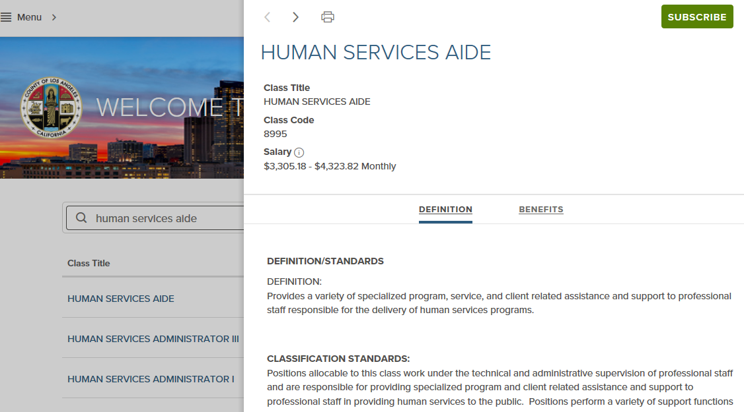
Job Interest Card
Job Interest Card by Classification Title
https://www.governmentjobs.com/careers/lacounty/classspecs/

Slide 8
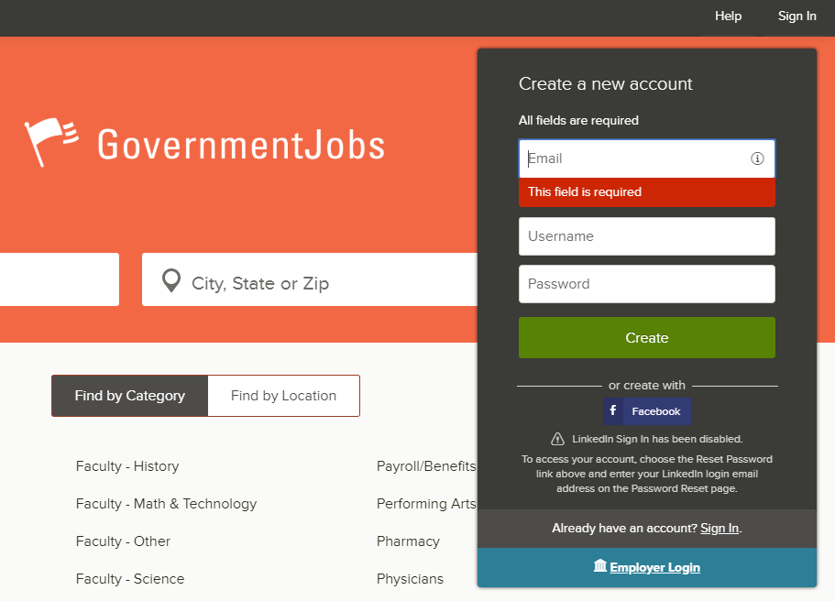
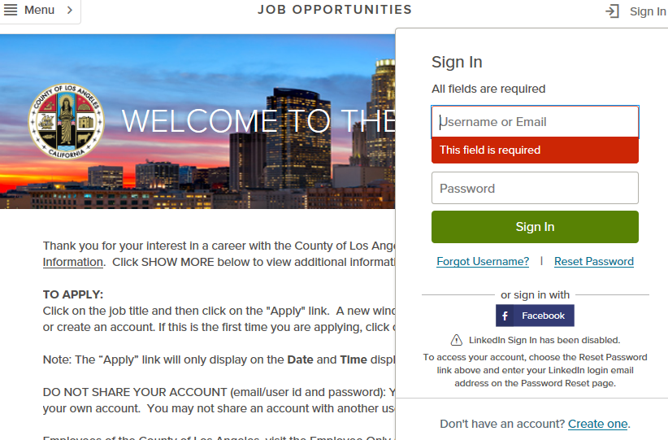
Setting Up Your Job Profile
Notes:
To get started with setting up your profile, you can create one through LA County’s website, hr.lacounty.gov or through www.governmentjobs.com
Both use the same application platform.

Slide 9
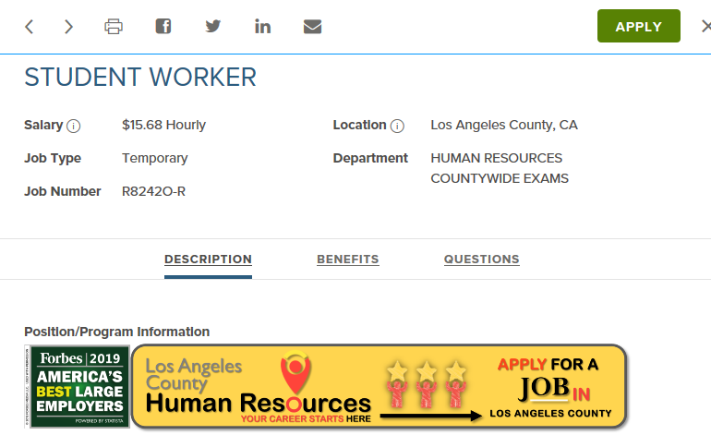
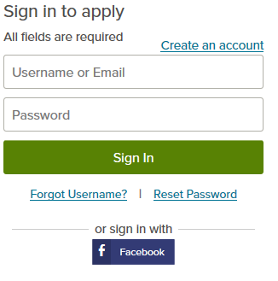
Setting Up Your Job Profile
Job posting contains link to apply

Slide 10
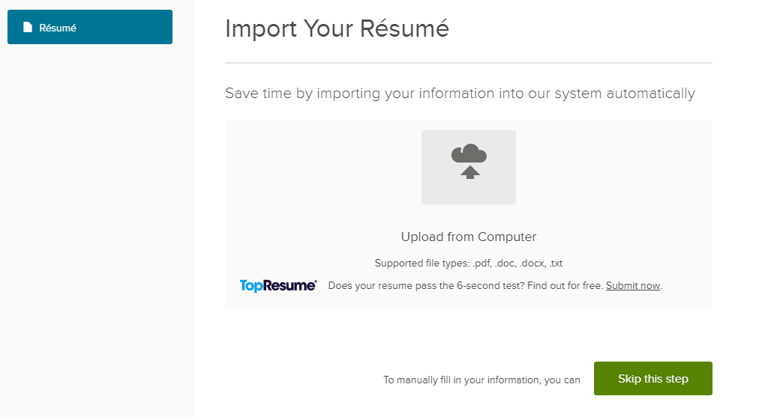
Setting Up Your Job Profile

Slide 11
Setting Up Your Job Profile

Slide 12
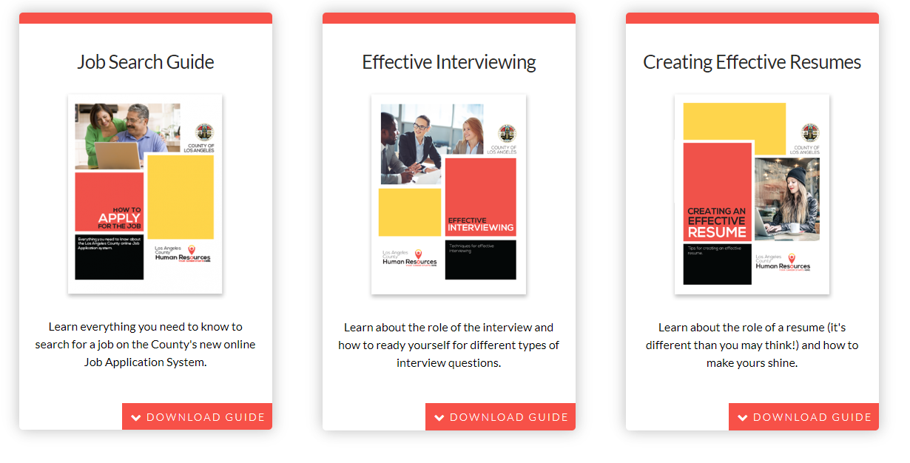
Resources for Job Searching and Profile Set Up
Getting help with navigating the County process
Job search guide at http://hr.lacounty.gov/job-search-toolkit/
Detailed assistance for reviewing job listings, setting up a profile, application information, and much more!

Slide 13
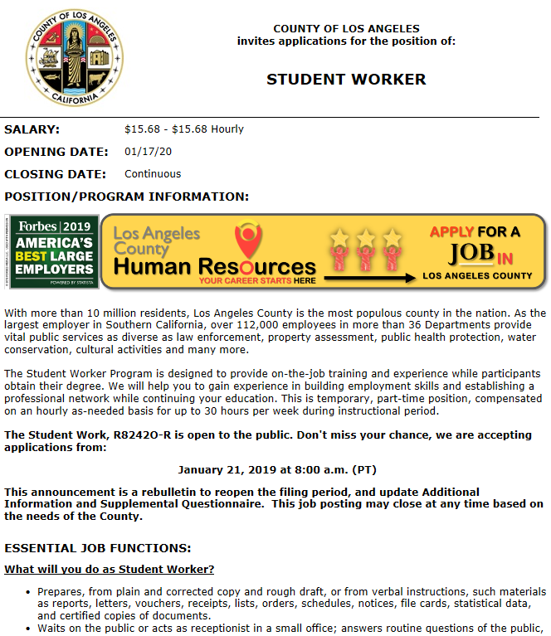
Job Posting

Slide 14
Job Posting
Minimum/Selection Requirements
Terms
“…at the level of….”
“…as a….”

Slide 15
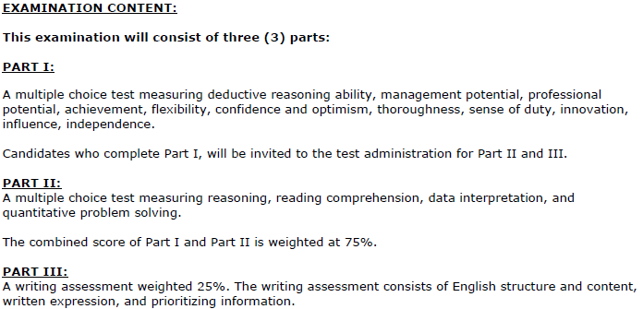
Job Posting
The Exam Plan
Test “hurdles”
Possible test types

Slide 16
Job Application
Very important components of the Job Application!
Duty Statements
The Supplemental Questionnaire

Slide 17
The Examination Process
Schedule notifications are typically emailed
Make sure email address is correct
Prevent emails from being identified as spam
Applicant portal “Inbox”

Slide 18
Practice Tests and Links
Written practice tests
www.hr.lacounty.gov, go to Find A Job, then Job Search Toolkit, then Employment Test Assistance
www.shldirect.com/practice_tests.html
Interview Tips
http://hr.lacounty.gov/interview-tips/

Slide 19
Eligibility List
Banding Process
Selection/Hiring Interviews
SCORE | BAND
100.01 – 110.0 | V
94.5 – 100.0 | 1
88.5 - 94.4 | 2
82.5 – 88.4 | 3
76.5 – 82.4 | 4
70.0 – 76.4 | 5

Slide 20
Notifications
Final result notifications are sent by email and/or USPS
Make sure contact information is up to date

Slide 21
Career Planning
Notes:
CAREER PLANNING:
Resources to help current and prospective employees plan a career with Los Angeles County are available. To explore career paths to and from nearly all job titles, please visit out interactive Career PathFinder application at http://career-pathfinder.hr.lacounty.gov.

Slide 22
Questions/Comments?
For any questions/comments, please feel free to contact:
Countywide Talent Assessment
213.738.2084
Talent Solutions
213.974.2382

